Slide 1
ELIZABETH REGINA
THE VIRGIN QUEEN
Presented by:
Canesin Gemma, Dibarbora Mattia, Geotti Camilla, Zamò Federico.
Liceo Scientifico A.Einstein, Cervignano Del Friuli.
4^ASA

Slide 2
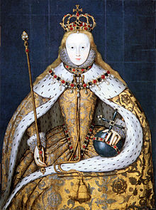
THE CORONATION DAY
She was crowned on 15th January 1559.
Her ceremony was fantastic.
Possessed charisma.
Was able to convince the people and to be loved by them.
The Coronation Day was a religious event.
The nobles were divided into Protestants and Catholics.
Was tall, beautiful, austere and determinate.

Slide 3
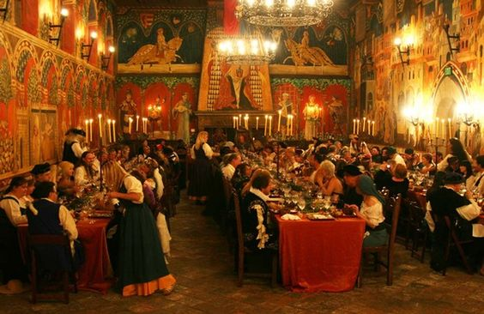
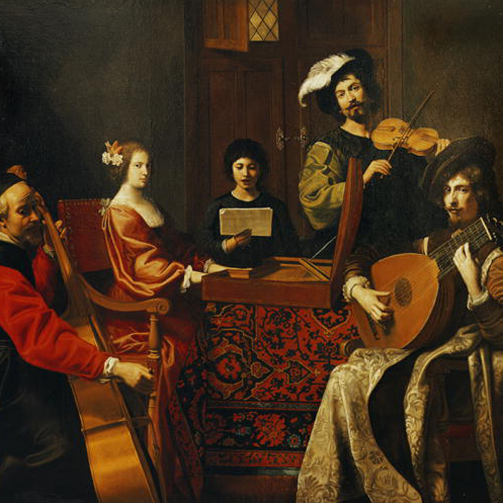
LIFE AT COURT
Was a stingy woman
Loved hunting and plays
Had a personal company of actors called «The Queen’s Players».
Very astute and clever
to avoid the plots.
Elizabeth organised a lots of bonquets and performances.

Slide 4
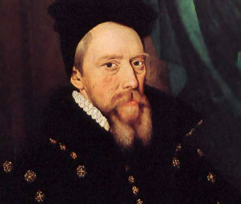
THE MARRIAGE GAME
The advisers wanted that the queen
married anyone to maintain the dynasty.
Marriage was a risk (specially had a child)
Cecil, an Elizabeth’s advicer.
Played marriage when England was vulnerable.

Slide 5
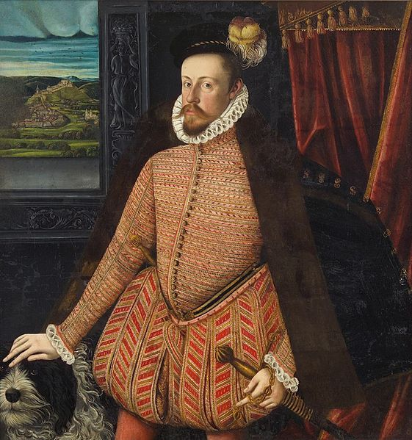
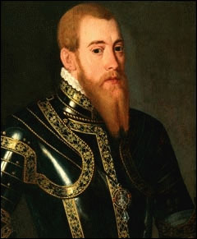
ALL THE QUEEN’S MEN
Erik of Sweden
Archduke Charles
Advantages
Disadvantages
Advantages
Disadvantages
This marriage would confirm the Queen’s Protestant supports.
It would bring no alliance with France or Spain.
He would be Emperor one day.
He would never risk a Protestant marriage.

Slide 6
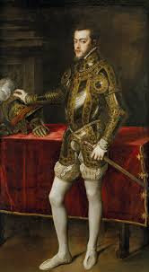
Philip of Spain
Advantages
Disadvantages
Noadvantages.
Was planning to marry
Elizabeth to maintain his interests in England.
Philip of Spain married Mary.

Slide 7
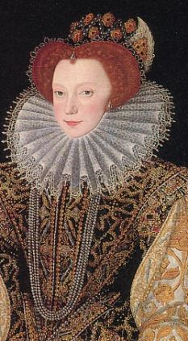
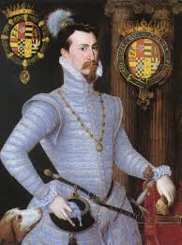
ROBIN
Robert Dudley(Robin) married Lettice Devereux and Elizabeth was disappointed.
Lettice Devereux, Robin’s wife
Adavantages
Disadvantages
Was passionate, athletic, gallant ,lively, loyal, courageous and devoted.
Was married and unpopular at Court.

Slide 8
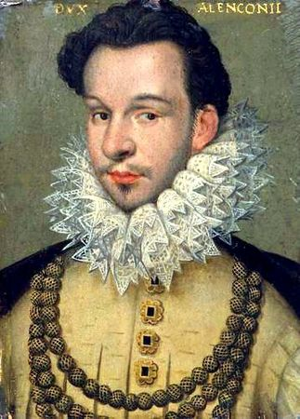
THE FRENCH SUITOR
Advantages
Wasn’t hostile to Protestant interests.
He had charme.
Disadvantages
English people didn’t want a marriage with a Catholic foreigner.

Slide 9
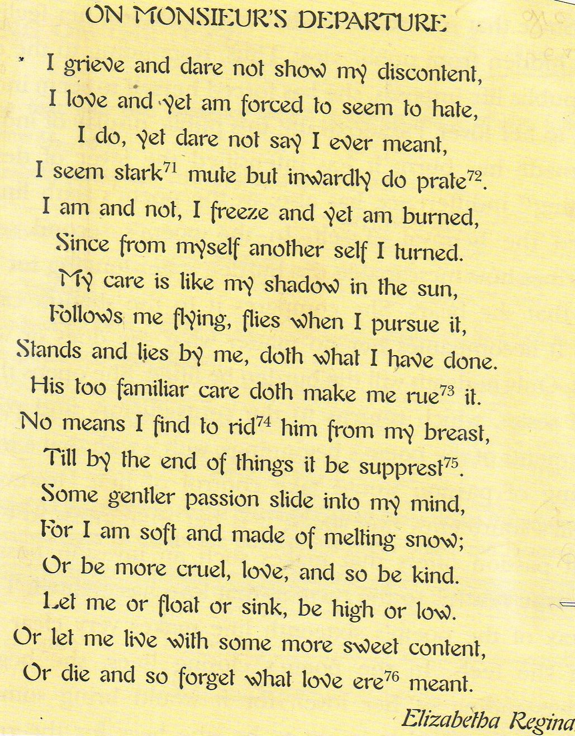
When Francis the Duke of Alencon went off the England, Elizabeth wrote this poem.
In this poem, written in rhymed iambic pentameter and divided into three sestets, Elizabeth told about the turmoil that the love has created.
Elizabeth was a woman of culture and she was a good writer. unfortunately, a lots of her writings were destroyed.

Slide 10
Thank you for your attention.

