Slide 1
ANTONY AND CLEOPATRA
WILLIAM SHAKESPEARE
ACT 5
Presented by
Cattaruzzi Simone, Clementin Emilio, Dibarbora Mattia, Pastoricchio Dana.
Liceo Scientifico A.Einstein, Cervignano Del Friuli.
4^ASA

Slide 2
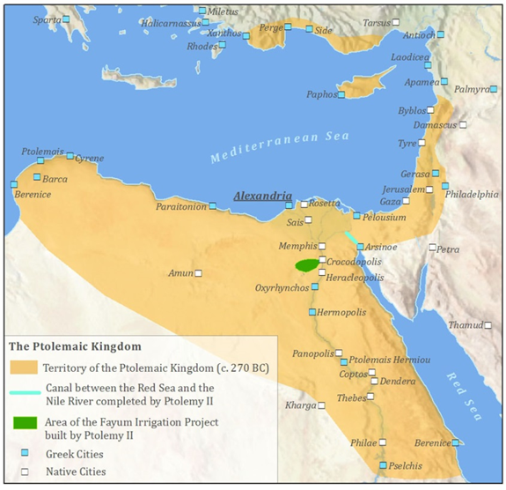
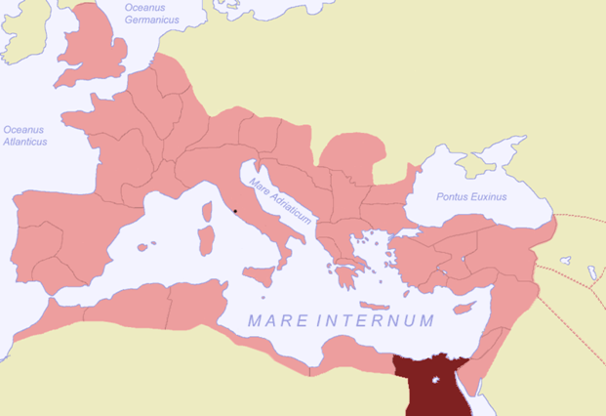
Function of the act in the tragedy’s economy
End of the love which influenced all the previous acts, separation caused by death
Summit of the tragedy
Definitive Cleopatra’s defeat

Slide 3
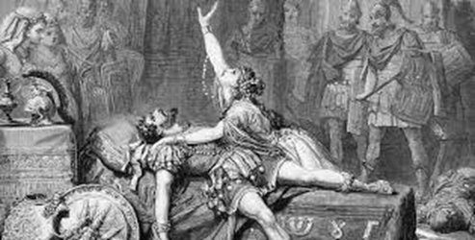
Relation with the previous act
Effects of Antony’s death to Cleopatra and Octavian
Same type of death of the previous characters who died
Regret of the characters for their actions

Slide 4
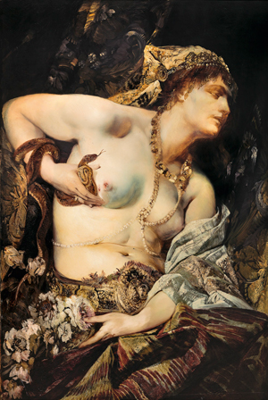
Aspects of the act
Historical plan: fall of Cleopatra’s kingdom, Roman rule’s beginning
Relationship between Cleopatra and Antony: absent, desperation after Antony’s death
Hans Makart (1840 - 1884)

Slide 5
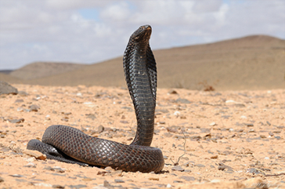
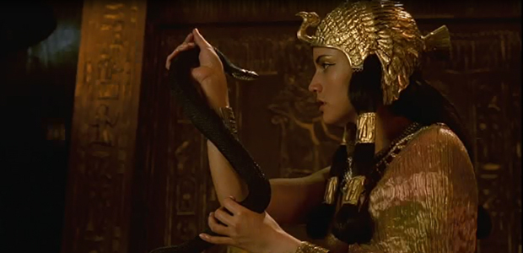
Themes: surrender, fear to live a humiliating life under Roman rule, suicide, loyalty and fidelity
Curiosities: Cleopatra’s selection of the snake for the suicide,
woman’s roles are acted by young men

Slide 6
LESSICAL ASPECTS
Use of the word “worm” to refer to the “asp” in the dialogue between Cleopatra and the clown
Ambiguity of the word “clown”
Presence of enjambement

Slide 7
THANKs FOR yOUR ATTENTION

