Slide 1
ELIZABETH REGINA
THE VIRGIN QUEEN
Anthony Boyle – Daniela Castellazzo
Presented by:
Canesin Gemma, Dibarbora Mattia, Geotti Camilla, Zamò Federico.
Liceo Scientifico A.Einstein, Cervignano Del Friuli.
4^ASA

Slide 2
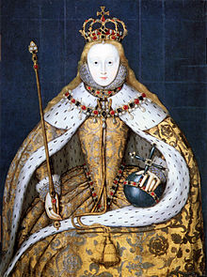
THE CORONATION DAY
She was crowned on 15th January 1559.
This ceremony was fantastic and amazing and an Italian diplomat told that it was similar to the spectacle of Doges in Venice.
Unlike Mary, Elizabeth possessed charisma and knew how to keep the crown. Elizabeth also was able to convince the people and to be loved by them.
The Coronation Day was a religious event but the nobles in attendance were divided by their beliefs. There were Protestants and Catholics nobles.
Elizabeth was tall, beautiful, austere and determinate.

Slide 3
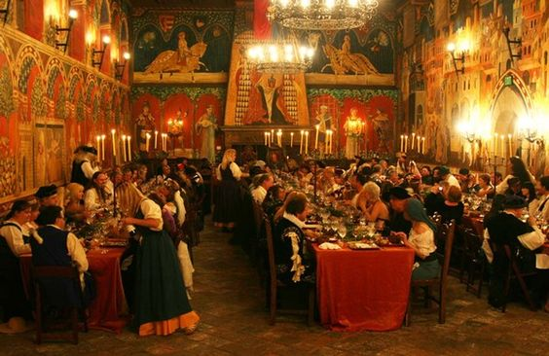
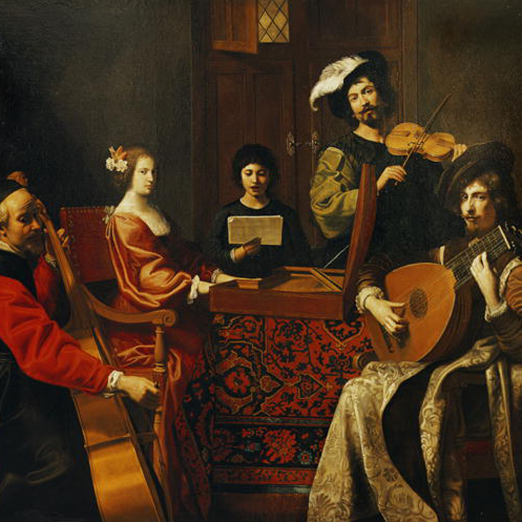
LIFE AT COURT
Elizabeth was a stingy woman but she loved hunting and plays; she also had a personal company of actors called «The Queen’s Players».
Elizabeth was very astute and clever
to avoid the plots.
Elizabeth organised a lots of bonquets and performances.

Slide 4
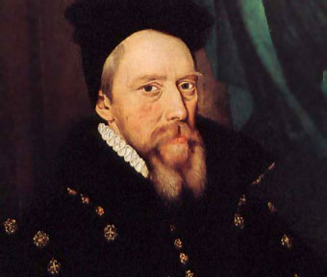
THE MARRIAGE GAME
Elizabeth’s advicers wanted that the queen
married anyone to maintain the dynasty.
Elizabeth knew that the marriage was a risk, specially had a child because the mortality rate during childbirth was high.
Cecil, an Elizabeth’s advicer.
Elizabeth played marriage until she was 60 years old when England was vulnerable and needed allies.

Slide 5
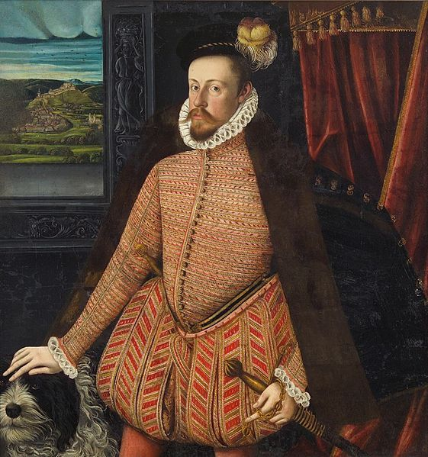
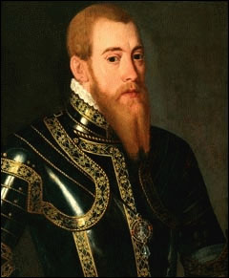
ALL THE QUEEN’S MEN
Erik of Sweden
Archduke Charles
Advantages
Disadvantages
Advantages
Disadvantages
This marriage would displease
nobody and would confirm the Queen’s Protestant supports.
It would bring no alliance with France or Spain.
He would be Emperor one day.
He would never risk a Protestant marriage.

Slide 6
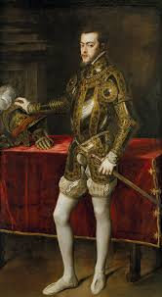
Philip of Spain
Advantages
Disadvantages
There weren’t advantages.
He was planning to marry
Elizabeth to maintain his interests in England.
Philip of Spain married Mary.

Slide 7
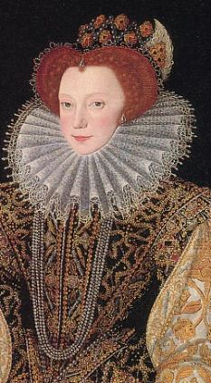
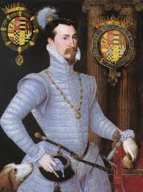
ROBIN
Robert Dudley(Robin) married Lettice Devereux and Elizabeth was disappointed.
Lettice Devereux, Robin’s wife
Adavantages
Disadvantages
He was passionate, athletic, gallant ,lively, loyal, courageous and devoted.
She felt fully a woman in his presence and was comfortable with him.
He was married and unpopular at Court.

Slide 8
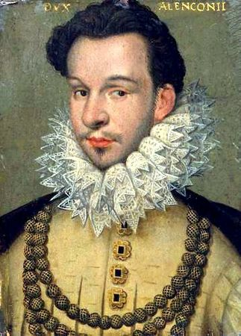
THE FRENCH SUITOR
Advantages
Francis was not hostile to Protestant interests. He also had charme.
Disadvantages
The public response to the union with a Catholic and a French was not favourable.
Moreover English people didn’t want a marriage with a Catholic foreigner.

Slide 9
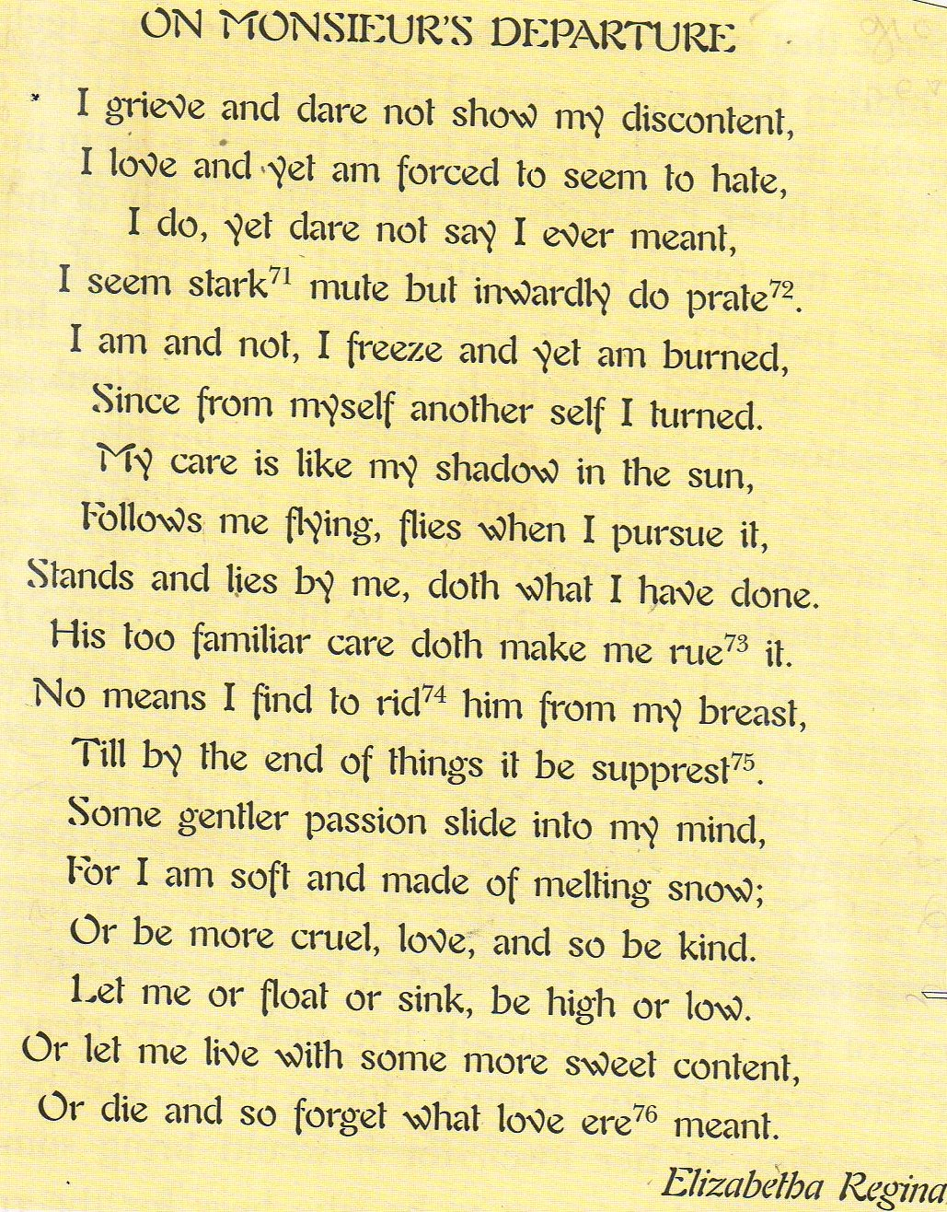
When Francis the Duke of Alencon went off the England, Elizabeth wrote this poem.
In this poem, written in rhymed iambic pentameter and divided into three sestets, Elizabeth told about the turmoil that the love has created.
Elizabeth was a woman of culture and she was a good writer; unfortunately, a lots of her writings were destroyed.

Slide 10
Thank you for your attention.

