Slide 1
TO HIS COY MISTRESS
by Andrew Marvell
PRESENTED BY
ALAMPI ALESSIA, Dibarbora Mattia AND MAINARDIS RICCARDO
I.I.S.S. “BASSA FRIULANA” - Polo liceale “A. Einstein” –
Cervignano del Friuli
ANNO SCOLASTICO 2016/2017
cl. 4 ASA

Slide 2
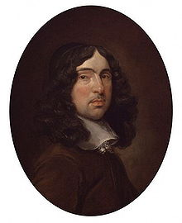
Who is Andrew Marvell?
ANDREW MARVELL:
Was an English metaphysical poet,
satirist and politician.
1)Upon Appleton House 2)The Garden
3)An Horatian Ode upon Cromwell's Return from Ireland 4)To His Coy Mistress
Born on 31st March 1621 in Winestead.
His poems.
Died on 16th August 1678 in London.
cl. 4 ASA

Slide 3
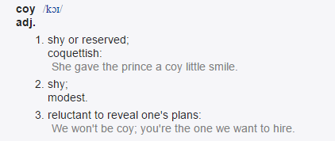
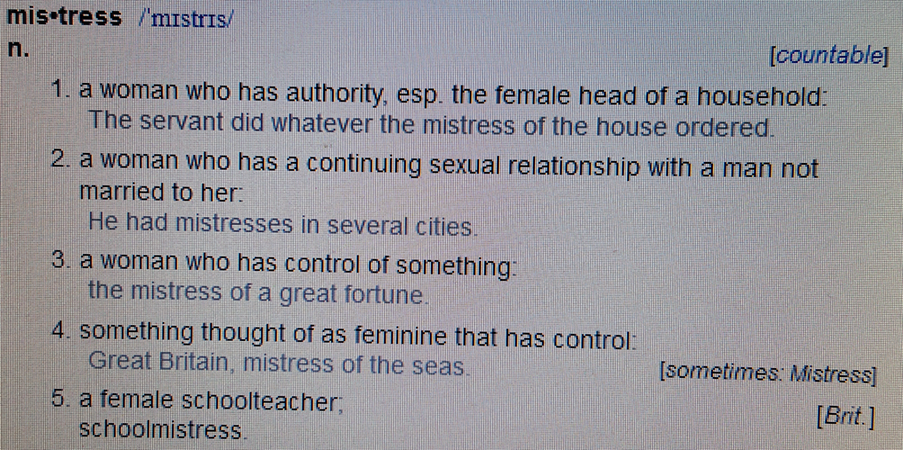
FUNCTION OF THE TITLE
To his coy Mistress
From the title the intelligent reader can understand that the speacking voice wrote this poem for a woman who has been slow to respond to his romantic advances.
cl. 4 ASA

Slide 4
Small summary of the content
The poem is considered one of the finest carpe diem arguments ever put in lines.
The poet wrote the poem at the service of Oliver Cromwell.
The poem is written in the point of view of a gentleman, who is trying to persuade a woman to have a sexual intercourse with him.
The woman is a bit timid and he tries to convince her that time is running out and that they must seize the moment.
Carpe Diem.
cl. 4 ASA

Slide 5
The poem is arranged in …
The poem is arranged into three stanzas:
In the first stanza the speaking voice tells the mistress that if there was time this coyness would be fair.
The speaking voice tells how much he would compliment her and admire her, if only there was time. He would focus on "each part" of her body until he got to the heart (the heart is a metaphore for sex and for love).
In the second stanza, the speaking voice tells that the human life is short and the death comes early.
He tries to convince her to have sex with him before the death.
In the last stanza the speaking voice asks her to have sex with him now that she is still young and beautiful, because in the grave this will not be possible.
cl. 4 ASA

Slide 6
From line 3 to 6
We would sit down, and think which way
To walk, and pass our long love’s day.
Thou by the Indian Ganges’ side
Shouldst rubies find; I by the tide
Of Humber would complain, I would
In 1650 England began its explorations and discoveries of the East.
The speaking voice compares his mistress to the river Gange
which was considered sacred.
Her
Him
River Gange
River Humber
cl. 4 ASA

Slide 7
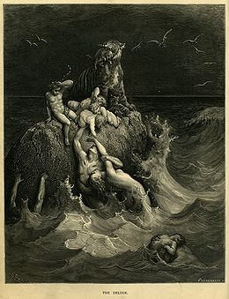
From line 7 to 10
Of Humber would complain, I would,
Love you ten years before the flood,
And you should, if you please, refuse
Till the conversion of the Jews.
Flood 4500 years ago.
In this verses the speaking voice use an hyperbole; in this way his mistress can understand that the love for her is great and passionate.
He would go back in time to Noah and the Flood, and forward in time to the "conversion of the Jews," all the while loving her.
cl. 4 ASA

Slide 8
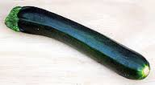
From line 11 to 12
My vegetable love should grow
Vaster than empires and more slow;
The poet may allude to the penis.
Vegetable love refers to a organic love that is a love without the pressure of anything.
The human reproductive organs have the shape of some vegetables.
cl. 4 ASA

Slide 9
From line 13 to 18
The speaking voice uses the words «hundred» and «age» because he wants to explain to his mistress that they haven’t lots of time.
An hundred years should go to praise
Thine eyes, and on thy forehead gaze;
Two hundred to adore each breast,
But thirty thousand to the rest;
An age at least to every part,
And the last age should show your heart.
The lover says that, if he had time, he would give her compliments about each of her individual body parts, and he would spend infinity years doing it.
cl. 4 ASA

Slide 10
From line 19 to 20
For, lady, you deserve this state,
Nor would I love at lower rate.
The speaking voice calls his lover «lady» and not «mistress» because he tells that this is her value and he wouldn’t give her anything less than that first-class love.
cl. 4 ASA

Slide 11
But at my back I always hear
Time's winged chariot hurrying near ; And yonder all before us lie Deserts of vast eternity. Thy beauty shall no more be found, Nor, in thy marble vault, shall sound My echoing song: then worms shall try That long-preserved virginity, And you quaint honor turn to dust, And into ashes all my lust : The grave's a fine and private place, But none, I think, do there embrace.
Now, therefore, while the youthful hue
Sits on thy skin like morning dew, And while thy willing soul transpires At every pore with instant fires, Now let us sport us while we may, And now, like amorous birds of prey, Rather at once our time devour, Than languish in his slow-chapt power. Let us roll all our strength and all Our sweetness up into one ball, And tear our pleasures with rough strife Thorough the iron gates of life : Thus, though we cannot make our sun Stand still, yet we will make him run.
From line 21 to 46
In the desert there isn’t life.
In the desert there isn’t sex.
There is a contrast between the vegetable love of the first stanza and the image of the desert of the second stanza.
The woman is the center of sexual passion of the speaking voice.
The speaking voice wants this woman.
cl. 4 ASA

Slide 12
USE OF LANGUAGE
In the first stanza there are humorously exaggerated references to traditional romantic ideas.
Images of death and decay are used in the second stanza to show the lover the pointlessness of resisting.
The final stanza, in which the speaker grows impatient to convince his mistress, is full of references to speed, urgency and passion.
cl. 4 ASA

Slide 13
Bibliography:
http://www.wordreference.com/definition/mistress
http://www.blupete.com/Literature/Poetry/CoyMistA.htm
https://it.wikipedia.org/wiki/Andrew_Marvell
http://www.gradesaver.com/andrew-marvell-poems/study-guide/summary-to-his-coy-mistress
cl. 4 ASA

Slide 14
Thank you for your attention.
cl. 4 ASA

