Slide 1
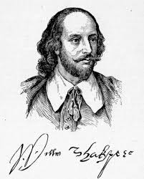
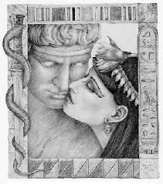
William Shakespeare
Antony and Cleopatra
Act IV
Liceo Scientifico A.Einstein
4^ASA
Digiusto Mattia, Geotti Camilla, Gregoretti Massimiliano, Pommella Gianluca

Slide 2
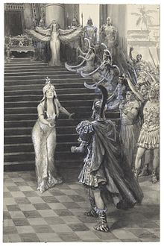
1. Function of the act
It expresses an overturning of the situation: before, Antony’s greatness and boldness; then his suffering and disillusion;
It sets the mood for the tragic final act of the play.

Slide 3
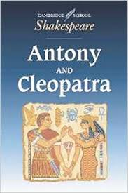
2. Relation to the previous and following act
It resumes the war mood of the 3° act;
Crescendo and suspense in the atmosphere from the 3° act;
It shows Antony and Cleopatra’s defeat, desperation and will to commit suicide, developed in the following act.

Slide 4
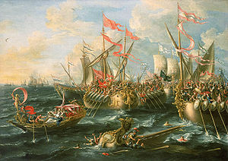
3. Aspect of history and the relationship between Antony and Cleopatra
The war between Octavian and Antony, between the West and the East of the Empire (31 B.C.- Azio- Greece);
A definitive change in the relationship between Antony and Cleopatra: before they love each other, then he accuses and repulses her.

Slide 5
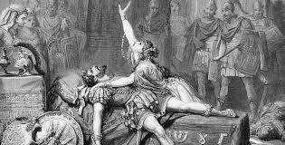
4. The themes and curiosities
Enobarbus’ treason;
Antony’s military defeat and suffering by love;
Antony ’s suicide in order not to be submitted by the Romans and enjoy an eternal peace with Cleopatra;
Antony always wants to wear his armour.

Slide 6
5. Aspect of lexis (semantic fields), syntax and figures of speech
High-ranking and “sumptuous” language;
Words connected to war;
Brief lines: quick rhythm;
Recurring imperatives and exhortations;
Use of alliterations.

