Slide 1
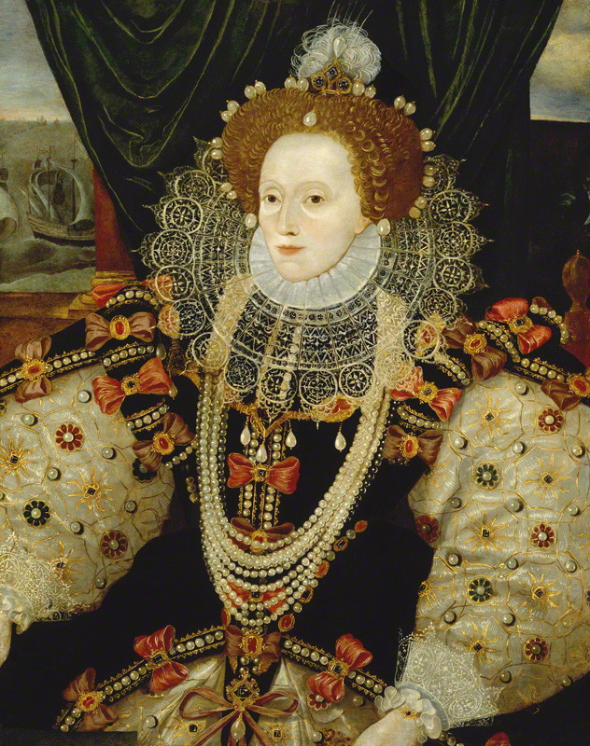
The origins and the fall of a myth
Liceo Scientifico A. Einstein
4^ASA
Clementin Emilio, Digiusto Mattia, Moratti Alex, Napodano Francesco, Pastoricchio Dana, Vidili Andrea

Slide 2
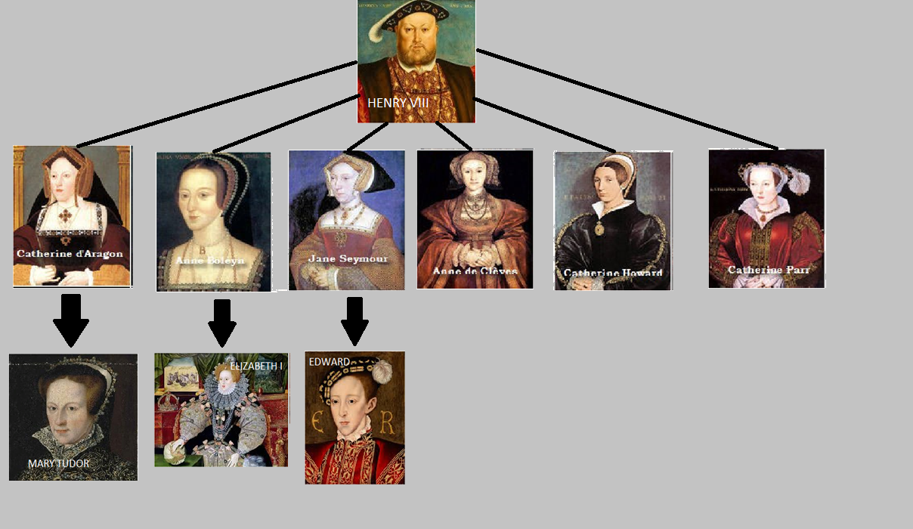
Genealogical tree

Slide 3
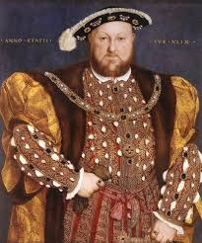
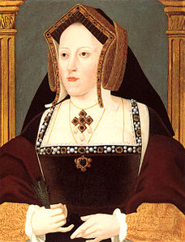
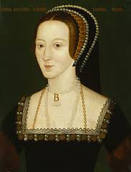
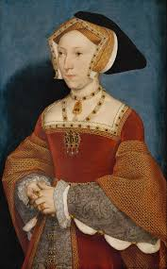
Henry VIII’s wives
Catherine of Aragon: 24 years marriage, highly spirited, Spanish nobility, six pregnancies (only Mary I survived)
Anne Boleyn: ambitious, cunning, determined, strong character, accused of adultery and incest
Jane Seymour: docile Anne Boleyn’s lady-in-waiting, mother of the long-awaited male son
1509-1533
1533-1536
1536-1537

Slide 4
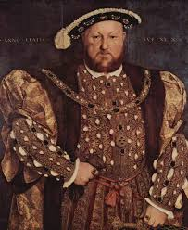
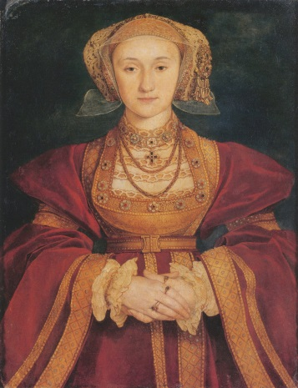
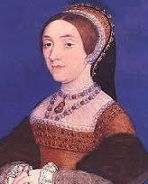
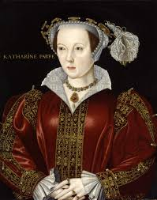
Henry VIII’s women
Anne of Cleves: German nobility, grotesque
Catherine Howard: highly spirited young woman, brought Elisabeth into the life of the court
Catherine Parr: nurse, auntie and matron, helped Elisabeth’s cultural development
1540-1540
1540-1541
1543-1547

Slide 5
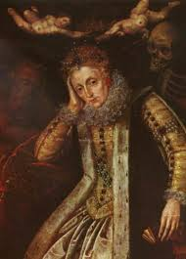
Elizabeth’s decline
Ageing
Religious problems
Competition with foreign powers (Spain, France)
Conspiracies at court and difficulties in keeping the Parliament quiet

Slide 6
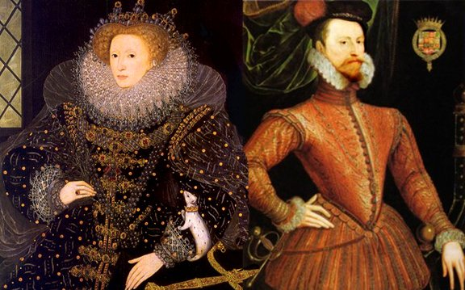
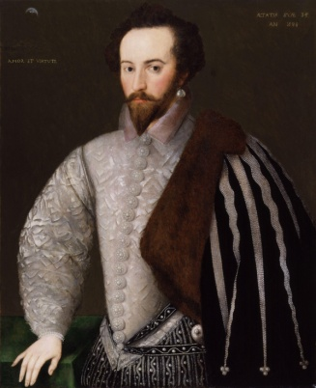
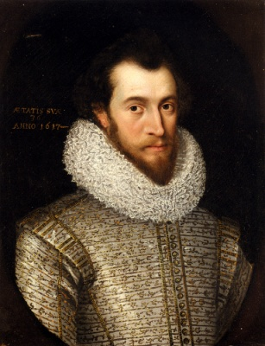
Robert Devereux (Earl of Essex):
strong, handsome, young, aggressive and impulsive man
entered into conflict with people at court, like
the Cecils and Sir Walter Raleigh, to obtain power
took part in the wars against Spain and Ireland
Sir Walter Raleigh
Robert Devereux

Slide 7
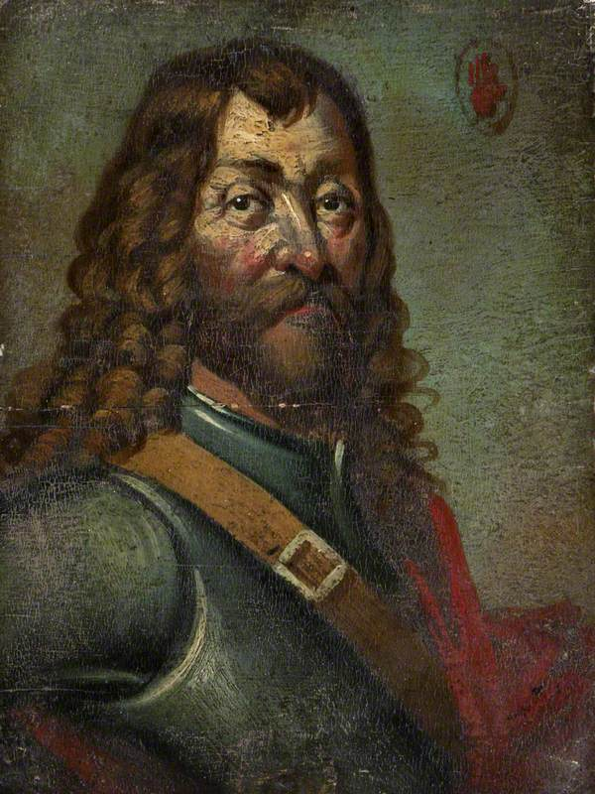
Ireland and the English
Henry VIII and Elizabeth attacked Ireland for strategic and economic reasons
Hugh O'Neill, Irish Earl of Tyrone, opposed the English army
Essex was sent to crush the rebellion but negotiated a truce with him

Slide 8
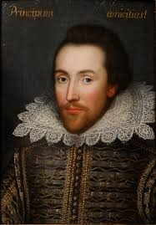
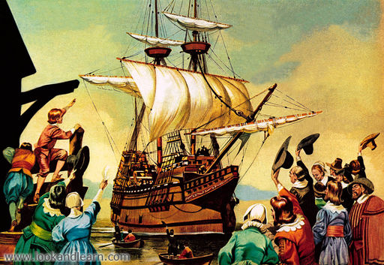
Positive aspects of Elizabethan reign
Development of commerce and economy
Demographic growing
Promotion of education and literature and the most excellent expression of the English Renaissance
First expeditions in North America
Birth of the E.I.C. (Eastern India Company)

Slide 9
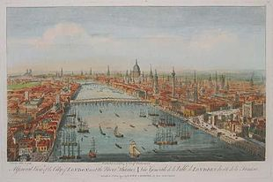
Negative aspects of Elizabethan reign
Persecution of Catholics
Burden of taxes
Low condition of soldiers and their families
Financial problems of the nobility
Spying network among the English population

Slide 10
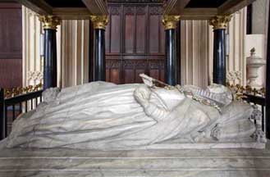
Elizabeth’s death
died on 23 March 1603
buried in Westminster Abbey
James Stuart succeeded her as King of England
Fonte: Elizabeth Regina – Anthony Boyle, Daniela Castellazzo
CONSORTS BOTH IN THRONE AND GRAVE
HERE REST WE TWO SISTERS
ELIZABETH AND MARY
IN THE HOPE OF NEW RESURRECTION

