Slide 1
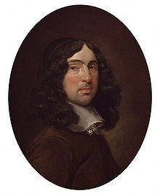
TO HIS COY MISTRESS
Andrew Marvell
Analysis
Presented by: Agostini Giacomo, Digiusto Mattia & Maran Thomas

Slide 2
Introduction
Andrew Marvell (1621-1678)→ well-known politician, English poet and satirist
Metaphysical poetry → concerned with the whole experience of men; investigations about sex, love, the earth, the universe, the divine
Use of irony, wit and wordplay

Slide 3

First stanza (lines 1-20)
Title: “coy mistress” → probably a coquette
“Had we but world enough, and time, This coyness, lady, were no crime” → if there was time and space, the poet would love and admire her forever → it seems they are ‘united’ against time

Slide 4
First stanza(lines 1-20)
“I would Love you ten years before the Flood”: PAST
“And you should, if you please, refuse
Till the conversion of the Jews”→ the end of the world: FUTURE
Hyperbolic images

Slide 5
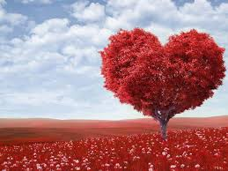
First stanza(lines 1-20)
“My vegetable love should grow, vaster than empires, and more slow”→ comparing his love with the vegetative part of the plant: deep, complex and vast

Slide 6
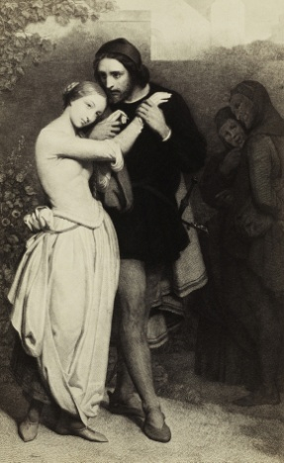
Second stanza (lines 21-32)
Brief passing of time
“Time’s wingèd chariot hurrying near;
And yonder all before us lie”
The speaker’s rhetoric changes from an acknowledgement of the Lady’s limitless virtue to insisting on the radical limitations of their time as embodied beings

Slide 7
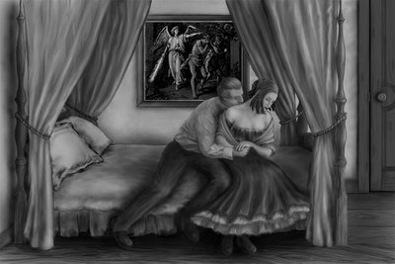
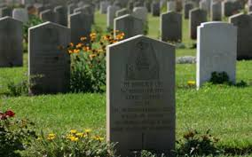
Second stanza (lines 21-32)
He assures the Lady, her virtues and her beauty will lie in the grave along with her body as it turns to dust
Likewise, the speaker imagines his lust being reduced to ashes, while the chance for the two lovers to join sexually will be lost forever

Slide 8
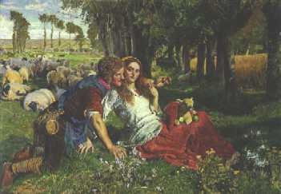
Third stanza (lines 33-46)
In the third and final stanza, the speaker complete his argument by stating that they won’t be young forever and should take advantage of it while they can

Slide 9
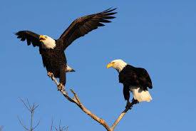
Third stanza (lines 33-46)
Comparison of himself and his lover to sportive animals, specifically “amorous birds of prey”
The love described seems rough and violent, not conventionally sweet and sentimental.
“And now, like amorous birds of prey”

Slide 10
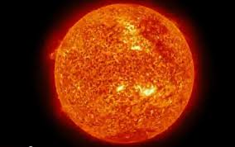
Third stanza (lines 33-46)
Introduction of the idea of sex (pleasures)
Sex seems to be the sun, but it cannot be exploited to stop time: on the contrary, they use it to go faster

