Slide 1
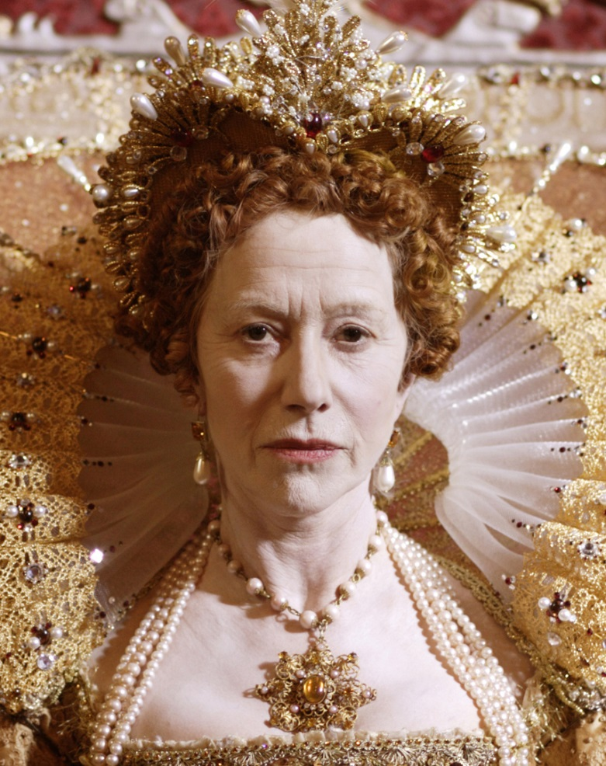
The Heart of a King
CHAPTER 4
Made by:
Busdon Rocco
Calligaris Elisa
Cattaruzzi Simone
Gregoretti Massimiliano
Mainardis Riccardo

Slide 2
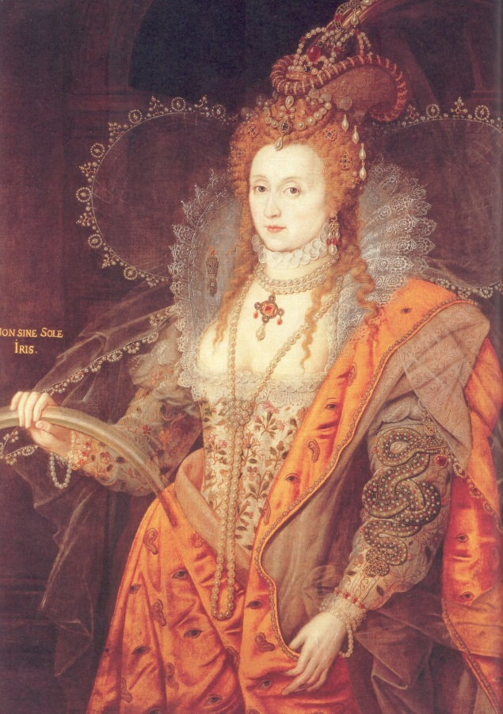
ELISABETH’S BEHAVIOURS
She could speak Latin, French, Italian and German.
Elizabeth was a very intelligent and charismatic person, therefore she made the interest of the entire nation.
She was conceited and arrogant and she often lose the control.
She was unwilling to make decisions.

Slide 3
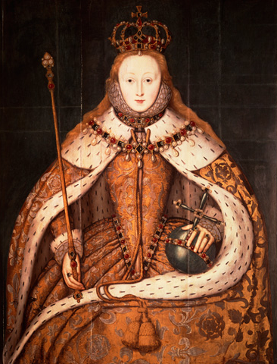
THE ISSUE OF SUCCESSION
Elizabeth didn’t want to get married
Elizabeth was Protestant
Pressure from the Parliament
Contrast between Elizabeth and the Pope
Plots to kill Elizabeth

Slide 4
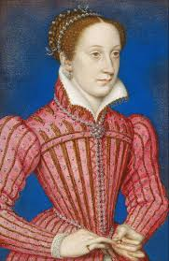
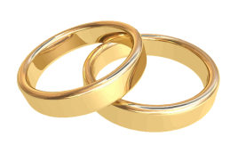
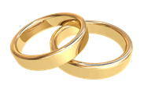
ELIZABETH’S CONFLICT WITH MARY QUEEN OF SCOTS
Mary Stuart (15)
Cousin Francis
Lord Darnley
James VI (I of England)
Mary Stuart

Slide 5
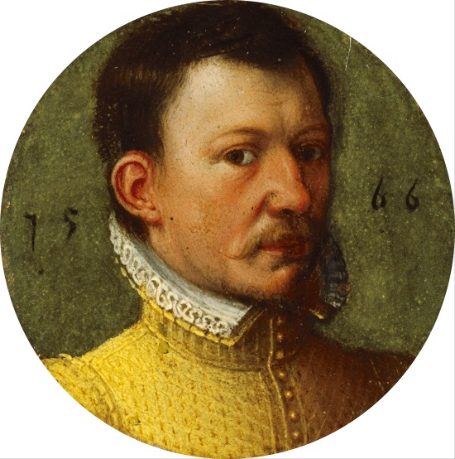
ELIZABETH’S CONFLICT WITH MARY QUEEN OF SCOTS
Mary Stuart (15)
Lord Darnley
Take part in the murder of David Rizzo
The Earl of Bothwell
Who was believed to be her second husband’s murder

Slide 6
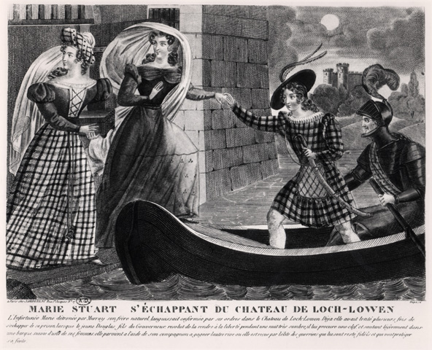
ELIZABETH’S CONFLICT WITH MARY QUEEN OF SCOTS
She was heavily criticized for her relationship with Bothwell
She was forced to adbicate
She searched for Elisabeth’s protection
She got arrested by Elizabeth

Slide 7
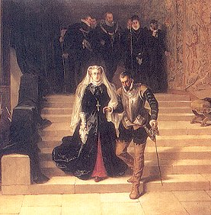
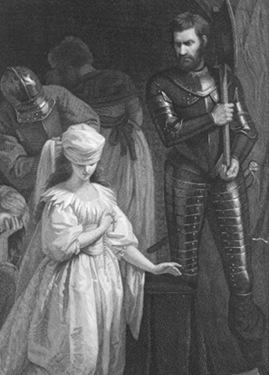
ELIZABETH’S CONFLICT WITH MARY QUEEN OF SCOTS
Mary got discovered in a plot to kill Elisabeth
Elizabeth signed Mary’s death sentence
Before dying, Mary willed her rights to the throne to Philip II of Spain
After the death of Mary, Elizabeth chose James VI as her rightful heir

Slide 8
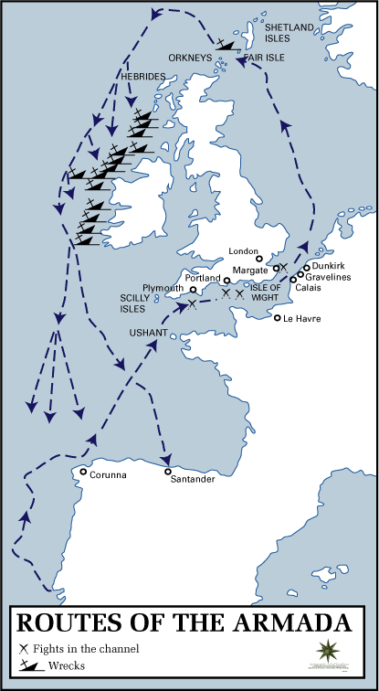
THE INVINCIBLE ARMADA
Reasons of the contrast between Philip II and Elizabeth
English intervention during the rebellion of the Netherlands
Queen’s support to the pirates who prayed the Spanish ships
The denial of marry by Elizabeth after her sister’s death

Slide 9
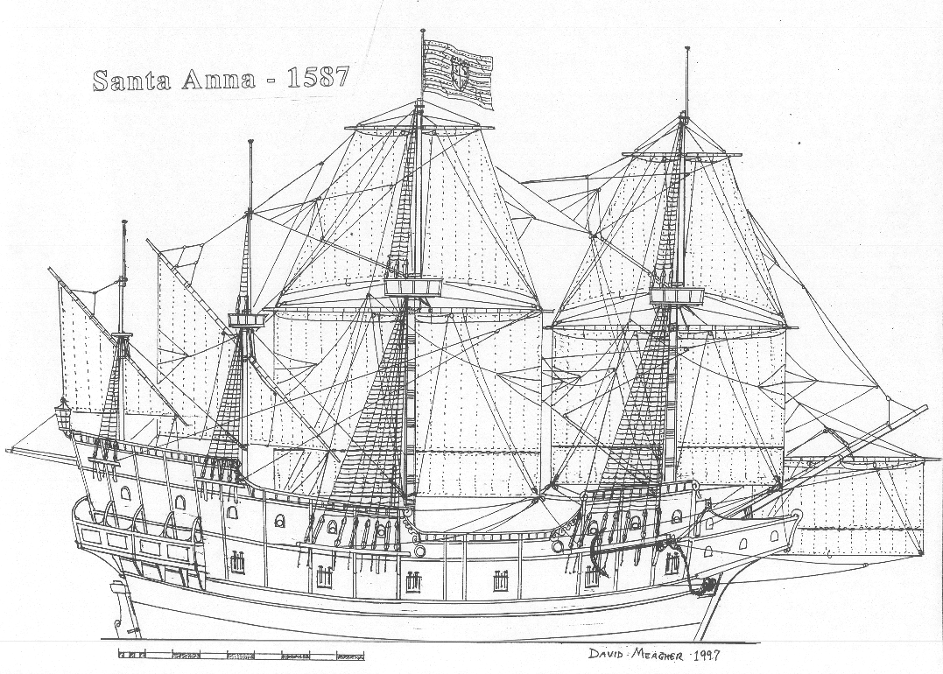
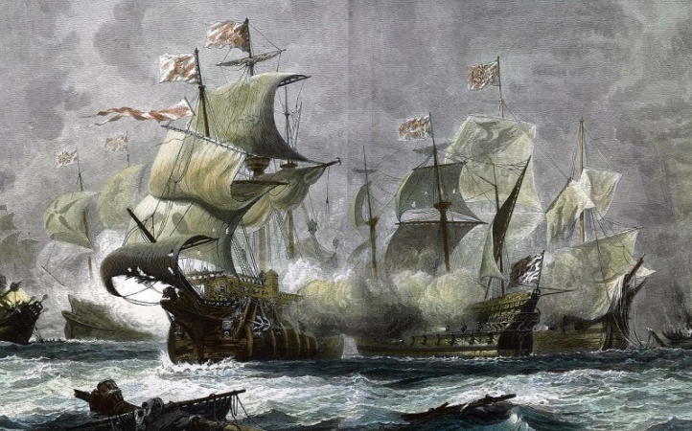
THE INVINCIBLE ARMADA
In 1588, the Armada entered in the English Channel
Spanish Ships
English vessels
-Big
-Slow
-Resistent
-Small weapons
-Made for boarding enemys
-Small
-Fast
-Heavy armed
-Advanced cannons
-Struck from the distance

Slide 10
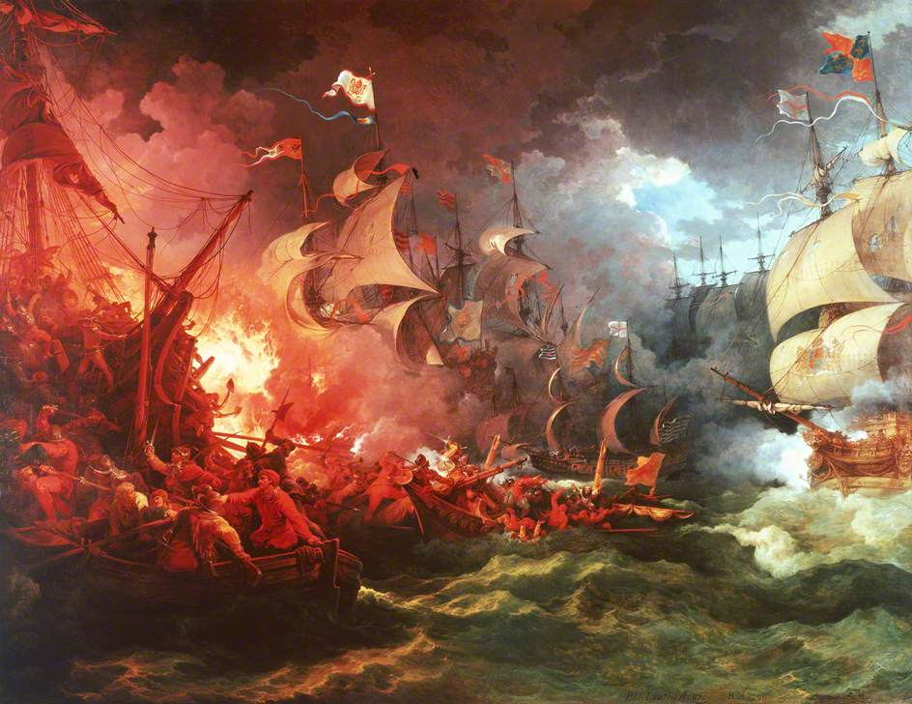
THE INVINCIBLE ARMADA
English fleet coudn’t make much damage to enemys
English attacked them with 8 incendiary ships
Spanish broke the formation
English defeated the Armada and gain the control of the sea

