Slide 1
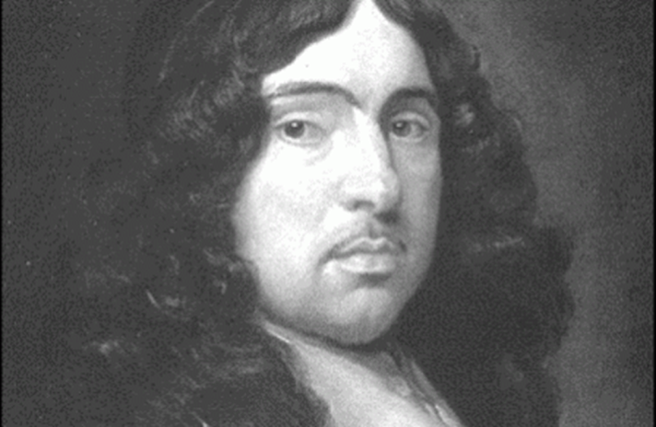
TO HIS COY MISTRESS
Andrew Marvell
By Cattaruzzi Simone, Clementin Emilio and Zamò Federico
4°ASA
2016/2017

Slide 2
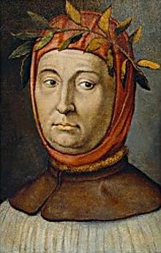
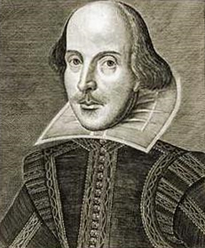
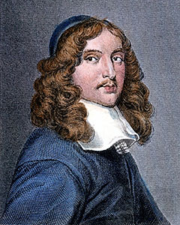
DEVELOPMENT OF POETRY
PETRARCH
WILLIAM SHAKESPEARE
ANDREW MARVELL
1304-1374
1588-1616
1621-1678

Slide 3
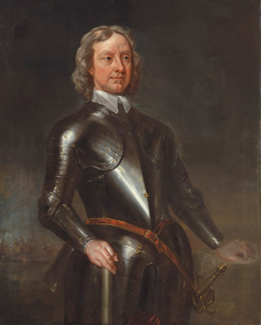
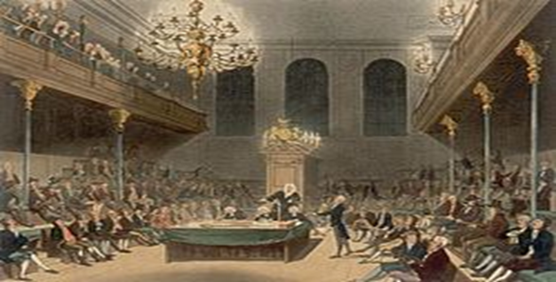
The poet
Andrew Marvell was a representative of Metaphysical poetry and a satirist.
Short biography:
He attended Trinity College (Cambridge)
He travelled in continental Europe
Moderate puritan, he sustained Cromwell
Friend of Milton
He sat in the House of Commons

Slide 4
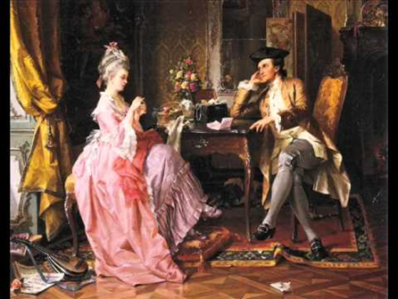
The poem
It belongs to Metaphysical poetry, it is written in iambic tetrameter and rhyming couplets
Organization (three stanzas):
First stanza (twenty lines)
Second stanza (twelve lines)
Third stanza (fourteen lines)

Slide 5
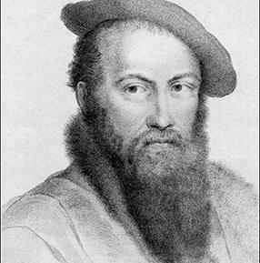
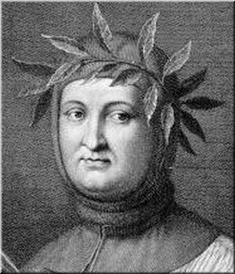
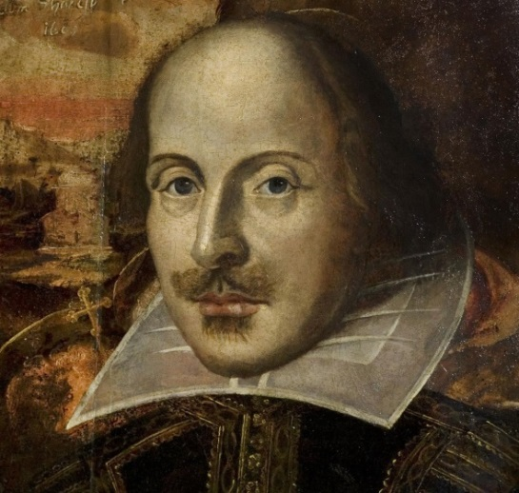
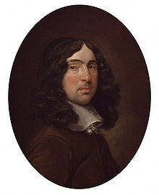
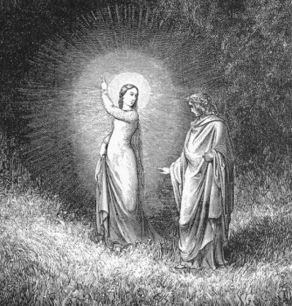
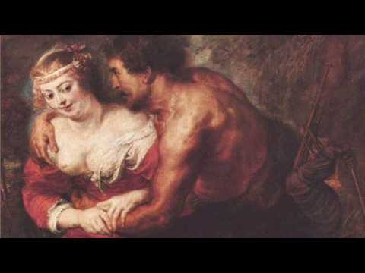
RELATIONSHIP BETWEEN POETRIES
COURTLY POETRY
METEPHYSICAL POETRY
WILLIAM
SHAKESPEARE
THOMAS WYATT
PETRARCH
ANDREW MARVELL
I FIND NO PEACE
PACE NON TROVO
TO HIS COY MISTRESS
Sonnet 130
MY MISTRESS’ EYES

Slide 6

FIRST STANZA
FIRST LINE: LIMITED TIME (we will die)
SEXUAL APPEARANCE (unlike the courteous poetry)
GROTESQUE CHARACTER:
DISTANCE BETWEEN
THE LOVERS
«[…] Thou by the Indian Ganges side
Should’st rubies find : I by the tide
Of Humber would complain,[…]»
LONG TIME BEFORE GATTING ANY KIND OF SEXUAL INTERCOURSE
«[…] Love you ten years before the flood,
And you should, if you please, refuse
Till the conversation of the Jews.[…]»

Slide 7


THEIR LOVE IS:
SLOW
VASTER THAN EMPIRES
COMPLEX
→VEGETABLE LOVE
THE AUTHOR:
PRAISES THE WOMAN FOR THOUSANDS OF YEARS
ONLY AT THE END (DEATH) HE PRAISES HER HEART
HEART → SYMBOL OF PURITY AND SEXUAL PASSION
CONTRAST WITH
COURTEOUS POETRY

Slide 8
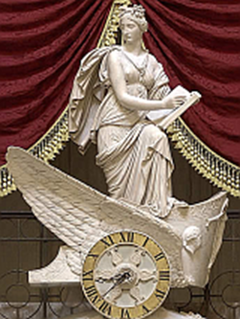
SECOND STANZA
Brief passing of time
Negative idea of eternity
Eternity was considered empty
CARPE DIEM
«[…] But at my back I always hear
Time's winged chariot hurrying near;
And yonder all before us lie
Deserts of vast eternity. […]»

Slide 9
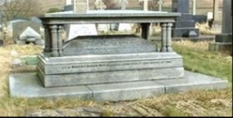
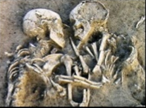
«Thy beauty shall no more be found,
Nor, in thy marble vault, shall sound
My echoing song; then worms shall try
That long-preserved virginity,
And your quaint honor turn to dust,
And into ashes all my lust;
The grave’s a fine and private place,
But none, I think, do there embrace.»
Her beauty will fade because we will die
He redicules women verginity that is considered a fundamental value for courtly poetry (Virgin Mary)
After her death he doesn’t sing to her
In the grave her honor will turn to dust and ashes
MEMENTO MORI
The courtly poetries is written
after her beloved death

Slide 10
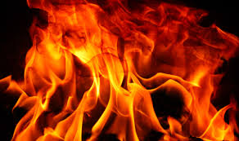
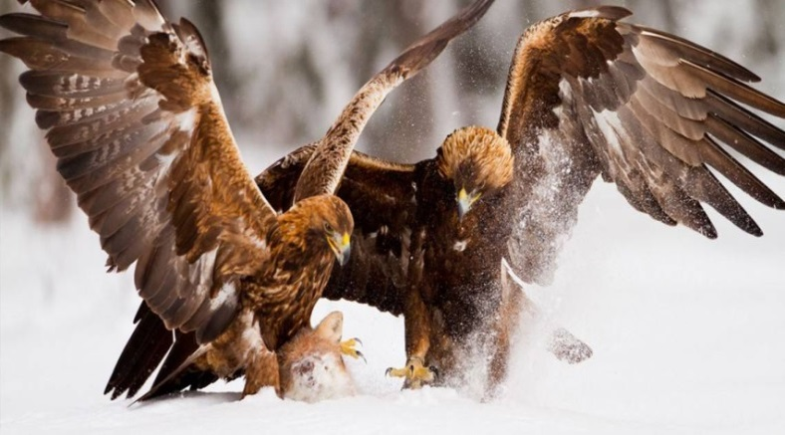
THIRD STANZA
Image of the souls that transpire fires
Symbol of passion
Reference to plants
«[…] And while thy willing soul transpires
At every pore with instant fires,
Now let us sport us while we may, […]»
Comparison between the two lovers and raptors
Violence of love
«Predate» time
Rather than be eaten by it
«And now, like amorous birds of prey,
Rather at once our time devour
Than languish in his slow-chapped power.»
Expressed in an animate way

Slide 11
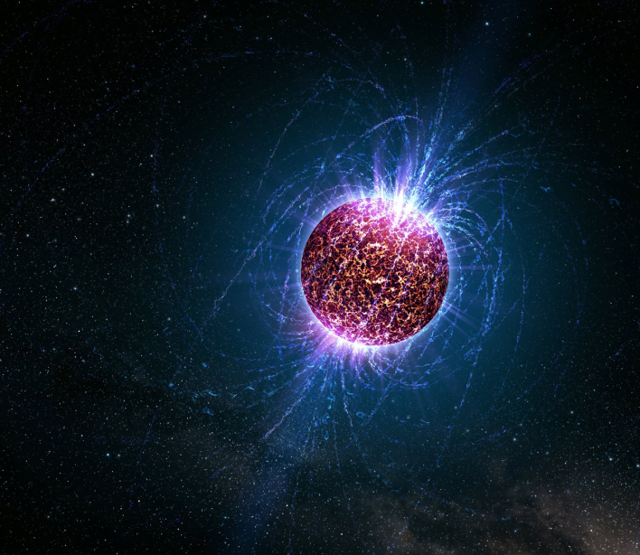
Introduction of the idea of sex
Fusion between the lovers’ forces and affections in a sphere (symbol of perfection)
Materialization of the conceit of life, «iron gates»
For the two lovers, sex is a way to another world
« Let us roll all our strength and all
Our sweetness up into one ball,
And tear our pleasures with rough strife
Through the iron gates of life:»
Sun, which represents sex,
can’t be used to stop time
The two lovers use it to make
time go faster

