Slide 1
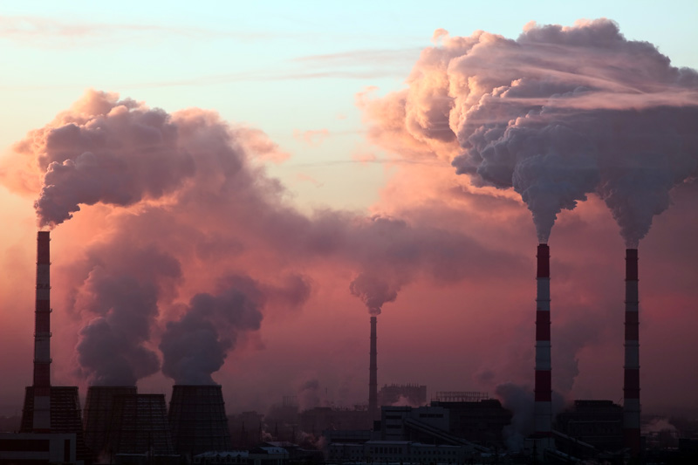
“NICE WORK”
by David Lodge
Chapter V
Davide Bodigoi, Federico Martinello, Giorgia Vita

Slide 2
“Some persons hold,” he pursued, still hesitatin, “that there is a wisdom of the Head, and that there is a wisdom of the Heart. Have not supposed it so; but,as I have said, I mistrust myself now. I have supposed the head to be all-sufficient. It may not be all-sufficient; how can I venture this morning to say it is!”
Charles Dickens: Hard Times

Slide 3
Structure
The chapter is divided into 4 parts.
Function:
1) The first part of the chapter tells the reader what each character thinks of the other: Vic loves Robyn and Robyn seems to change her mind about Vic.
2) In the second extract the narrator shows Vic’s insecurities and Robyn’s rationality.
3) The narrator highlights the two different thoughts of the characters about the night they spent together.
4) In the fourth part the writer focuses on the way the characters dismiss their memories.

Slide 4
Characters
Robyn Penrose and Vic Wilcox:
She belonging to a very different social species from Vic Wilcox;
The two characters are very different but they are involved in a sentimental story;
Vic is in love with Robyn but she doesn't love him;
Robyn doesn't believe in love, she thinks “we aren’t unique individual essences existing prior to language. There is only language.”

Slide 5
Setting
From Rummidge to Frankfurt;
Robyn’s room;
A sauna after Penny and Robyn’s Monday evening
Game of squash;
Robyn’s parents house on the South Coast;
Vic Wilcox usual frequented places.

Slide 6
Narrative techniques
Alternance between narration and dialogue;
The chapter grow up on a logical line of time of events that succeed;
Extensive use of acronyms (there are a lots acronyms in the whole book);
Widespread use of descriptions;
Use of dialogue between Robyn and Penny to better explain her feelings and
thoughts;
Use of a letter to introduce Charles’ judgements and change of life.

Slide 7
Use of language
Popular language;
Use of idioms and contracted form of words;
Alternance between narration and dialogue;
Reported speech.

Slide 8
Themes
Contrasts between City workers (Robyn's brother) and factory ones (Vic): according to Vic’s
vision, businessmen do not produce anything concrete, they simply move “bits of paper”;
Are the world's inhabitants victims of the system? Or, are they the lucky exploiters of their
ingenuity and co-operation?;
The recession in the UK is due to the greed and the laziness of the country in the fifties and sixties;
The idea of men's power and money is a turn-on for women like Robyn;
“You'd probably learn more about how people's minds work by reading novel”;
Some universities will be closed and the available funds will be distributed to the others;
Only the privileged universities deserve an idyllic and pastoral background;
Previously the state represented everything but now the City is taking over the universities because
of its vital force and democracy: this happened because the country was no longer willing to
provide money to the system;
Also the City has a semiotic system: the numerical one.

Slide 9
Peculiarities
Despite Vic is a businessman who often makes business trips, without Robyn's knowledge in German, he couldn't bring the deal to a successful conclusion;
"Tis all a muddle" - Charles Dickens (the same book has been quoted in the foreword);
Robyn is writing a book called “Domestic Angels and Unfortunate Females”;
Vic describes in his mind the time he spends with Robyn using Jennifer Rush's words and in the nightclub a Jennifer Rush's song wakes his hidden emotions up;
There are political references (the actions of the left and Mr. Penrose's participation in the Social Democratic Party);
Thatcher is mentioned by Charles that defends her from those who see the woman like the ruin of the nation;
References to Evelyn Waugh, Ford Madox Ford, Henry Green, Adrian Mole, the Bible and classical mythology.

Slide 10
Open questiones
What has changed, compared with the eighties, in the university system?
Have the funds mentioned by Robyn's father in this chapter been distributed to some universities? And, have other universities had to close?
How has the British economy evolved compared to the German one during the last thirty years?

