Slide 1
ANNA
VIDAL

Slide 2

MY IDENTITY CARD
My name is Anna Vidal.
I’m 15 years old.
I was born on 8th March 2002 in Udine.
I live in Privano, a small country in the north-east of Italy.

Slide 3
MY PERSONALITY
VIRTUES:
kind
sociable
honest
friendly
available to help my friends
FLAWS:
messy
stubborn
-Once you realise your values, yous flaws fade away -

Slide 4
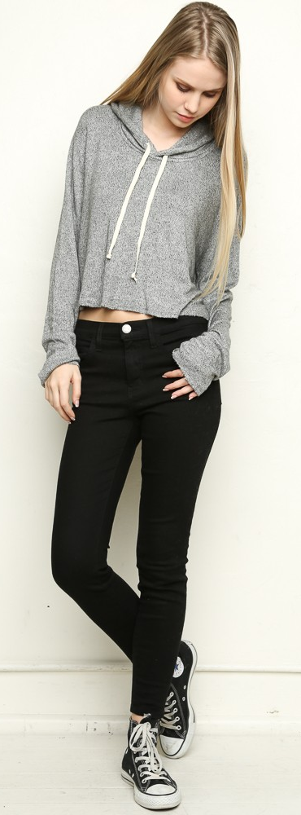
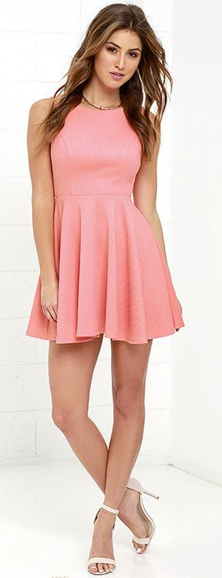
MY LOOK
I’m tall and slim.
I’ve got long wavy brown hair and big brown eyes.
I’m a casual dresser, so I love comfortable clothes. I usually wear a pair of jeans, a T-shirt and a hoodie. On special occasions I wear elegant clothes such as skirts, tops and dresses.
VS

Slide 5
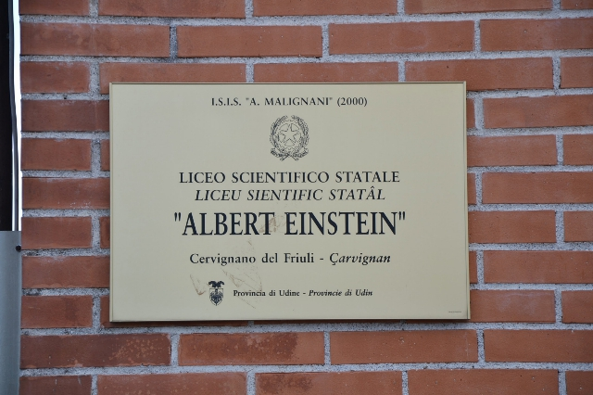
MY OCCUPATION
I attend Liceo Scientifico «Albert Einstein» in Cervignano, a country not so far from mine.
I’m in the second form.
I choose liceo scientifico because it provides the student with an overall preparation.
I go to school by bus; it takes me about 15 minutes.
My favourite subject is Art History.
I find Physics difficult.

Slide 6
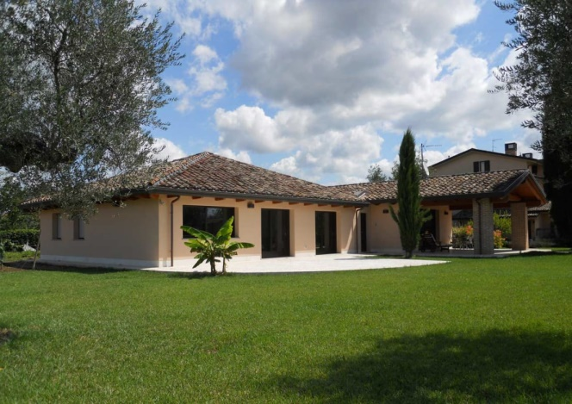
MY HOUSE
I live in a house with a large garden
In my house there are a ground floor and a basement. On the ground floor there are a kitchen, a living room, two bathrooms, two bedrooms and a study. On the basement there are a cellar and a laundry.
At home I spend most of my time in my bedroom.

Slide 7
MY RELATIVES
Maternal grandparents
Mario and Claudia
Uncle
Norberto
Mum
Susanna
Cousin
Jacopo
Paternal grandparents
Luciano and Gioiella
Dad
Stefano
Aunt
Valentina
Sister
Marta
Me
Anna

Slide 8
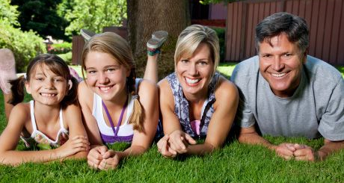
MY FAMILY
My family is composed by four people: my father, my mother, my sister and I.
My father’s name is Stefano, he is 52 years old and he’s a carpenter.
My mother’s name is Susanna, she is 51 years old and she’s the secretary of my dad.
My sister’s name is Marta, she is 19 years old and she studies at university, at faculty of school training.

Slide 9
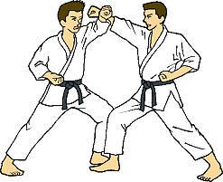
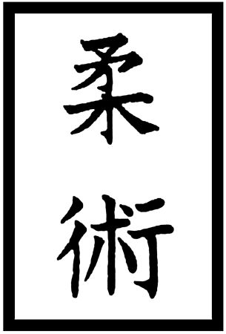
MY SPORTS
When I was in kindergarten I went swimming in Staranzano.
From 7 to 11 years old I practice judo in Strassoldo.
When I was in junior high school I also did athletics with my PE teacher.
Now I practice ju-jitsu, a Japanese martial art.
Two jutsuka, that means who practices ju-jitsu
The sign ju-jitsu in Japanese

Slide 10
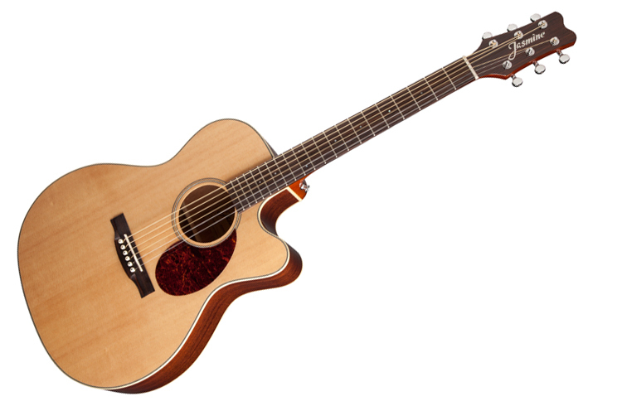
MY HOBBIES
In my free time I usually go out with my friends. If the weather is fine, we go to the park of our country; if the weather is rainy, we go to the shopping centre or to the cinema.
I like listening to music and watching movies, while I don’t like reading books.
I have been playing the guitar since I was 9 years old. I love this musical instrument!

