Slide 1
DESCRIPTION OF MYSELF
Leonardo Spanghero
2^ALS

Slide 2
My name is Leonardo Spanghero.
I was born on 14th of November in 2002, in Gorizia.
I live in Aquileia, in the North East of Italy.
I live in a house.
My favourite colour is black.

Slide 3
I am tall; I have brown hair and eyes.
I usually am kind and funny.
I try to engage in everything I do.

Slide 4
In my family we are in four: my mother, my father, my sister and me.
My mother’s name is Tatiana, my father’s name is Gabriele and my sister’s name is Veronica.
I have two grandmothers and one grandfather.

Slide 5

When I was five years old, I have played football.
I play basketball in a team, in Cervignano.
I have training three times a week.
I play basketball since I was six years old.
My favourite team is Golden State Warriors.

Slide 6
I attend the Liceo Scientifico “A. Einstein” in Cervignano.
I chose this school because I’m good at scientific subjects.
I think in my future I’m going to study architecture.
My favourite subject is Maths.

Slide 7
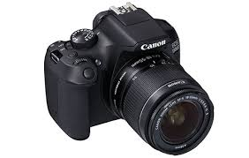
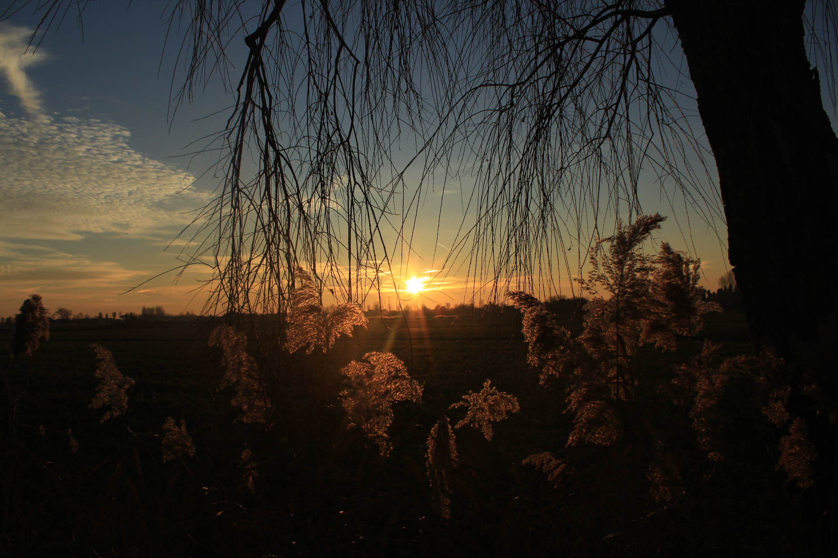
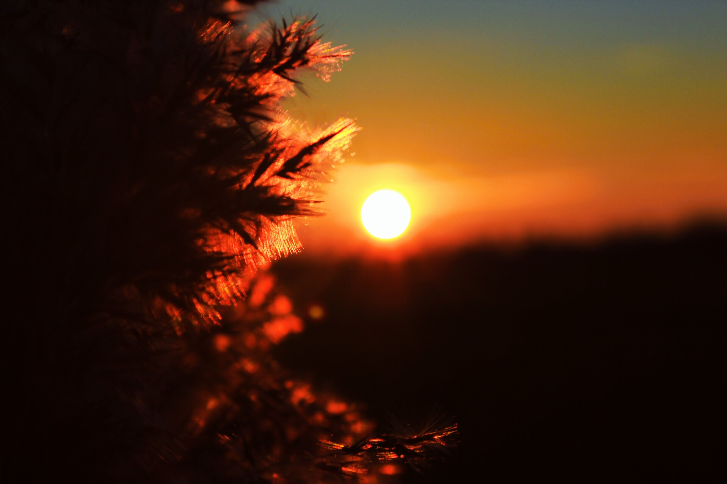
One of my favourite hobbies is to take photos.
I like listening to music.
I like pop music.
One my favourite Tv series is Grey’s Anatomy.

Slide 8
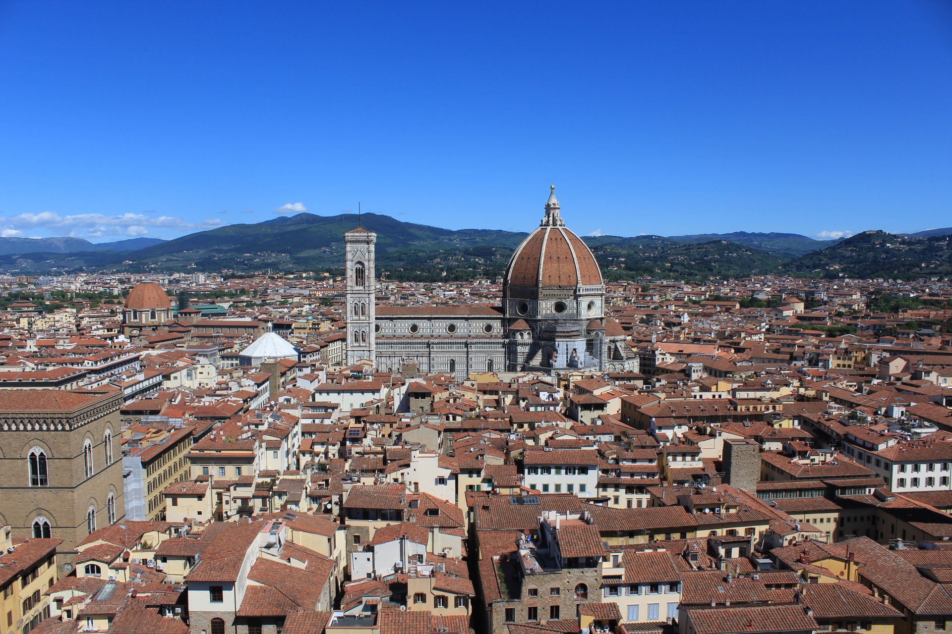
I like travelling very much.
This year I have been in Amsterdam and in Florence, with my family and some friends.
In the last three years I visited the following places: Barcelona, Prague, Puglia, Garda Lake, Lake Maggiore and Lugano, Sicily and England.

Slide 9
In my free time I usually meet my friends.
Sometimes we go to the cinema or we go shopping.
During the summer, we went to Grado and Lignano.

Slide 10
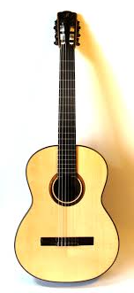
I can play the guitar.
I played the guitar for 5 years.
I had guitar lessons until 3 years ago.

