Slide 1
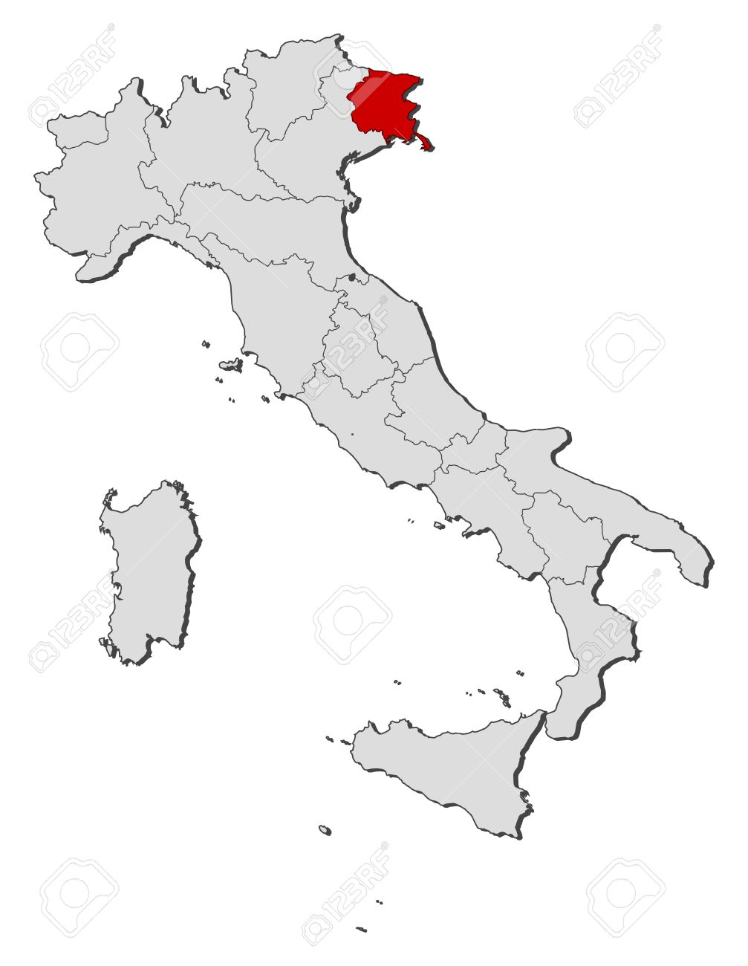
Talking about myself
I’m Rebecca Grimaldi;
I’m fourteen years old;
My birthday is on the 1st of November;
I’m Italian and I live in Villa Vicentina, a small village in the north-east of Italy (it’s about two hours’ train from Venice ).

Slide 2
How am I physically and emotionally?
I’m quite slim and not very tall;
I have curly and blond hair;
I’m very shy and calm;
I’m generous and ambitious;
I think it’s better not to be too tall because it can sometimes be a curse rather than a blessing: for example if you are too tall, you enter in a room by a small door with difficulty!
I’m very stubborn and when I put on my mind a goal, I absolutely must reach it.

Slide 3
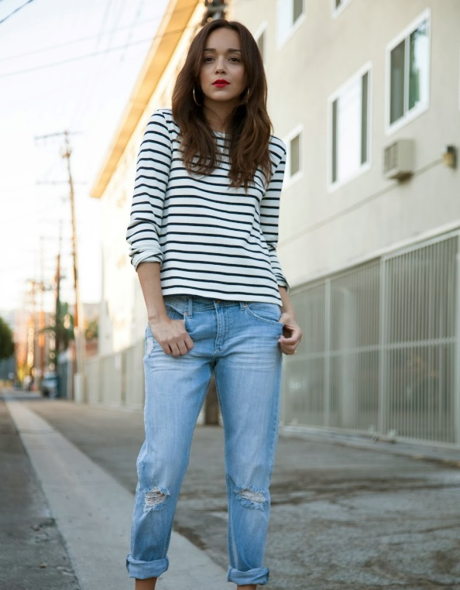
What do I like wearing?
I love wearing casual and comfortable clothes because:
I think one shouldn’t be trapped in smart dresses or skirts just to give a beautiful impression;
I don’t like to show me off;

Slide 4
What about school?
I attend Liceo Scientifico Albert Einstein;
My favourite school subject is science;
In fact I would like to become a biologist.
I like school because without it i wouldn’t know how spend the whole day;
I hate it deeply when we’re full of homework for the next day.

Slide 5
And what about hobbies?
TODAY…
Music is my big passion;
I like all genres, but I mostly listen to pop and modern music;
I sing in a chorus: our repertoire ranges from ancient music of the XV century to the sacred music of today;
I have danced since I was 11 years old;
I like dancing very rhythmical songs!

Slide 6
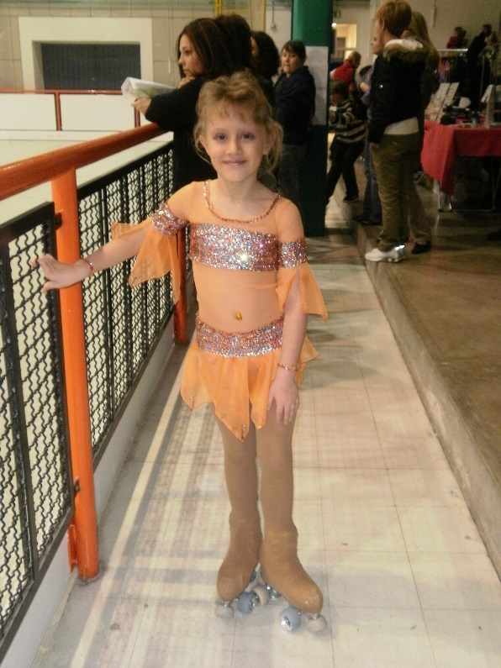
WHEN I WAS YOUNGER…
I had been skating before I decided to change sport;
I was five years old when I began skating;
I mostly loved the clothes with we taken part at the races.

Slide 7
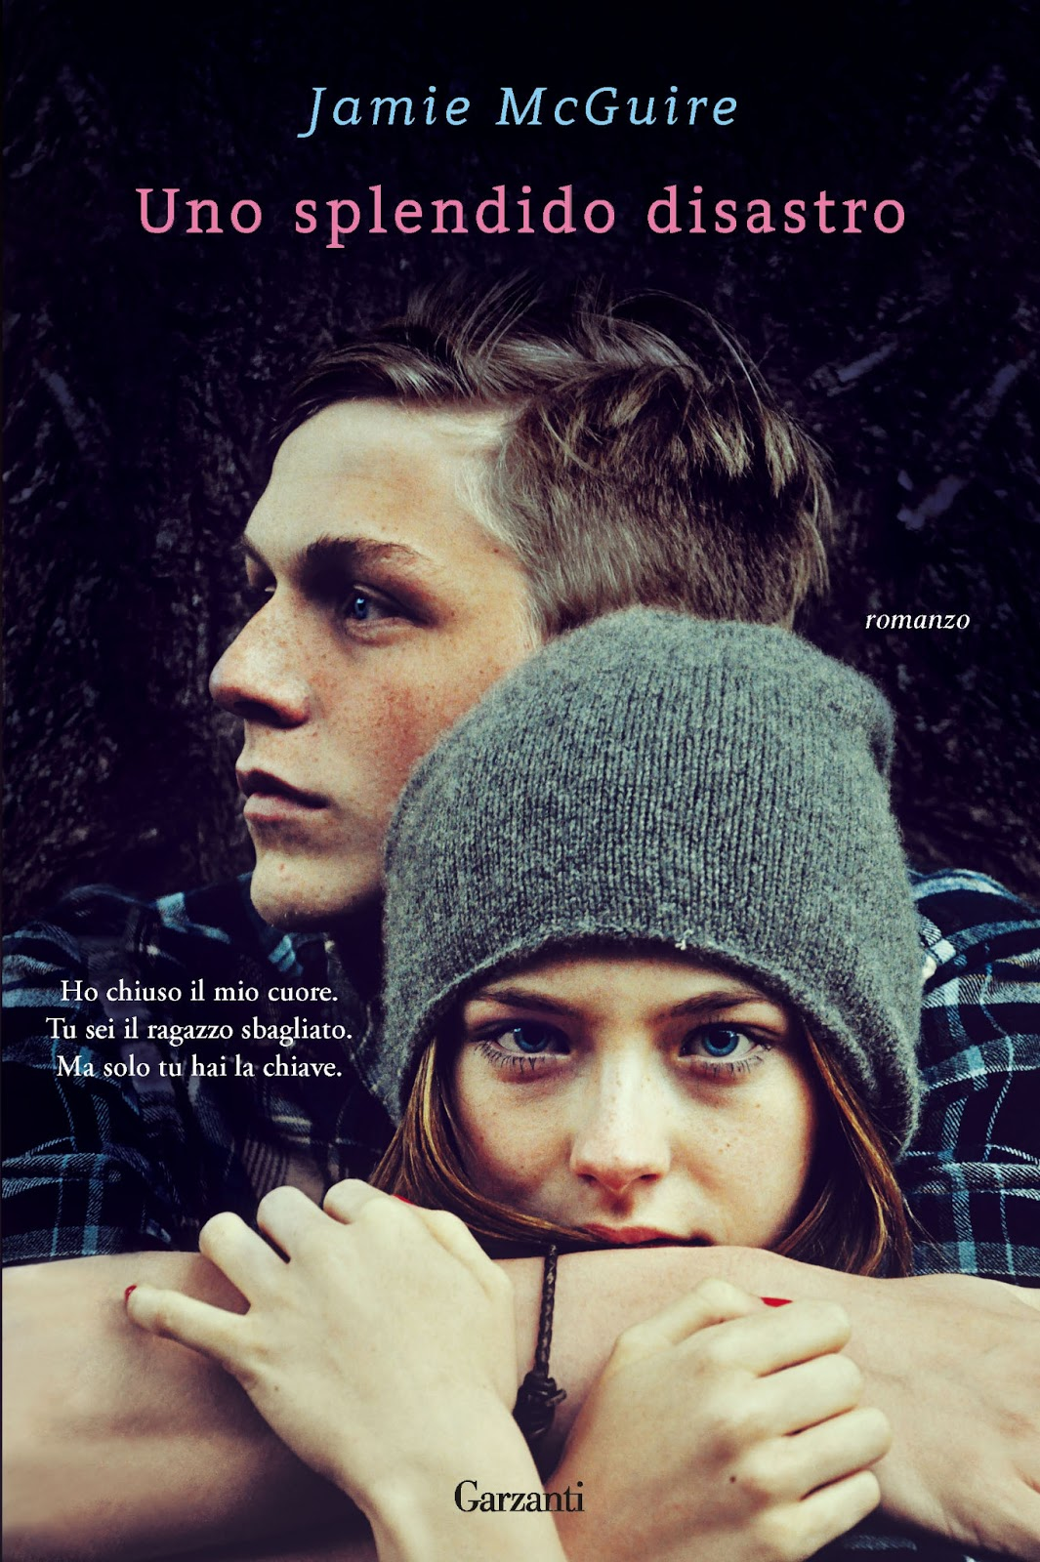
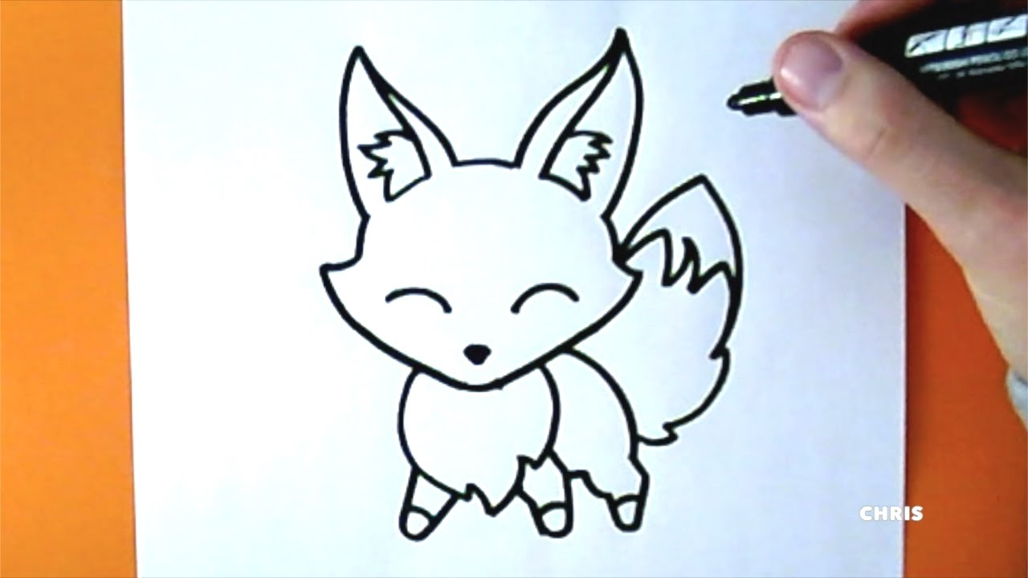
I usually read novels and love stories because they make me identify in characters as no other kind of book can do;
I’m not good at draw and I don’t like it.

Slide 8
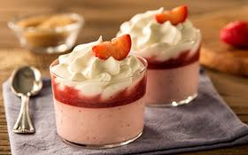
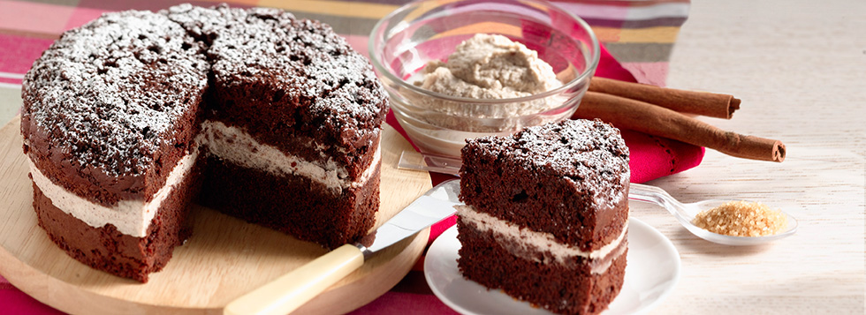
Merits or defect?
I usually take decisions very slowly and with difficulty because I’m always afraid to hurt someone or that I can repent of the thing chosen;
I’m very gluttonous of sweets; I love all of them: cakes,biscuits,croissants…
I would always have them if it was possible and they didn’t get fat!

Slide 9
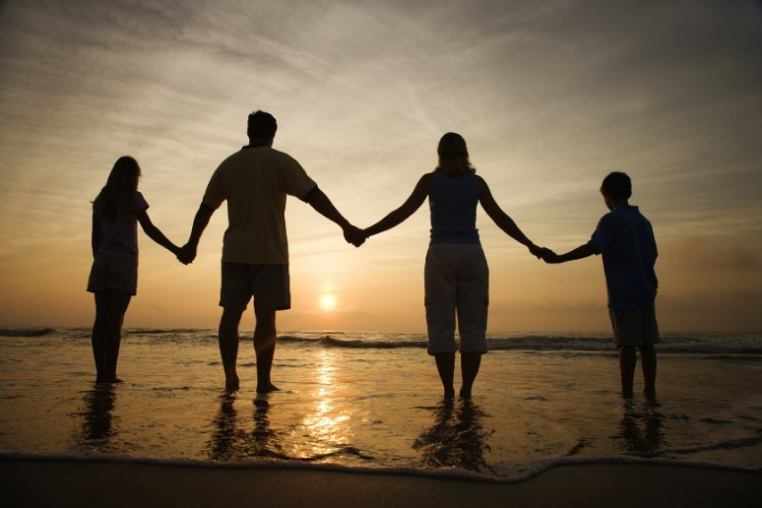
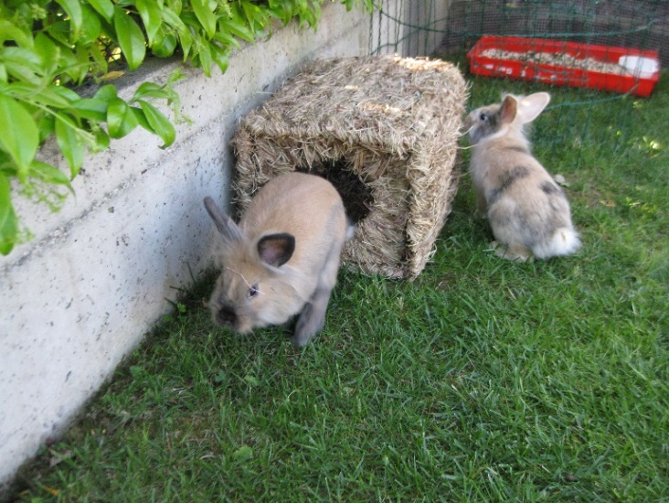
My family
I have got a father, a mother and a sister;
My father’s name is Ciro and is 51, my mother’s name is Livia and is 50 as well;
My sister’name is Rachele and is 11; she attends the middle school;
I have got two rabbits: their names are Miele and Coffee…they are 3 years old and are so cute!

Slide 10
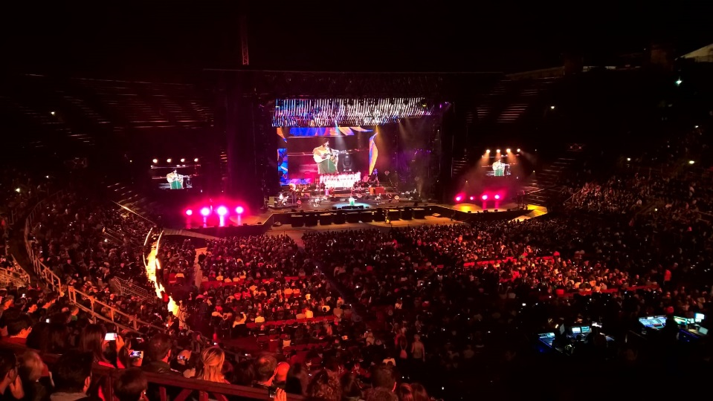
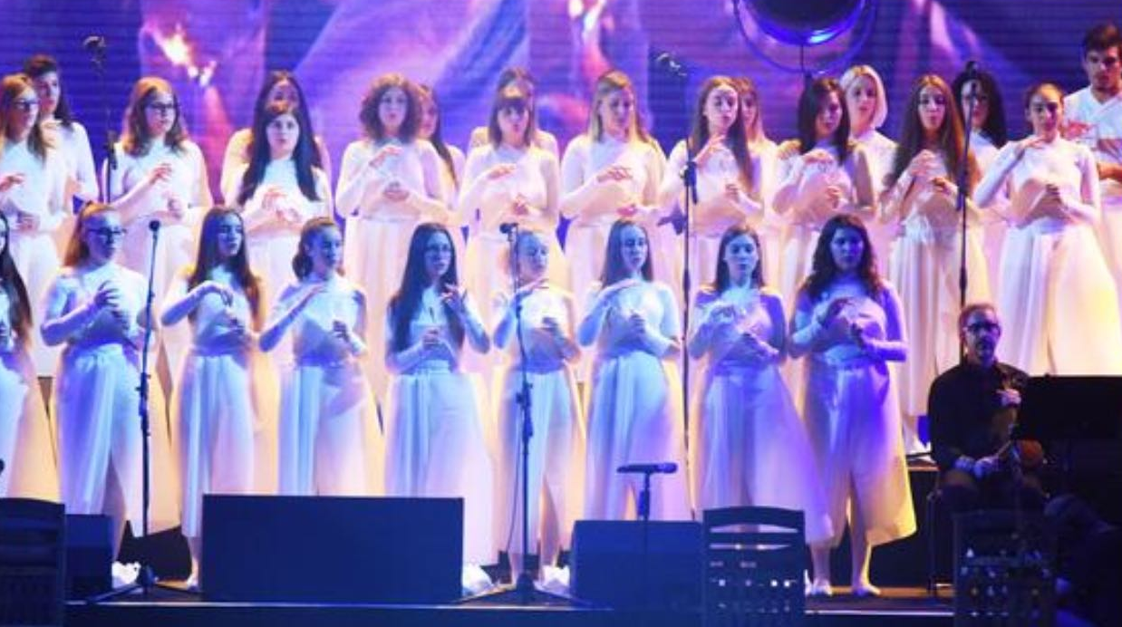
An experience unforgettable
In this summer, the choir «Artemìa» and I focussed on singer Elisa’s songs to bring them out at the Verona’s Arena in a concert with her;
This happened on the 13th of September of this year;
I love Elisa and singing with her was like a dream;
I met there Fabri Fibra, Francesco De Gregori and Luca Carboni!

