Slide 1
The War in the Mountains
Rudyard Kipling
Group work 3: Bragagnini, De Losa, Della Torca, Tecovich, Zuliani

Slide 2
Introduction
Task:
Find out the idea of war and Italian soldiers in Kipling’s text in order to approach to English War Poetry
Objectives:
to get close to the first world war through a different point of view
to learn how to analyse a war report
to generate of a multimedia presentation
Literary genre: report of war

Slide 3
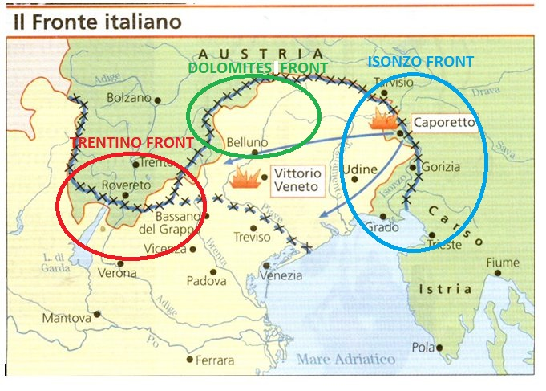
SPACE

Slide 4
Chapter I: The roads of an Army
Narrator and Narrative techniques:
First person narrator
Showing and telling
Language:
Informal register
Present tense
Simple and specific words
Rhetorical figures → metaphors (giants at a hunting)
→ anaphoras (head, head)
→ alliterations (made maps, showed streaks of snow, hard people . habituated to handing hard stuffs)
Kipling’s opinion:
Italian’s ability to fight and work in spite of mountainous and bad conditions
Italian’s adaptability and spirit of cooperation

Slide 5
Chapter II: Podgora
Narrator and Narrative techniques:
- First person narrator
- Showing and telling
Language:
- Semantical choices → references to natural elements and its colours
- Rhetorical figures
→ metaphors (in a month the smooth Italian roads would overrun them as vine tendrils overrun rubbish-heaps)
→ metonymy (but none the less the machines beat over them from both sides)
→ personification (No one, except a few pieces who were finishing some private work, was saying anything)
Kipling’s opinion:
- Italian soldiers are considered as stubborn and hard as French soldiers
- From officer’s answers comes to light that «height is everything» in the war in the mountains

Slide 6
Chapter III: A Pass, a King, and a Mountain
Narrator and Narrative techniques:
- First person narrator
- Showing and telling
Language:
- Informal register
- Simple present and simple past
- Rhetorical figures → similes (They arrive at their proper place by the same means that Rome was built)
(new roads [...] as thin and threadlike as the exposed roots of a botanical diagram to illustrate capillary attraction)
Kipling’s opinion:
- Italian soldiers’ values telling about the King of Italy
- Human activity refers to Puritan ethic

Slide 7
Chapter IV: Only a few steps higher up
Narrator and Narrative techniques:
- First person narrator
- Showing and telling
Language:
- Informal register
- Simple present and simple past
- Rhetorical figures → personification of the nature which is described as a monster
→ alliteration of the sounds “w” and “s” (wilderness of wrathful crags and fissures had revealed itself)
Kipling’s opinion:
- He uses expressions such as «joyous children» and the adjective «young» more than once in order to highlight the members of the Alpine regiments’ ability even if they may not have many years of experience
- They are brave, strong, genuine and happy young people who chose to fight for their Nation

Slide 8
Chapter V: The Trentino front
Narrator and Narrative tecniques:
- First person narrator
- Showing and telling
Language:
- Informal register
- Past simple
- Specific words → reportage
- Rhetorical figures → similes (the single sentry lying-out like a panther pressed against a hump of rock)
→ metaphors (General Cadorna’s headquarters, which might be a monastery or a laboratory)
Kipling’s opinion:
- Italian soldiers’ sense of belonging
- Italian soldiers’ organization in work
- Austrian Empire as the Devil
- War as a way to reach National Unity

Slide 9
Conclusion
Kipling’s overall idea of the Italian soldiers that comes to light from the report underlines their positive attitudes of courage, strength and sacrifice.
Indeed they are presented as heroes who left their homes and families in order to completely devote to their country by joining the Army. Waging war does not mean only fighting, but also engaging into activities ranging from road to outposts construction, through maintenance work necessary to sustain soldiers at the front.
On the contrary, Kipling does not express a clear judgment about war.
Indeed he exalts the innovations that war brought about in Italy such as the construction of new roads, however, despite these considerations he underlines the worthless massacre of the WWI.

