Slide 1
The War in the Mountains
Group work 2: Baldan, Bertoli, Danielis, Romano
Liceo Scientifico "A. Einstein" - V ALS - A. S. 2017/2018
Notes:
1

Slide 2
Introduction
Activities:
Reading of the war report The War in the Mountains by R. Kipling
Analysis of the report
Production of a PowerPoint Presentation
Objective:
- Dis-covery of Kipling’s vision of the war and the soldiers’s role through textual analysis
Liceo Scientifico "A. Einstein" - V ALS - A. S. 2017/2018
Notes:
2

Slide 3
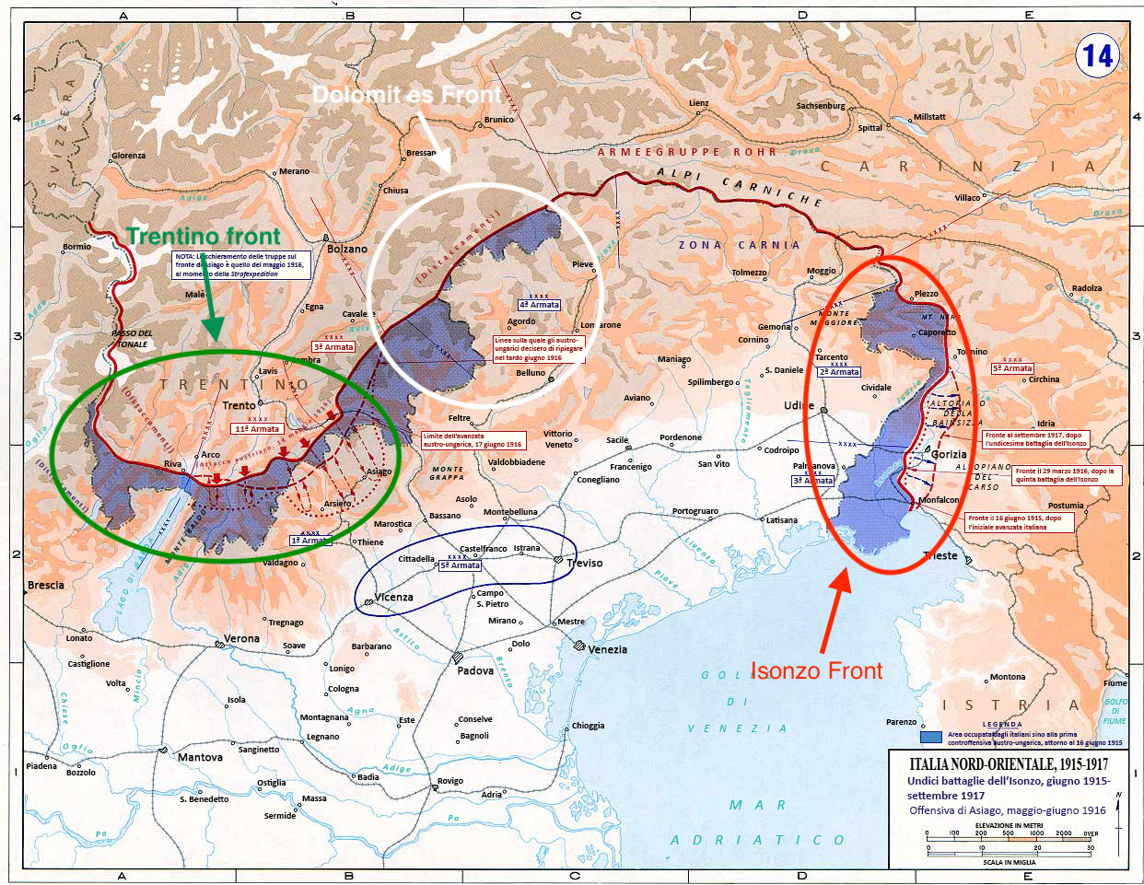

Slide 4
Chapter I - The Roads of an Army
Text type: War Report
Structure:
Narrative (mixture of dialogues and descriptions) – telling and showing
Language:
short, simple sentences, with the use of coordination
lexical choices → semantic area of war (last paragraph of the first sequence and last paragraphs of The Belly of Stones) nature (first paragraphs) that to the reader to create an idea about soldiers’ conditions.
Rhetorical figures → alliterations (sound “t” and “ c ” , 3rd paragraph) that convey soldiers’ conditions of life, anaphoras (like head –head, 4th paragraph of The Belly of Stones) that underline their harder conditions of fighting.
R.Kipling’s ideas of:
War → It is a way to reach the National Unity of Italy.
Soldiers → He celebrates the slain and the victims of WWI and the strenght of the italian soldiers that fought in the mountains.
Liceo Scientifico "A. Einstein" - V ALS - A. S. 2017/2018
Notes:
4

Slide 5
Chapter II - Podgora
Text type: War Report
Structure:
Narrative (mixture of dialogues and descriptions) – telling and showing
Language:
- short, simple sentences, with the use of coordination → involves the reader going on in the reading
lexical choices → semantic areas of war and nature (enemy, death, bombs, fights, trench, soldiers, war, cannons, military service) → difficulties the soldiers have to face with
rhetorical figures → alliteration of sounds ‘s’ and ‘t’’ covey the difficult situations soldiers have to support in war life
R. Kipling’s ideas of:
War → the war in the mountains is hard because the mountains get more difficult the mouvements of the troupes
Soldiers → R.Kipling understands soldiers must be ready for everything in a mountain war
Liceo Scientifico "A. Einstein" - V ALS - A. S. 2017/2018

Slide 6
Chapter III - A pass, a King and a Mountain
Text type: War Report
Structure:
Narrative (mixture of dialogues and descriptions) – telling and showing
Language:
short, simple sentences, with the use of coordination→ increasing rhythm that makes the reader going on with the reading
lexical choices →Semantic areas of war, nature and references to Puritanism→ soldiers work hard in order to achieve their duties even in adverse conditions
rhetorical figures → alliterations of sounds “s” and “t” convey the idea of bad weather conditions soldiers have to face with; similes (Sometimes the discharge sounded like a triumphant whoop across the snows)→ reinforce the positive idea of soldiers convyed by the text
R.Kipling’s ideas of:
War → It involves every aspect of life
Soldiers → R.Kipling considers soldiers as vehicles to win the war and achieve the National Unit
Liceo Scientifico "A. Einstein" - V ALS - A. S. 2017/2018

Slide 7
Chapter IV - Only a few steps higher up
Text type: War Report
Structure:
Narrative (mixture of dialogues and descriptions) – telling and showing
Language:
short, simple sentences, with the use of coordination→ growing rhythm that makes the reader going on in the reading and conveyssoldiers’ sense of precariety
lexical choices → semantic areas of war and nature→ main difficulties the soldiers have to face with (war rules and lifestyle in “wild places”)
rhetorical figures → alliteration of sound “s” and “t” with the rhythm convey the precarious situation of soldiers who risk their lives ; similes between nature and a monster underline the difficult weather condition of the front and the hard work soldiers have to do in order to organize comunication and their camps.
Kipling’s idea of:
War → negative idea: people must face with a new situation in order to survive
Soldiers → R.Kipling considers soldiers as brave and full of energy young men who have to face with any situation and sacrifice themselves, changing their life to defend their Nation
Liceo Scientifico "A. Einstein" - V ALS - A. S. 2017/2018
Notes:
7

Slide 8
Chapter V – The Trentino Front
Text type: War Report
Structure: Narrative (mixture of dialogues and descriptions) – telling and showing
Language:
short, simple sentences, with the use of coordination
lexical choices → Kipling uses words belonging to semantic areas of war, nature and references to Puritanism in order to characterize positevely soldiers
rhetorical figures → Similes and alliterations of sounds “s” and “t” convey to the reader the hardness situation the soldiers had to face with during the war
Kipling’s ideas of:
War → It is a way to reach the National Unit
Soldiers → R. Kipling underlines their values that remind Puritan ideology: work, efficiency and determination to reach their objectives
Liceo Scientifico "A. Einstein" - V ALS - A. S. 2017/2018

Slide 9
Conclusion
IDEAS CONVEYED
The war
R.Kipling shows an ambiguous opinion about the war. Indeed, some chapters convey a contradictory vision of the conflict: on one side it brought innovation in economy, communication and transport, on the other side, it implied sacrifices and the death of young men who believed in the idea of the National Unit.
The soldier
R.Kipling appreciates Italian soldiers’ dedication and values (recalling Puritan ideology: determination, perseverance and work). In addition, soldiers are a means to reach a National Unit.
Liceo Scientifico "A. Einstein" - V ALS - A. S. 2017/2018

