Slide 1
The War in the Mountains
Group work 2: Baldan, Bertoli, Danielis, Romano

Slide 2
Introduction
Activities:
Reading of the report of war The War in the Mountains by R. Kipling
Analysis
Production of PowerPoint Presentation
Objective:
- Research of Kipling’s vision of the war and soldiers conveyed by the text

Slide 3
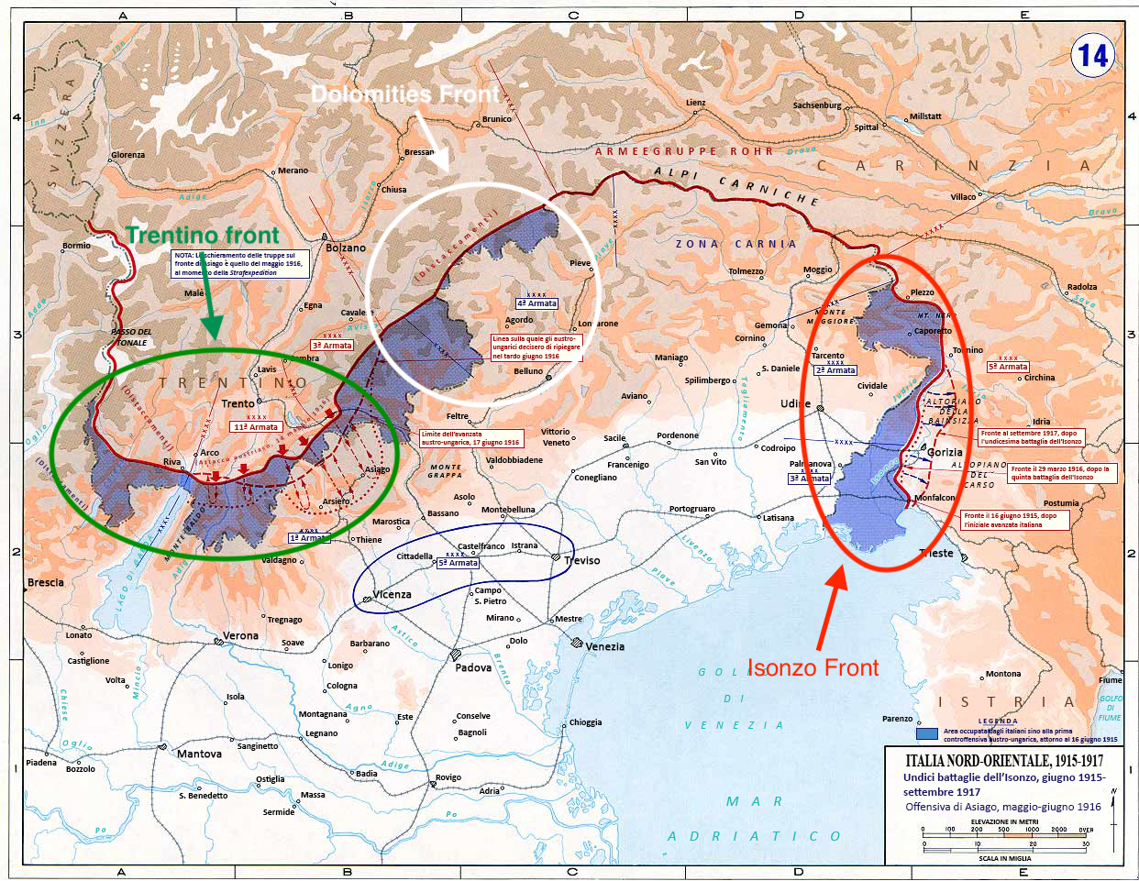

Slide 4
Chapter I - The Roads of an Army
Structure:
  Report of war
  Dialogical and descriptive sequences
Language:
  Paratactical syntax
  Lexical choices → semantic areas of war (last paragraph of the first sequence and last paragraphs of The Belly of stones) and nature (first paragraphs)
  Rhetorical figures → Alliterations (the sound “t”, 3rd paragraph), anaphoras (like head –head, 4th paragraph of The Belly of stones)
Kipling’s ideas of:
  War → It is a way to reach the National Unit of Italy
  Soldiers → He celebrates of slain and the victims of the first world war

Slide 5
Chapter II - Podgora
Structure:
  Report of war
  Dialogical and descriptive sequences
Language:
  Paratactical syntax
  Lexical choices → semantic areas of war and nature (enemy, death, bombs, fights, trench, soldiers, war, cannons, military service)
  Rhetorical figures → metaphors “…in a month the smooth Italian roads would overrun them as vine tendrils overrun rubbish-heaps”
Kipling’s ideas of:
  War → War in mountains is difficult and the height is everything to survive
  Soldiers → Kipling thinks soldiers must be ready for everything in a mountain war

Slide 6
Chapter III - A pass, a King and a Mountain
Structure:
  Report of war
  Dialogical and descriptive sequences
Language:
  Paratactical syntax
  Lexical choices → Semantic areas of war, nature and references to Puritanism
  Rhetorical figures → alliterations of sounds “s” and “t”; similes (Sometimes the discharge sounded like a triumphant whoop across the snows)
Kipling’s ideas of:
  War → It involves every aspect of life
  Soldiers → Kipling considers soldiers as vehicles to achieve the objective of the war

Slide 7
Chapter IV - Only a few steps higher up
Structure:
  Report of war
  Descriptive and dialogical sequences
Language:
  Paratactic syntax
  Lexical choices → Semantic areas of war and nature
  Rhetorical figures → Alliteration of sound “s” and “t”; similes between nature and a monster
Kipling’s idea of:
  War → negative idea: people have to adapt themselves to a new situation in order to survive
  Soldiers → Kipling considers soldiers as brave and full of energy young men who adapt and sacrifice themselves, changing their life to defend their Nation
Liceo Scientifico "A. Einstein" - V ALS - A. S. 2017/2018

Slide 8
Chapter V – The Trentino Front
Structure:
  Report of war
  Dialogical and descriptive sequences
Language:
  Paratactical syntax
  Lexical choices → Semantic areas of war, nature and references to Puritanism
  Rhetorical figures → similes (Battalions slipped like shadows through the mists between the pines ) ; alliterations of sounds “s” and “t” (hardness that impresses or immense efforts and necessities)
Kipling’s ideas of:
  War → It is a way to reach the National Unit
  Soldiers → Kipling underlines their values that reminded to puritan ideology: work, efficiency and determination to reach their objectives

Slide 9
Conclusion
Idea of the war: Kipling has an ambiguous opinion about the war. Indeed, some chapters convey an opposite vision of the conflict: it has brought innovation in economy, communication and transport. Whereas, on the other side, it implied sacrifices and deaths of young men who believed in National Unit ideas.
Idea of the soldier: Kipling appreciates Italian soldiers’ dedication and values (remind to puritan ideology: determination, perseverance and work). In addition, the novelist connotes soldiers as a way to reach National Unit.

