Slide 1
POSTCOLONIALISM
By Agostini Giacomo and Vidili Andrea
Cl. 5^ASA
Anno Scolastico 2017/2018

Slide 2
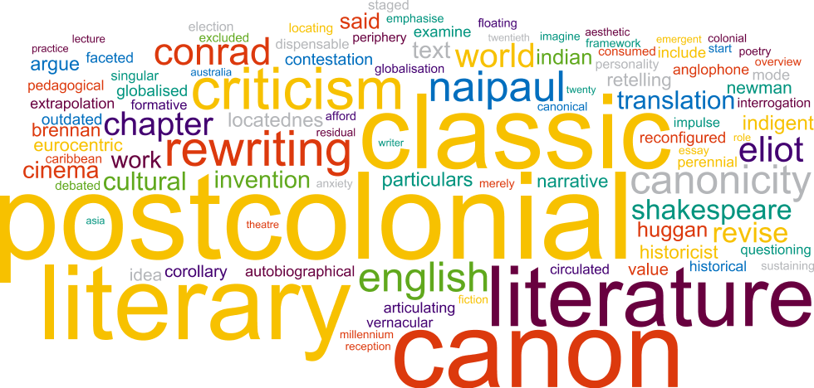
DEFINITION OF ‘POSTCOLONIAL’
The Period after colonisation and the one after independence (second half of the 20th century ca.)
The study of the interactions between European nations and the societies they colonized in the modern period

Slide 3
Postcolonial literature
Written by people living in countries formerly colonized by other nations
There are many problems with this definition
literal colonization is not the exclusive object of postcolonial study
some critics argue that the term misleadingly implies that colonialism is over
we are studying novels that have been written while the nations in question were still colonies

Slide 4
Postcolonialism’s issues
Contrasts between colonizers and colonies
Cultural, economic and scientific problems
Sense of displacement
Different new languages (Englishes)

Slide 5
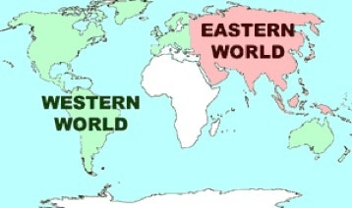
The literature of the colonized
Concept of «otherness», it includes both identity and difference
Differences between Eastern and Western world
Colonized people are diverse in their nature and traditions

Slide 6
The literature of the colonized
Violation of the aesthetic norms of Western literature
Colonized writers search to encounter their culture’s ancient
They attempt to deal with problems of social order
Development of hybrid and reclaimed cultures in colonized countries

Slide 7
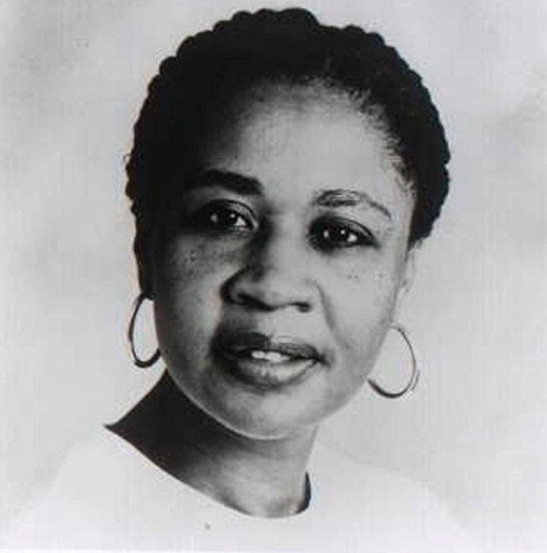
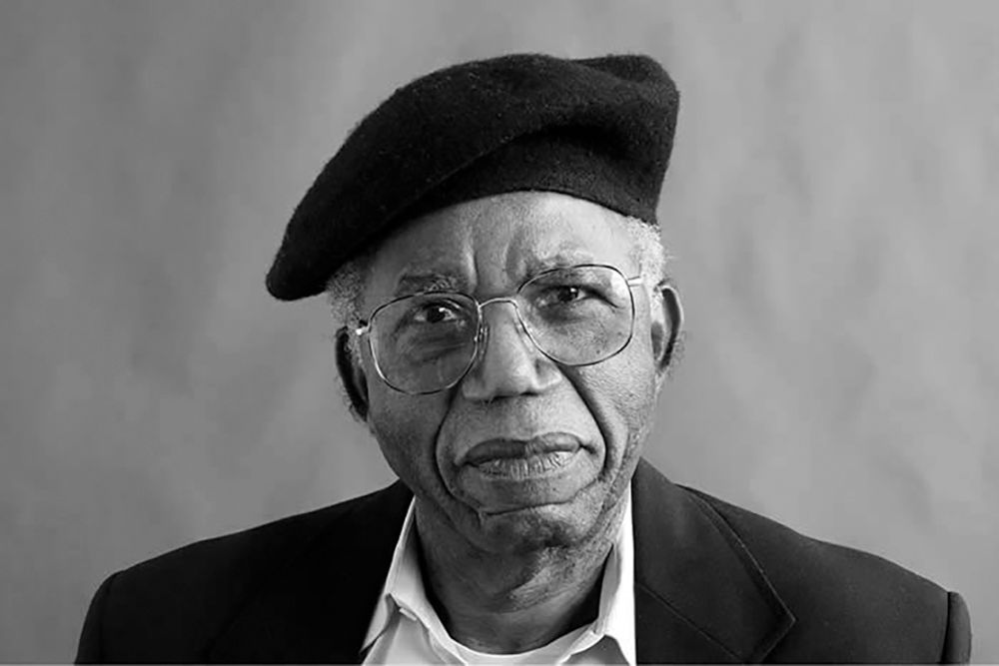
Major figures
Chinua Achebe
Peter Abrahams
Salman Rushdie
Jamaica Kincaid
Anita Desai
Assia Djebar

Slide 8
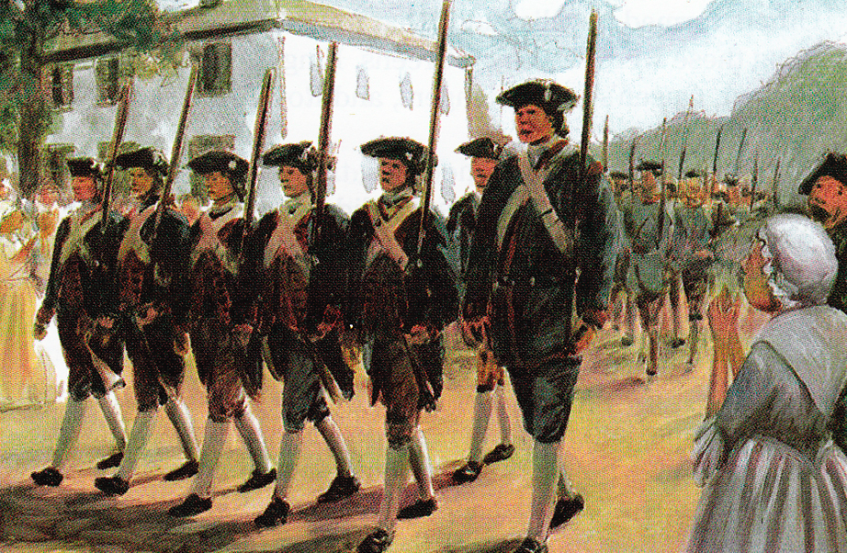
The literature of the colonists
Their ideology implied the Anglo-European culture as the most civilized, sophisticated, or metropolitan.
Based on the colonizers’ assumption of their own superiority
Colonists’ literature tries to continue, equal, replicate the original tradition, to write in accord with British standards

Slide 9
Thanks for your attention

