Slide 1
COLONIAL PRESENTATION by Nourin Binte Saeed ANALYSIS OF CHAPTER I
Credits Dana pastoricchio
Class 5^asa
a.s. 2017 / 2018

Slide 2
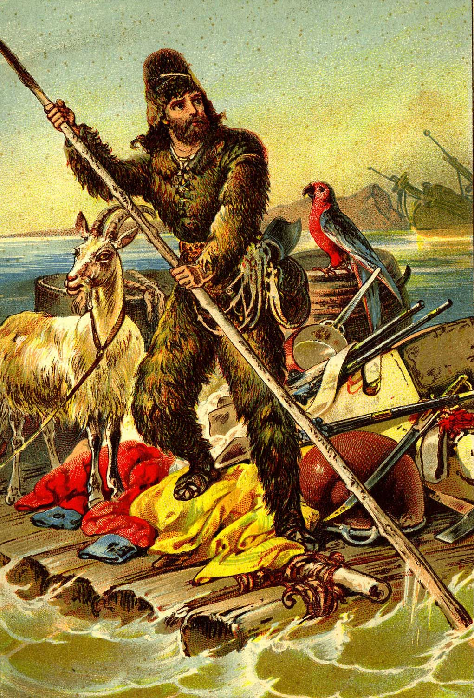
The theme of the chapter
The colonialism novel ROBINSON CRUSOE
Colonialism novel tells about adventure story
written by Daniel Defoe
published in 1719
Colonialism by the colonisator point of view
Dana Pastoricchio class 5^ASA a.s. 2017/2018

Slide 3
Structure of the chapter
argumentative text
the chapter is in turn divided into paragraphs in which each presents an aspect of colonialism
simple and direct language
analysis of the novel critically from the point of view of an external opinion
comparison with other colonial novels to highlight similarities and differences with Robinson Crusoe
Dana Pastoricchio class 5^ASA a.s. 2017/2018

Slide 4
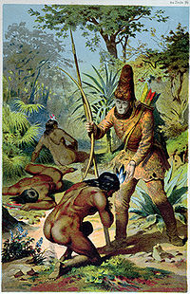
Presentation of the text (themes)
Definition of colonialism from the colonists' point of view
Presentation of the colonialist and capitalistic mentality of those years
presentation of the values matured during the colonial age:
Domination
power
origins
asymmetric position between colonisers and colonised (submission of colonisated)
Dana Pastoricchio class 5^ASA a.s. 2017/2018

Slide 5
object of the research: What is the perspective of the colonizers towards the colonized?
IN ALL LITERATURES OF THE COLONISTS:
Domination
Powerful
Standard life
Discovery and adventure
Imposes their origins
maintain the relationship between slave-master
IN ROBINSON CRUSOE he imposes to Friday his:
Language (He imposed his language, English)
Name (He gives Friday an European name)
Religion (He transforms Friday from a pagan savage to Christian slave)
Habits (He changes his cannibalistic attitudes )
Dana Pastoricchio class 5^ASA a.s. 2017/2018

Slide 6
elements in favor of the theme
ROBINSON CRUSOE
FRIDAY
Coloniser
European
Master
Civilized
Represents Literatures of the colonists
Colonised
Savage
Slave
Uncivilized
Represents Literature of the colonised
Dana Pastoricchio class 5^ASA a.s. 2017/2018

Slide 7
elements in favor of the theme
the island represents the utopian aspects of the ideology of the colonisers
Robinson uses domination to impose his his culture
Dana Pastoricchio class 5^ASA a.s. 2017/2018

Slide 8
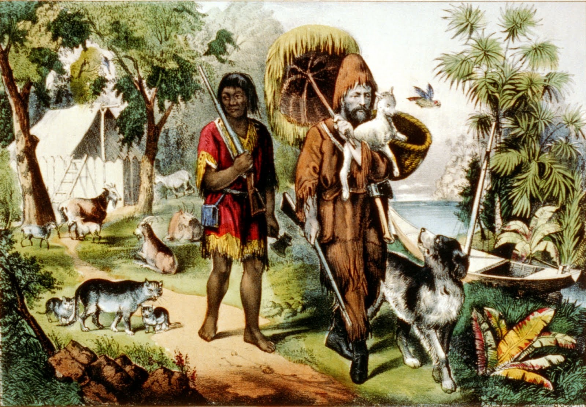
Personal consideration
the historical period influences the novels written at that time and colonialism influenced the writing of Defoe who presented in his novel the figure of the coloniser
Narrator underlines European mentality
Idea that economic and scientific power gives opportunity to dominate others
Dana Pastoricchio class 5^ASA a.s. 2017/2018

