Slide 1
POSTCOLONIAL LITERATURE
Presented by:
Clementin Emilio & Zamò Federico
I.I.S.S. “BASSA FRIULANA” - Polo liceale “A. Einstein” –
Cervignano del Friuli
ANNO SCOLASTICO 2017/2018
Cl. 5 ASA

Slide 2
KEY TERMS
ALTERITY →lack of identification, diversity.
DIASPORA → refers to any people or ethnic population forced or induced to leave their traditional ethnic homelands.
EUROCENTRISM → the practice of emphasizing European concerns, culture and values disadvantaging the other cultures.
HYBRIDITY →an important concept in post-colonial theory, it refers to the integration of cultural practices from the colonizing and the colonized cultures.
IMPERIALISM → the policy of extension of the authority over foreign countries to increase the European power. The term is used by some to describe the policy of a country in maintaining colonies and dominance over distant lands.

Slide 3
WHAT IS POSTCOLONIAL LITERATURE?
Two considerations :
all the postcolonial literary production took position against imperialism (political, linguistic and cultural domination)
European colonial powers (Eurocentrism) → colony
the word “post-colonial” should be understood
through the process of “decolonization”, when
the colonies obtained their independence from
European empires.

Slide 4
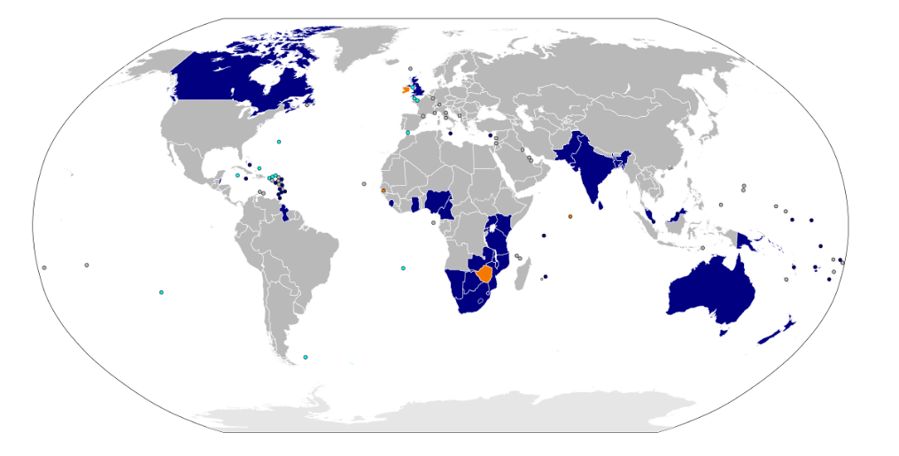
WHEN AND WHERE?
After the period called decolonization.
Postcolonial studies acquired prominence in the 1970s.
Publication of Edward Said’s book → Orientalism (1978)
Publication of Salman Rushdie’s text → The Empire writes back (1982)
It developed in all the colonies of the British Empire (actually members of the Commonwealth):
Africa
South America
Middle East
Ireland
India
Australia
New Zealand
Canada

Slide 5
WHY?
Postcolonialism is used to take position against imperialism and Eurocentrism
Political independence did not always lead to cultural indipendence from political, economic and cultural models
British English over local languages, writing culture over oral culture and highbrow culture over folk culture
Reactions :
There is who suggests a native identity and language
must be adopted to get back the lost cultural heritage
(minority).
and who prefers a «transnational» identity and criticizes
the post-colonial state (majority)

Slide 6
FEATURES
The writers of the colonized countries desire to protest against the former European powers using literature.
They highlight the problems related to Post-colonialism:
Identity
Culture and tradition
Belief and religion
Language
Location or sense of displacement
They use English to make their voice audible everywhere and as a provocation because it was the language of the British empire.

Slide 7
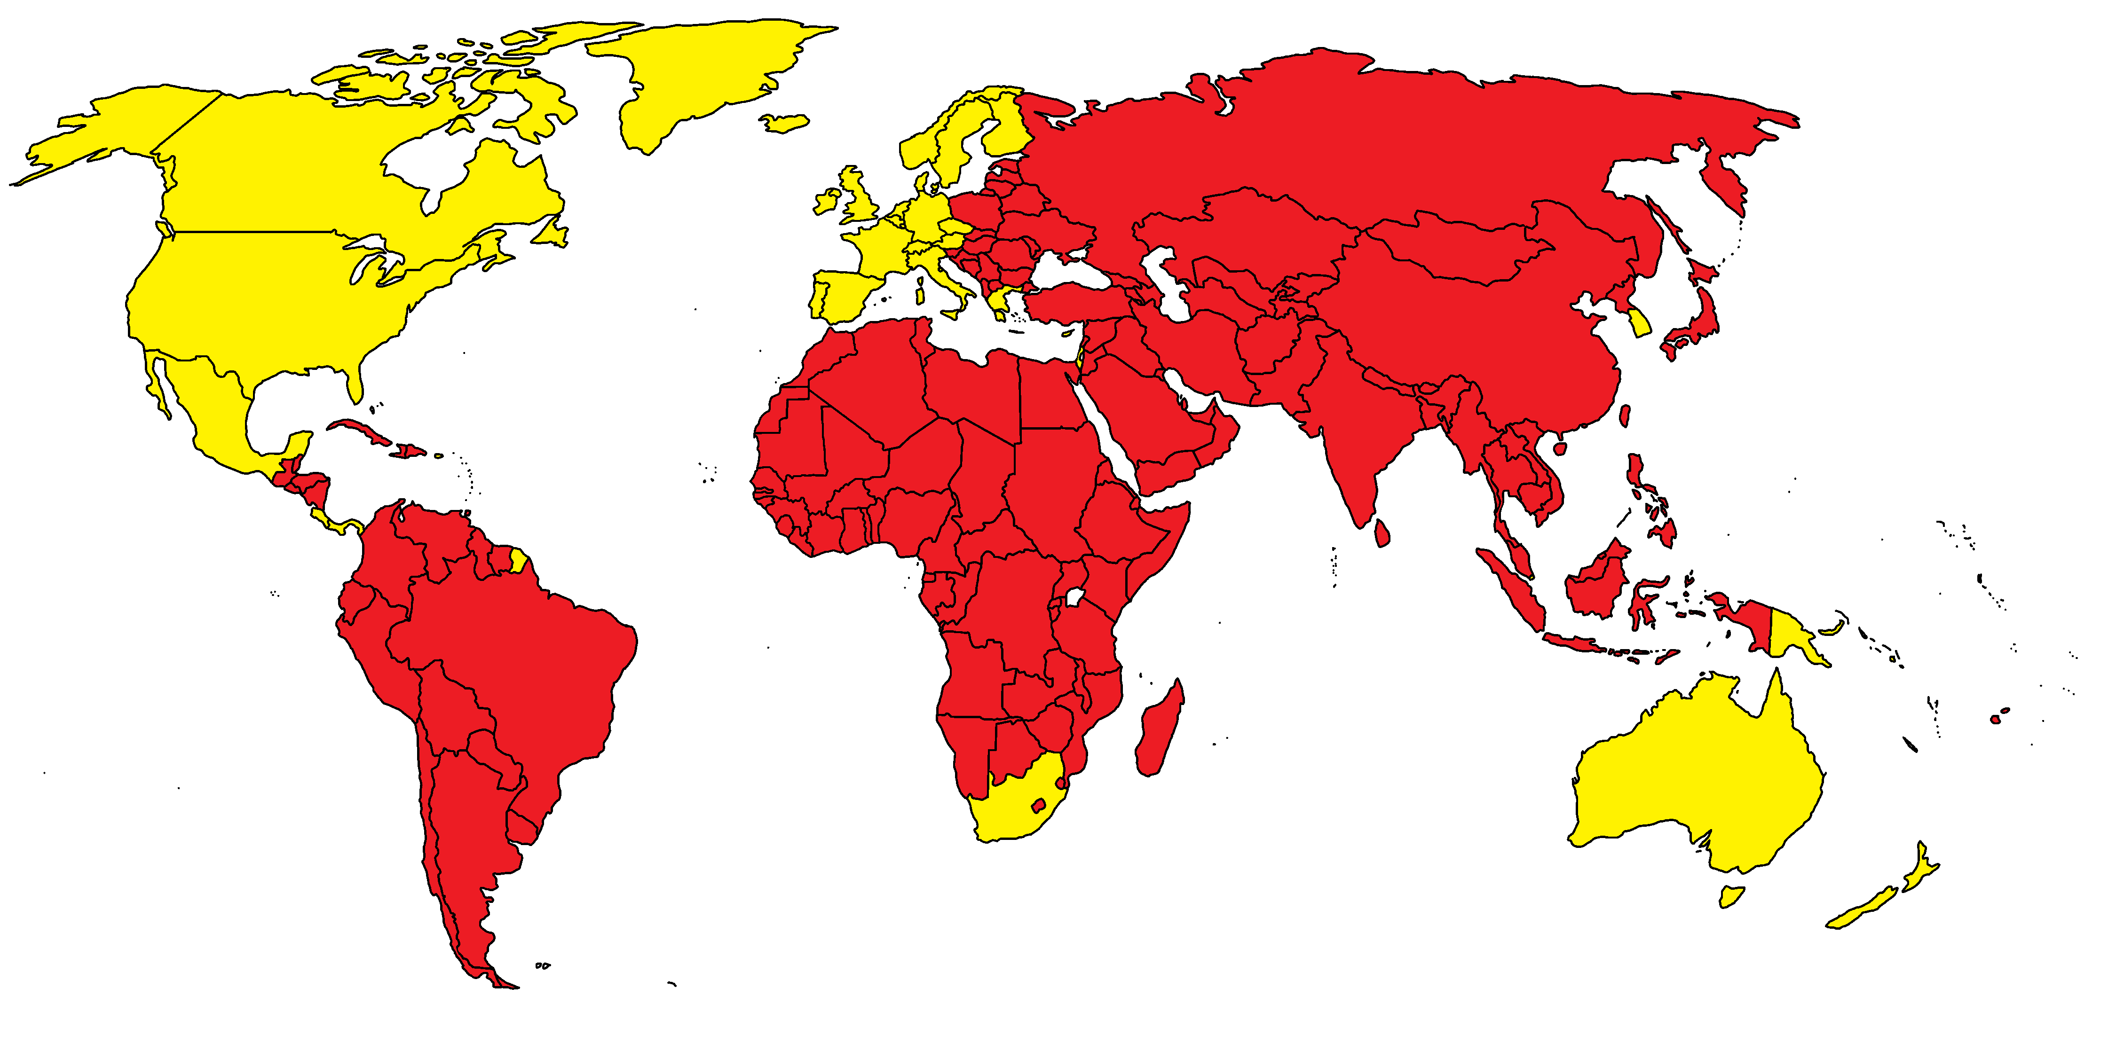
Postcolonial theory is built through the concept of otherness and the concept of resistence/opposition
The Western concept of the Oriental world is based on prejudices: if the West is ordered, rational, masculine and good, the Orient is chaotic, irrational, feminine, evil…. The writers want to change this prospective
Hybrid → referring to
the integration of cultural
signs and practices from
the colonizing and the
colonized cultures

Slide 8
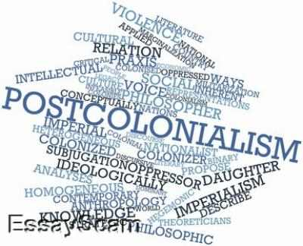
Writers claimed dignity for themselves and for the communities they belong to.
They represent a different voice in the debate about contemporary issues, and it is typical for the post-colonial period.

Slide 9
POSTCOLONIAL WRITERS
CHINUA ACHEBE (THINGS FALL APART, 1958)
NADINE GORDIMER (THE CONSERVATIONIST,1974)
SALMAN RUSHDIE (MIDNIGHT’S CHILDREN, 1981)
TASLIMA NASREEN (OPPOSITION, 1992)
MOHSIN HAMID (EXIT WEST, 2017)

Slide 10
POSTCOLONIAL WRITER: SALMAN RUSHDIE
Representative of Post-colonial literature
Use of literature to overturn the point of view about colonialism
«The Empire writes back»
Employment of magic realism

Slide 11
THE EMPIRE’S LITERATURE
DEVELOPED DURING XIX CENTURY (GROWTH OF THE BRITISH EMPIRE)
FOCUSED ON DEMONSTRATING THE SUPERIORITY OF WHITES
JUSTIFIED EUROPEAN DOMINATION IN THE WORLD

Slide 12
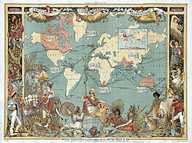
COLONIZATION
DIFFUSION OF BRITISH SYSTEM AND ORGANIZATION OVER THE COLONIES
IMPOSITION OF THE DOMINATING CULTURE
APPEARENT REASON: NEED TO CIVILIZE INDIGENOUS PEOPLE
REAL REASON: NEED TO
INCREASE THE EMPIRE’S
POWER

Slide 13
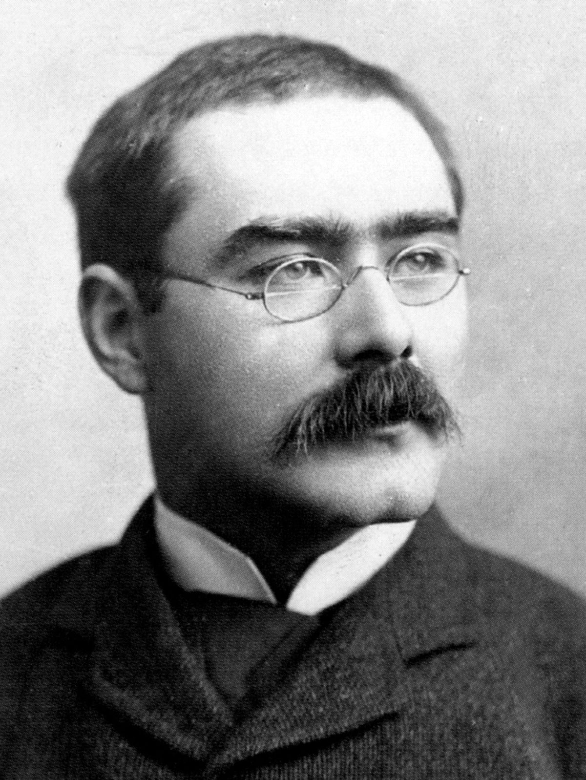
COLONIZER LITERAURE: RUDYARD KIPLING
Focused his studies on India
Justified the European supremacy using the idea that Western countries were more «developed»
Promoted the diffusion of civilization for colonized countries

Slide 14
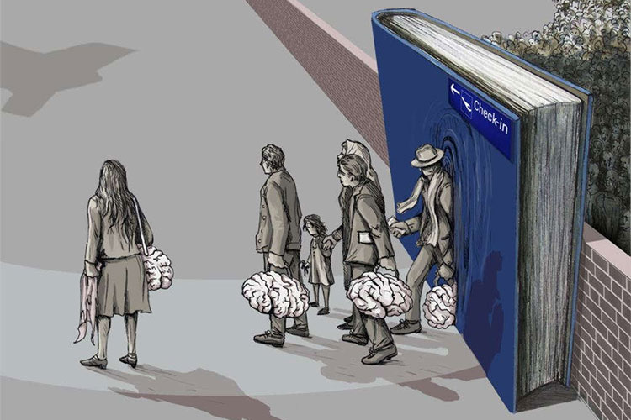
THEMES
Condition of exile
Racial conflict
Eradication of emigrants
Post-war migration
Migrations
Globalization
Struggle for individual and collective cultural identity and related
themes of alienation, unhomeliness , double consciousness and hybridity
Economic problem

Slide 15
STYLES
Innovative postmodern narrative styles
Use of ironical registers to take distance from the serious questions writers are dealing with
Current use of magic realism
Characters search identity in the novels

