Slide 1
Postcolonial Literature
Presented by
Dibarbora Mattia and Digiusto Mattia
I.I.S.S. “BASSA FRIULANA” - Polo liceale “A. Einstein” –
Cervignano del Friuli
ANNO SCOLASTICO 2017/2018
Dibarbora Mattia, Digiusto Mattia
cl. 5 ASA

Slide 2
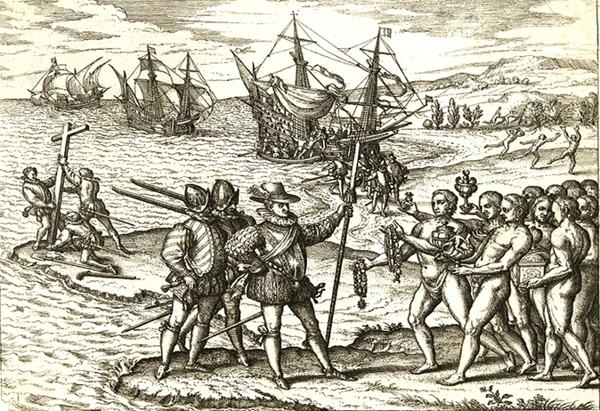
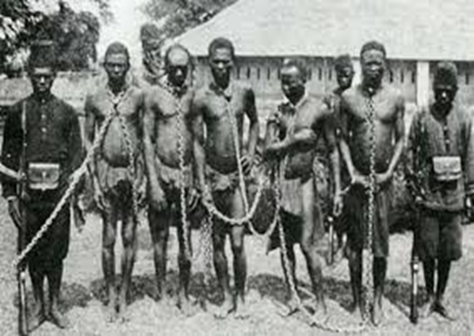

Slide 3
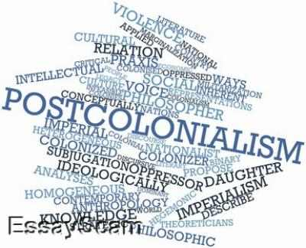
Main questions:
1. What does postcolonial literature mean?
2. Which were its causes and how did it develop itself?
3. Which are its characteristics?

Slide 4
Definition of the term ‘postcolonial’
‘Postcolonial‘ refers to both the period after colonisation and the one after independence (second half of the 20th century in general)
«Collection of theoretical and critical strategies used to examine the culture of former colonies of the European empires, and their relation to the rest of the world»

Slide 5
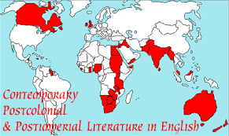
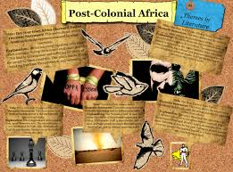
Definition of the term ‘postcolonial literature’
Literature written by people living in countries colonized by other nations
Study of the interactions between European nations and the societies colonized in the modern period

Slide 6
Definition of the term ‘postcolonial literature’
Problems with the definition due to:
- imprecision and lack of historical and material particularity
- Difficult identification and relationship between colonizers and colonies
- Troublesome and broad use of the term

Slide 7
How it developed itself
In response to colonial domination, from the first point of colonial contact to the present
‘postcolonial’ used to determine a position against imperialism and Eurocentrism
Imperialism: the policy of extending the control or authority over foreign entities as a means of acquisition and/or maintenance of empires
Eurocentrism: the practise of placing emphasis on European concerns, culture and values at the expense of those of other cultures

Slide 8
Major issues
Identity: it can be legal, social, cultural, sexual and artistic
Writers write of characters in search for their personal identity and historical roots

Slide 9
Major issues
Hybridity: it refers to the integration of cultural signs and practises from the colonizing and the colonized cultures
It deals with the assimilation and adaptation of cultural practises and the cross-fertilization of cultures
It can be political, social, linguistic, religious

Slide 10
Major issues
Culture and tradition
Belief and religion: coexistance of Animism with monotheism and tribal beliefs
Language: creation of new «Englishes»
Location and sense of displacement

Slide 11
The literature(s) of the colonized
It is based around the concept of otherness:
1. Otherness includes both identity and difference
2. Real difference between the Western and the Eastern world
3. Colonized people are highly diverse in their nature and traditions
4. They gradually transform themselves through time

Slide 12
The literature(s) of the colonized:
National or cultural literature helps to reconstitute the identity of the colonized people, but there are many difficulties owing to:
No tradition at all or literature influenced by Western one
Problem of adopting language (English or local languages?)
- A hybrid national literature
Different style and narrative strategies: magic realism
Prevailing use of the English language

Slide 13
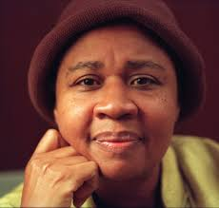
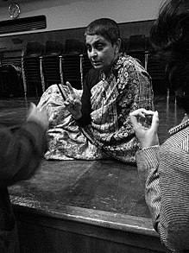
Main postcolonial writers
Edward Said
Homi Bhabha
Frantz Fanon
Gayatri Spivak
Chinua Achebe
Wole Soyinka
Salman Rushdie
Jamaica Kincaid
Buchi Emecheta
Edward Said
Salman Rushdie
Gayatri Spivak
Jamaica Kincaid
Homi Bhabha

Slide 14
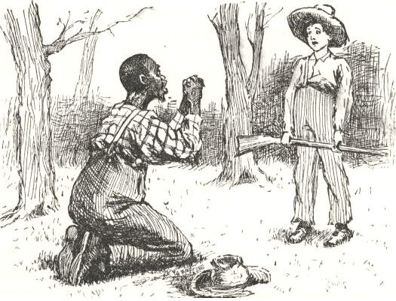
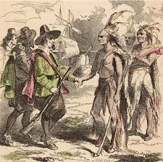
The literature(s) of the colonists:
Their ideology implied the Anglo-European culture as the most civilized, sophisticated, or metropolitan.
Based on the colonizers’ assumption of their own superiority
Colonists had to adapt to the new realities’ traditions and developed a hybrid literature as well, with the use of myths, symbols and definitions of different traditions

Slide 15
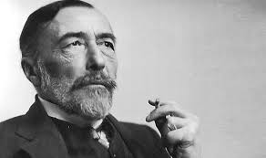
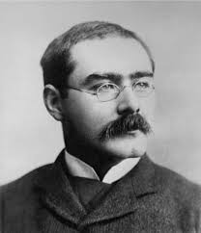
Main postcolonial writers (colonizers)
- Rudyard Kipling
- Joseph Conrad
- Alan Paton
Joseph Conrad
Rudyard Kipling

Slide 16
THANK YOU FOR YOUR ATTENTION

