Slide 1

Colonial Representation
Nourin Binte Saaed
Credits
Dibarbora Mattia and Digiusto Mattia
Liceo scientifico Scienze Applicate “A. Einstein”
A.S. 2017/2018
cl. 5 ASA

Slide 2
Structure of the document
Abstract: introductory function
Introduction: a more detailed explanation about the main concepts analysed in the document
Chapter-I: Representation of the Colony: Subjugation, Domination and Power in Robinson Crusoe
Chapter-II: Geography, Vice and Imperialist Ideology: Conrad’s Heart of Darkness
Chapter-III: Colony, People and Culture: Forster’s A Passage to India

Slide 3

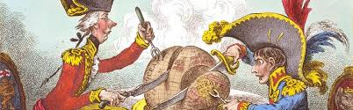
Colonialism
All the novels deal with colonialism, defined as an occupation of some territories by a stronger country for political and economic reasons
Ideals of power and domination
Subjugation of the white race over “inferior people”

Slide 4
Robinson Crusoe
Adventure story written by Daniel Defoe and published in 1719
Relationship between two characters, Robinson and Friday
Robinson
Friday:
Coloniser
Civilized
Master
European
Christian
Colonized
Uncivilized
Slave
Savage
Pagan

Slide 5
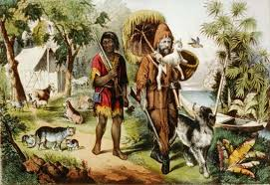
Robinson Crusoe
Robinson Crusoe is a coloniser since he changes Friday’s language, religion, habits and name
Friday’s identity, body and mind have been strongly shaped by Crusoe

Slide 6
Robinson Crusoe
Language: Robinson uses English language as a medium of teaching and learning on the island
Name: Robinson gives a name to the savage, proving whether he is European or not
Religion: Robinson through the learning of Christian knowledge transforms Friday from a pagan savage to Christian slave
Habits: Robinson changes his cannibalistic attitudes and the savage behaves more like an European and seems faithful and devote to his master

Slide 7
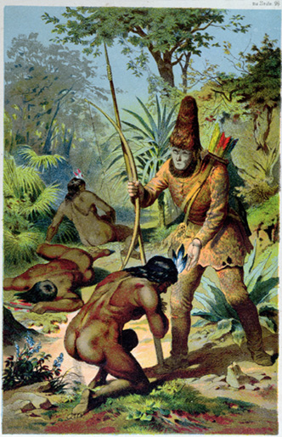
Robinson Crusoe
Discovery and Adventure: Robinson’s aim , as a colonialist and merchant, is to discover new places in the world and take advantage from the exploitation of the land.
Robinson represents the colonialist and capitalistic mentality of those years

Slide 8

Heart of Darkness
It was written in 1899 by Joseph Conrad
It denounces the colonialist activities in the Belgian Congo
It shows a clear relationship between concepts of colonialism and imperialism

Slide 9
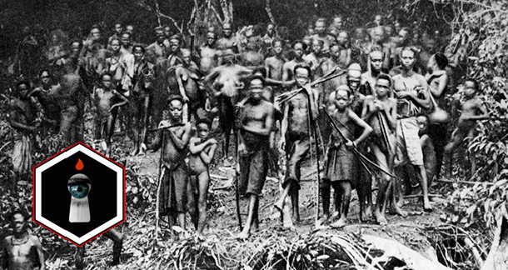
Heart of Darkness
Conrad demonstrates the distinction between :
Black and white
Good and evil
Purity and violetation
Civilization and uncivilization

Slide 10
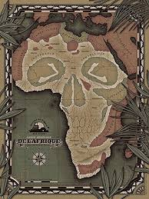

Heart of Darkness
.
Two key characters:
Marlow: he notices and denounces the brutal and violent behaviour of the colonisers
Kurtz: he represents the colonialist attitude since he subjects native people and works with ivory commerce; natives consider him as a God, suggesting colonizers’ superior abilities

Slide 11
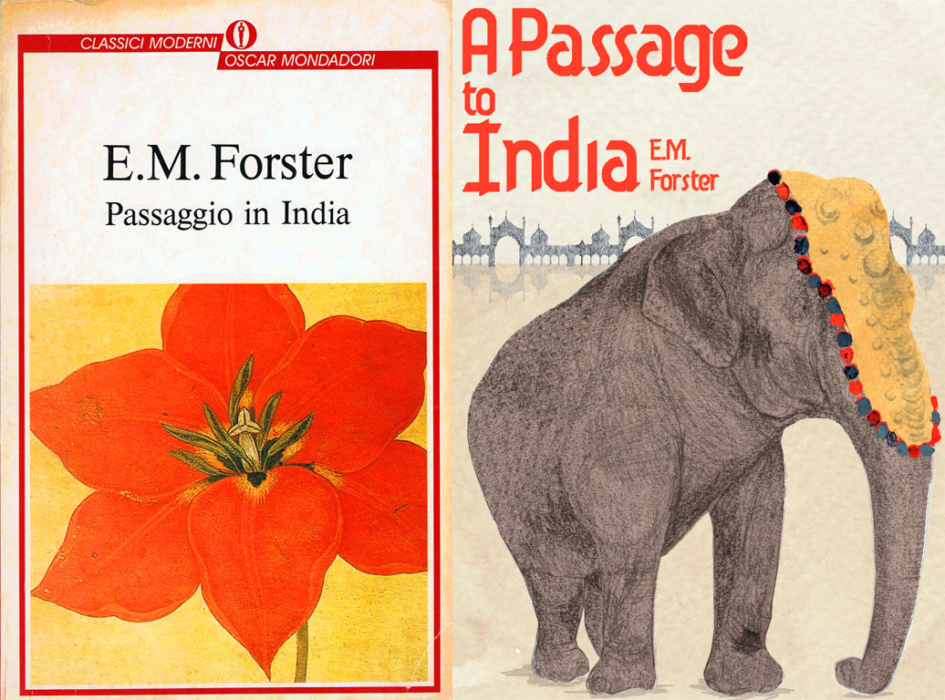
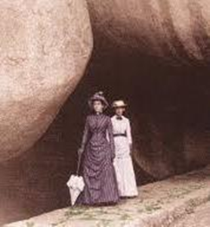
A passage to India
It was published in 1924 by E.M. Forster.
It is a social, philosofical and political novel.
It deals with a critique of the British rule in India (English create justice, unity in India keeping it in peace)

Slide 12
A passage to India
The chapter represents:
Image of India: land, geographical explorations, native culture, division in castes, exotic places
the clash between cultures of the East and the West, between Indians and Anglosaxons
Concept of racialism and the relationship between colonisers and colonised: English are rational while Indians are irrational and superstitious → English superiority and Eurocentric point of view

Slide 13

Conclusion
Direct, objective and formal language as it is thesis of graduation
Daniel Defoe, Joseph Conrad and E.M. Forester’s works all deal with the issue of colonialism, imperialism and racialism

Slide 14
THANKS FOR YOUR ATTENTION

