Slide 1
Postcolonial Literature
Polo Liceale “A.Einstein”
Cervignano D. Friuli
5 ASA
Gregoretti Massimiliano
Pommella Gianluca

Slide 2
WHAT MEANS “POSTCOLONIAL LITERATURE”?
The adjective Postcolonial refers to:
  The period after colonisation
  The period after independence
  Any writing critical of colonialism
Is the literature produced by writers of the former British colonies

Slide 3
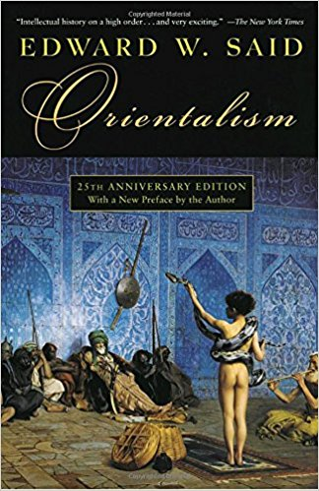
WHEN IT WAS BORN AND WHY?
It was born in 1978 when Edward Said's book “Orientalism” was published
The book is a critic to the Western constructions of the Orient

Slide 4
WHEN IT WAS BORN AND WHY?
Postcolonial Literature's goals are:
  contrast the distorts experience and realities of colonized people convaided by the colonizing culture
  articulate the identity of the colonized, who try to reclaim their past in the face of the past's inevitable otherness

Slide 5
WHAT ARE IT'S MAIN FEATURES?
Postcolonial Literature is based on concepts like:
  Otherness
  Resistance
  Hibridity

Slide 6
WHAT ARE IT'S MAIN FEATURES?
Postcolonial Literature is based on “Resistance” interpreted as subversion, opposition or mimicry
The concept of Resistance is related to ideas like liberty, identity, individuality and human freedom

Slide 7
WHAT ARE IT'S MAIN FEATURES?
Otherness is defined as lack of identifications with some part of one's personality or one's community
The concept of “Otherness” is related to impossibility to reconstituate their pasts, but only revisit and realize it in partial fragmented ways

Slide 8
WHAT ARE IT'S MAIN FEATURES?
Postcolonial Literature is based on “Hibridity” in the sense that both the colonized and colonizing cultures have been changed by Colonialism
Hibridity is related to the cross fertilization of culture that can be seen as enriching as well as oppressive

Slide 9
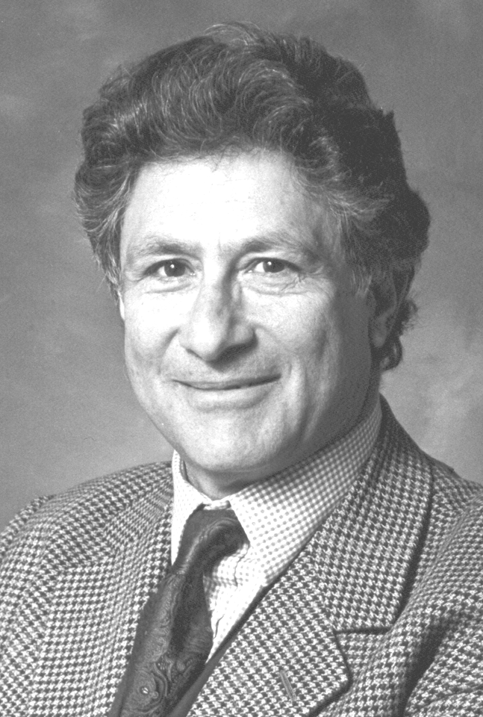

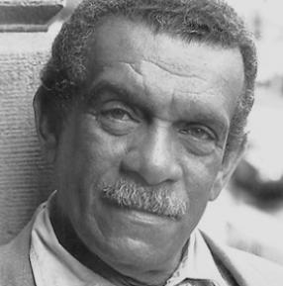
MAJOR FIGURES
Edward Said
Salman Rushdie
Derek Walcott

Slide 10


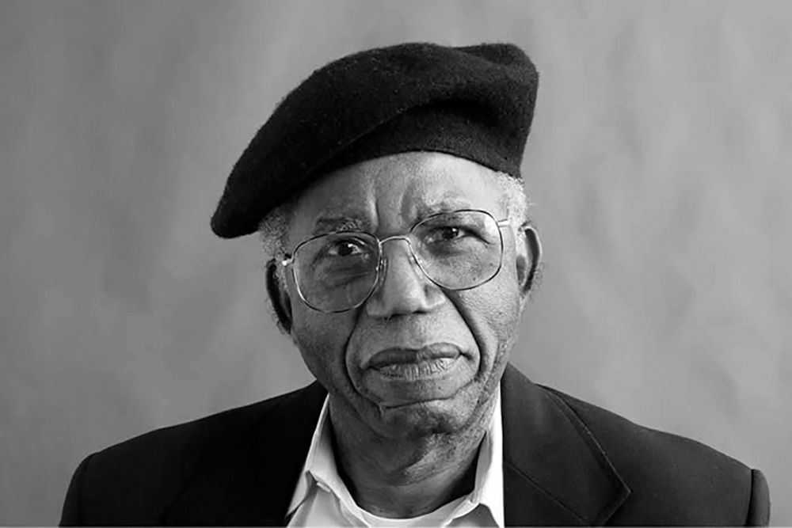
MAJOR FIGURES
Bill Ashcroft
Homi Bhabha
Chinua Achebe

Slide 11
BIBLIOGRAPHY
http://www.marilenabeltramini.it/schoolwork1718/UserFiles/Admin_teacher/postcolonialism.pdf
http://www.marilenabeltramini.it/schoolwork1718/UserFiles/Admin_teacher/postcolonial_literature.pdf
http://www.marilenabeltramini.it/schoolwork1718/UserFiles/Admin_teacher/postcolonial_response.ppt

