Slide 1


COLONIAL REPRESENTATION
Liceo Scientifico "Albert Einstein" Opzione Scienze Applicate
A.S. 2017/2018
CREDITS:
Busdon Rocco

Slide 2
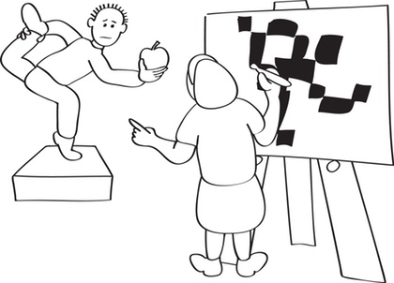
What does ‘representation’ mean?
It is the presentation of an object, individual, idea or entity not by drawing it as it is but by “representing” it or preparing it in a new structure or a new form.

Slide 3
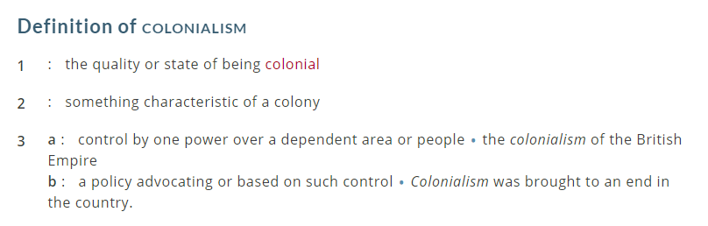
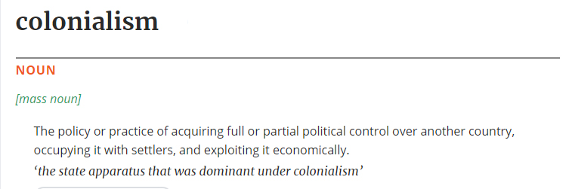
What does ‘Colonialism’ mean?

Slide 4
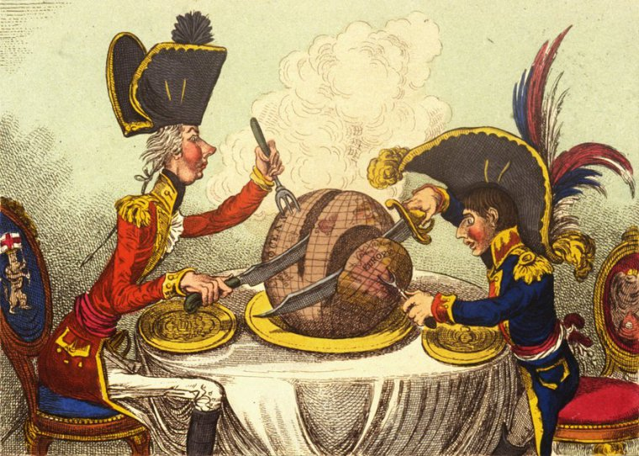
What does ‘Colonial Representation’ mean?
It is a false ideology that makes colonizers feel superior towards colonists
Until Colonial Representation exist, there will always be racism or favoritism among races.

Slide 5
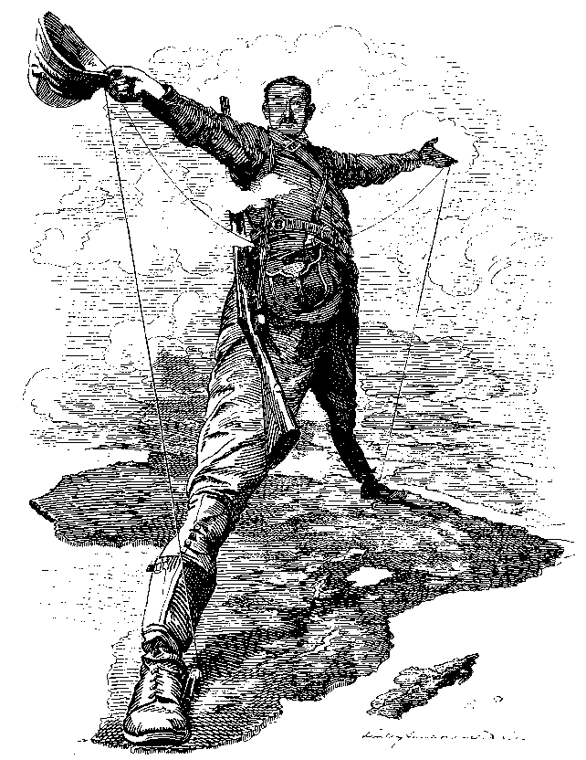
Europeans’ ideology and vision
Colonists are seen like dark, uncivilized, inferior, wild, dangerous and inferior.
There’s a process of discrimination, inequality and alienation towards colonists.

Slide 6
Europeans’ ideology and vision
Colonists must learn european’s cultures to get civilized
White supremacy is legitimized by the history.
The economic power legitimite the process of subjugation of the colonists

Slide 7


Colonial representation’s problem: hybridity
It is a problem that reverses the effects of the colonialist disavowal
It means that all cultural aspects of a culture will blend with the ones of another culture
Key concept: Salad Bowl vs Melting Pot

Slide 8

Colonial representation’s problem: otherness
It is a lack of identifications with something of someone’s personality in a community or the community itself
The behave of colonizers who rules colonists as master bring to a inferiority complex

Slide 9

Colonial representation’s problem: identity
It is the ability of stay connected to your roots even if you are forced to learn a different culture
It is the characteristic that allow you to understand who you are for real

Slide 10
Colonizer’s key novels
Key novels to understand the European idea of colonisation:
Robinson Crusoe, by Daniel Defoe
Hearth of Darkness, by Joseph Conrad
A passage to India, by Edward Morgan Forster

Slide 11
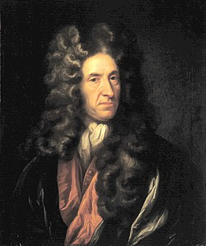
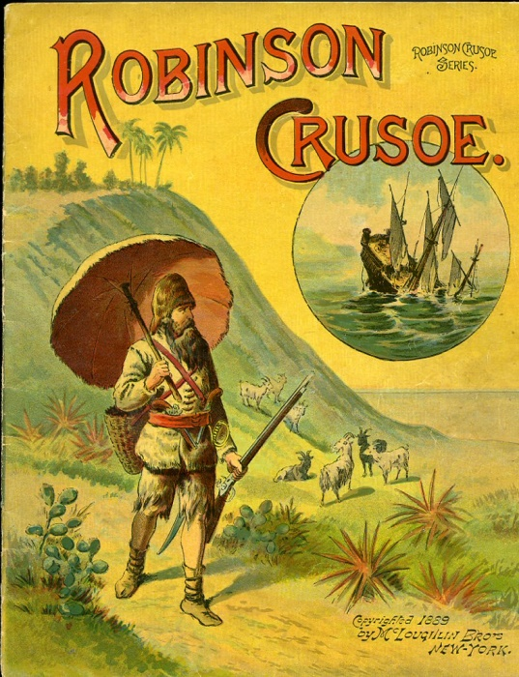
Robinson Crusoe
It was published in 1719 by Daniel Defoe
It is an adventure novel
It represents the relationship between colonizers and colonists

Slide 12
Robinson Crusoe
Robinson Crusoe submitted Friday to his will
Friday must learn Robinson’s culture and language
Key concepts of racism, identity, relationship between master and slave

Slide 13
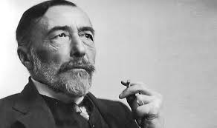

Hearth of Darkness
It was published in 1899 by Joseph Conrad
It is an adventure novel
The novel reports the overuse of power towards colonists

Slide 14
Hearth of Darkness
Contrasts between the use of power in Europe and in Africa
Representation of a capitalistic mentality
Exposes the colonists’ vision of the colonizers

Slide 15
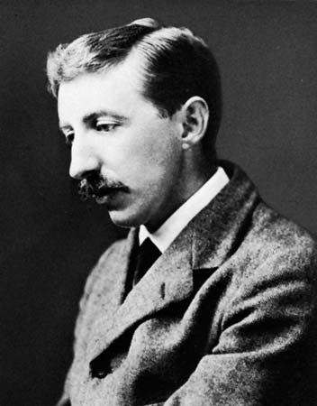

A passage to India
It was published in 1924 by Edward Morgan Forster
It is a report of the English’s abuse of power in India

Slide 16
A passage to India
Unjustice of Colonialism: English superiority
Eurocentrism point of view
Key concepts of identity, otherness, superiority

