Slide 1
POSTCOLONIAL LITERATURE
by R. Busdon and A. Moratti
Polo Liceale ‘A. Einstein’ Cervignano del Friuli

Slide 2
What does the term ‘postcolonial’ mean?

Slide 3
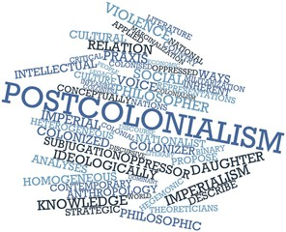
Definition of ‘postcolonial literature’
Postcolonial literature can be summarized as the literature of the countries that were once colonised by European countries. It often deals with themes such as the cultural independence, the consequences of colonization and racialism.

Slide 4
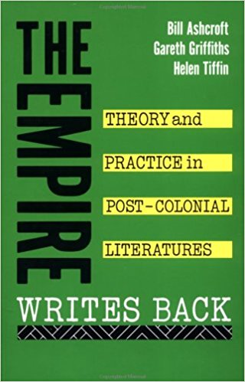
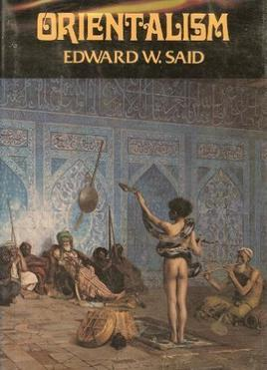
The origins of the term
The term ‘postcolonial literature’ was born since the publication of Edward Said’s ‘Orientalism’ in 1978.
It was consolidated by the appearance in 1989 of The Empire Writes Back: Theory and Practice in Post-Colonial Literatures by Bill Ashcroft, Gareth Griffiths and Helen Tiffin.

Slide 5
The origins of the term
Political independence did not always lead to cultural independence
necessity of create a form of freedom against those limits

Slide 6
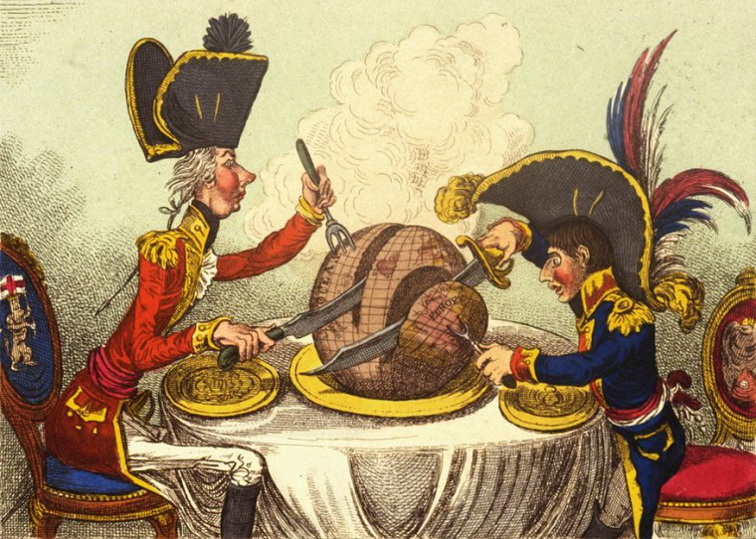
Features of Postcolonial literature
Postcolonialism literature take position against imperialism and Eurocentrism.
All postcolonial literature products were written and made in the language of the colonizers.
Postcolonial literature’s key concepts: resistance, otherness and hibridity.

Slide 7
Resistance: issue of Postcolonial Studies
It is related to ideas like liberty, identity, individuality and human freedom
Writers write of rebel characters who fight for their rights.
Resistance is interpreted as subversion, opposition or mimicry

Slide 8
Hybridity: issue of Postcolonial Studies
It refers to the integration of culture of colonizing and colonized cultures.
It means that all cultural aspects of a culture will blend with the ones of another culture.
Key concept of Salad Bowl vs Melting Pot.

Slide 9
Otherness: issue of Postcolonial Studies
It is a lack of identifications with something of someone’s personality in a community or the community itself.
It is related to the impossibility to walk back towards their pasts, but only to watch at it like a fragmentary puzzle.

Slide 10
The literature(s) of colonized
Racism and discrimination from colonists
Change of culture and people through time
The use of English became the favorite one from colonists

Slide 11
The literature(s) of colonists
Colonists help the develop of colonizer’s culture and society.
Based on the colonizers’ assumption of their own superiority.
Colonists had to face the inverse phenomenon: globalization.

Slide 12
Major Postcolonial writers
Edward Said
Homi Bhabha
Frantz Fanon
Gayatri Spivak
Chinua Achebe
Wole Soyinka
Salman Rushdie
Jamaica Kincaid
Buchi Emecheta
Salman Rushdie
Edward Said
Homi Bhabha

Slide 13
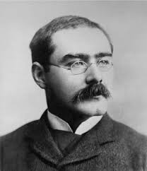
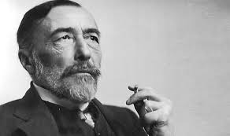
Main writers of the colonizers
Rudyard Kipling
Joseph Conrad
Alan Paton
Rudyard Kipilng and the cover of the novel ‘The Jungle Book’
Joseph Conrad and the cover of the novel ‘Hearth of Darkness’

Slide 14
Fin.
THANKS FOR YOUR ATTENTION

