Slide 1

COLONIAL REPRESENTATION
Credits:
Carinola Raffaele, Gregoretti massimiliano, pommella gianluca
Liceo Scientifico «Albert Einstein» Opzione Scienze Applicate.
A.S. 2017/2018

Slide 2
What does «Representation» mean?
Representation can be defined:
As the act of representing.
As the presentation of an object, individual, idea or entity not by drawing it as it is but by “representing” it or preparing it in a new structure or a new form.

Slide 3
What does «Colonialism» mean?
Colonialism has many definitions:
Colonialism is the control or governing influence of a nation over a dependent country, territory or people.
Colonialism is the system or policy by which a nation mantains or advocates such control or influence.

Slide 4
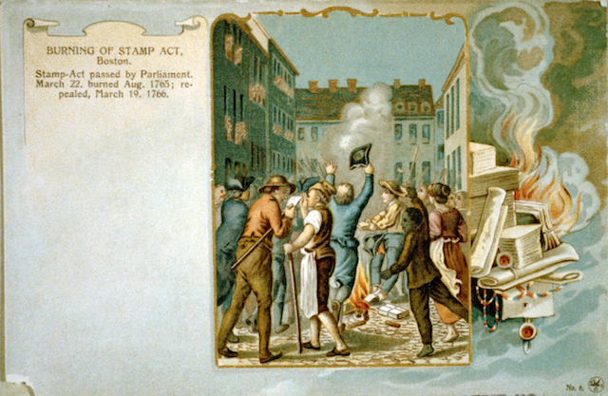
What is Colonial representation?
It presents semiotic meanings in which words, characters or situations often express contradictory attitudes.
It is a political representation that cannot be “natural” or “true”.

Slide 5
What are its main features?
It is constructed with false images, images that relate with colonizers ideology.
It is characterized by uniqueness:
  Colonized countries always loses their identity
It is strictly linked with racism:
  Colonized people were considered inferior

Slide 6

Colonisers’ main novels
There are three main colonisers’ novels that conveys the idea of colonisation:
“Robinson Crusoe” by Daniel Defoe.
“Heart of Darkness” by Joseph Conrad.
“A Passage to India” by Edward Forster.

Slide 7
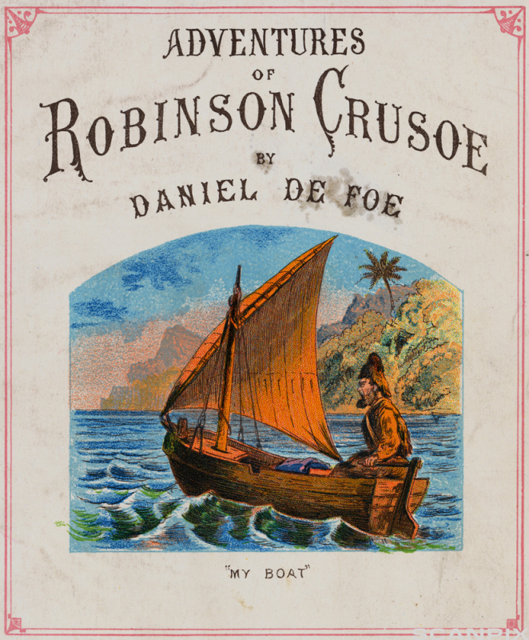
Robinson Crusoe
It’s an adventure story.
It presents the relationship between Robinson and Friday.

Slide 8
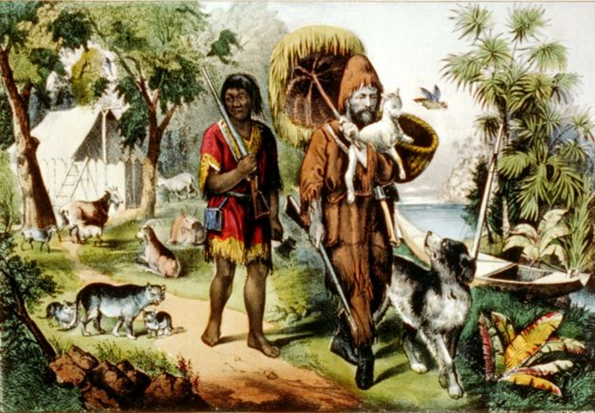
Robinson Crusoe
Robinson is a coloniser.
Friday is a colonised.
The novel conveys the idea of racism, power identity by pointing out the way Robinson treats Friday.

Slide 9
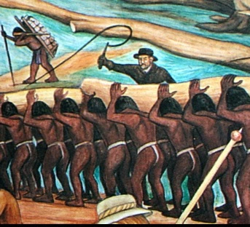
Robinson Crusoe
Robinson can be considerated as a master
Friday can be considered as a slave
The master imposes the slaves his culture

Slide 10

Heart of Darkness
Adventure novel
It denounces the European’s colonialism

Slide 11

Heart of Darkness
The novel presents
various themes:
Enslavement.
Colonisation.
Differences between
European’s and
African’s laws.

Slide 12
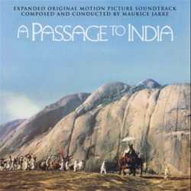
A passage to India
Satire and denounce novel.
It presents the British rule in India.
It underlines the injustice of colonialism.

Slide 13
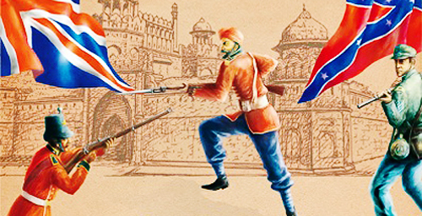
A passage to India
India is presented as a expansion of the British Empire.
It is characterized by conflicts.
Colonialism is criticized.

Slide 14
A passage to India
The novel can be divided into three sections:
The first one underlines the Indians’ emotions
The second one focuses on the Intellects
The third one rest on the emotions of love, devotions and sense of identity.

