Slide 1

POSTCOLONIAL LITERATURE
Short summary and its main feature
I.I.S.S. “BASSA FRIULANA” - Polo liceale “A. Einstein” –
Cervignano del Friuli
ANNO SCOLASTICO 2017/2018
Raffaele Carinola

Slide 2
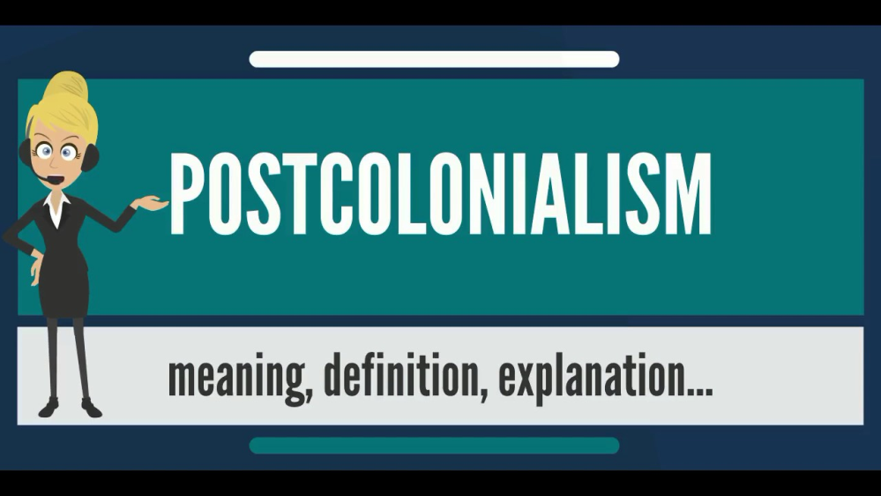
What is its definition?
Postcolonialism has various definitions:
Postcolonialism or postcolonial studies is the academic study of the cultural legacy of colonialism and imperialism, focusing on the human consequences of the control and exploitation of colonised people and their lands

Slide 3
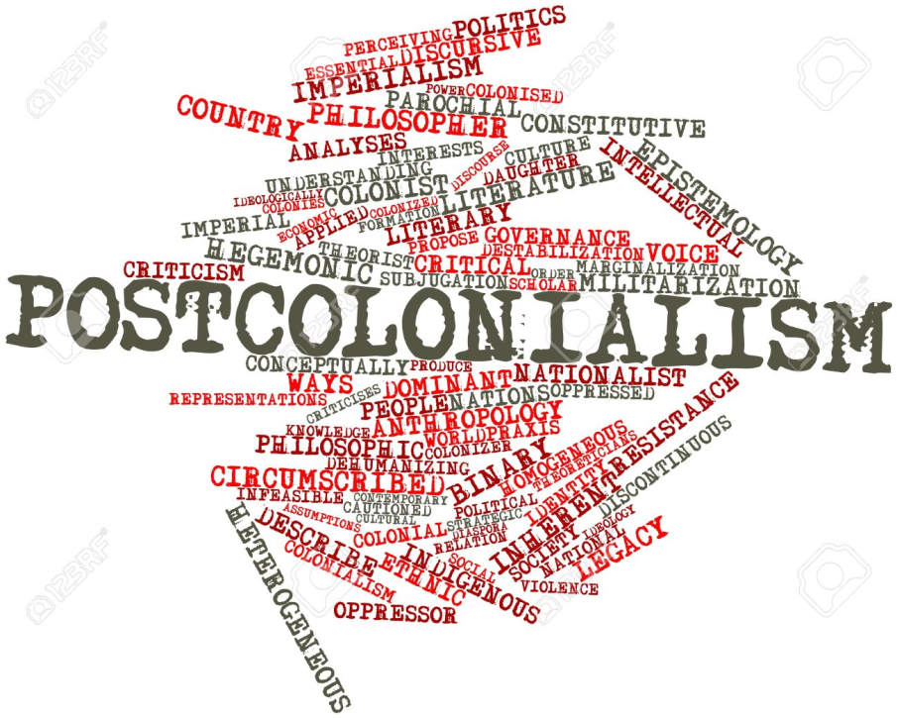
What is its definition?
Postolonial is a theoretical approach in various disciplines that is concerned with the lasting impact of colonization in former colonies.
Postolonial is the political or cultural condition of a former colony.

Slide 4
What are its main features?
Valorization of Cultural Identity:
  Postcolonial writers change the idea that cultures of colonized peoples were inferior
Nationhood and Nationalism:
  A lot of these writers are very patriotic
  They write books on behalf of their nations.
  Their work is often nationalist, because postcolonial writers like to highlight and valorize their nation's cultural, political and social identity

Slide 5
What are its main features?
Appropriation of Colonial Languages:
  Authors use native language within their writing
Rewriting History:
  The British wrote the histories of the empires they conquered. Postcolonial writers don't like this version of history.
  Postcolonial writers set about writing history from their own perspective, showing how colonialism was actually a pretty violent, terrible thing.

Slide 6

What are its main features?
Postcolonial Literature's goals are:
  The contrast the distorts experience and realities of colonized people convaided by the colonizing culture
  Articulate the identity of the colonized, who try to reclaim their past in the face of the past's inevitable otherness

Slide 7
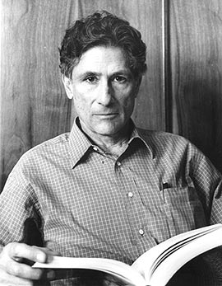
Major figures
Edward Said:
He’s known for the book Orientalism (1978), a critique of the cultural representations that are the bases of Orientalism.

Slide 8

Major figures
Salman Rushdie:
Sir Ahmed Salman Rushdieis a British Indian novelist and essayist.
His work is concerned with the many connections, disruptions, and migrations between Eastern and Western civilizations.

Slide 9

Major figures
Bill Ashcroft:
One of his most significant and important works during his life is the contribution he give to the book: The Empire Writes Back

Slide 10
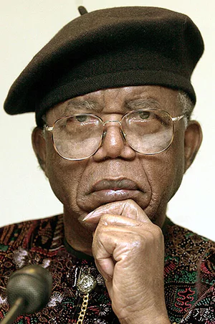
Major figures
Chinua Achebe:
Albert Chinualumogu Achebe, was a nigerian novelist, poet, professor, and critic.
He’s considered the father of Modern African Literature.

Slide 11
Bibliography
http://www.marilenabeltramini.it/schoolwork1718/UserFiles/Admin_teacher/postcolonialism.pdf
http://www.marilenabeltramini.it/schoolwork1718/UserFiles/Admin_teacher/postcolonial_literature.pdf
http://www.marilenabeltramini.it/schoolwork1718/UserFiles/Admin_teacher/postcolonial_response.ppt

Slide 12
Bibliography
https://en.wikipedia.org/wiki
https://en.wikipedia.org/wiki/The_Empire_Writes_Back
https://post-colonialism.weebly.com/features-of-post-colonialism.html
https://www.britannica.com/event/postcolonialism

Slide 13

THE END
THANK YOU FOR YOUR ATTENTION

