Slide 1
POSTCOLONIALISM
Simone Cattaruzzi 5 ASA
I.S.I.S. ”Bassa Friulana”- Polo liceale “A. Einstein”
Cervignano del Friuli, Anno Scolastico 2017-2018

Slide 2
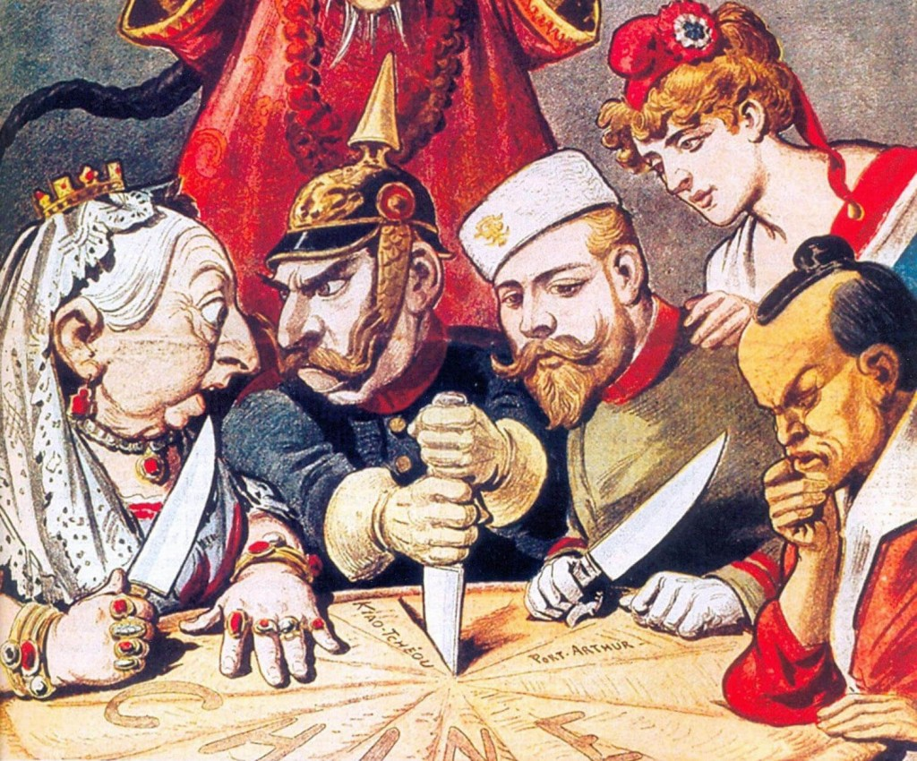
Colonialism
The European power
Their behaviour toward the native
How the colonizers rule
Integration or disintegration of cultures
The aim of the colonizers

Slide 3
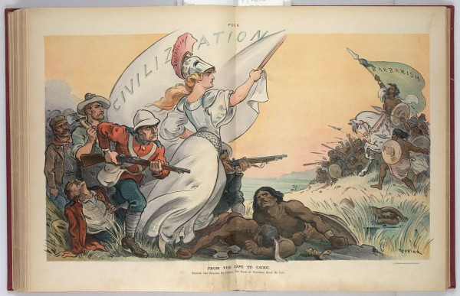
Colonial literature
"The White Man's Burden: The United States and the Philippine Islands” by Rudyard Kipling
Development of English’s values

Slide 4
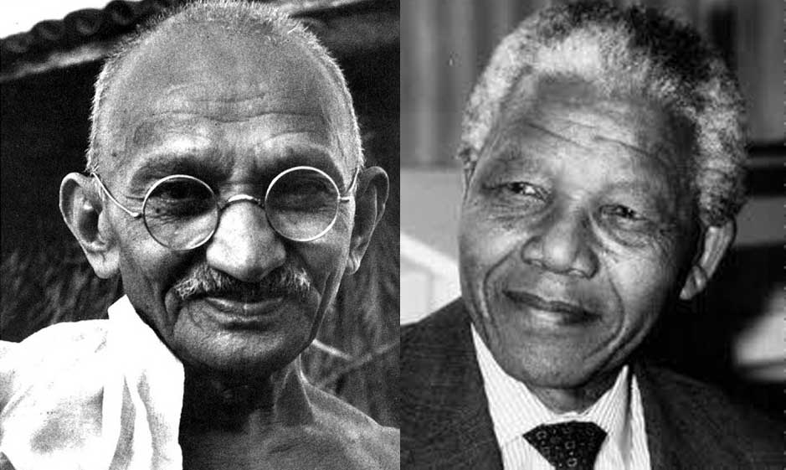
Decolonisation
It’isn’t a historical period
Differently from every country:
Settlers
Non-settlers
Partially settled

Slide 5
Postcolonialism
Definition:
Of, relating to, or being the time following the establishment of independence in a colony
Coutries that gain the total independence and relevant power in world politics
Different situations
Only political independence

Slide 6
Similarity
The influence of colonizing culture
The question of identity, the concept of hibridity
The impossibility to return to the past
The issue of language and culture

Slide 7
Dissimilarity
How to gain the indipendence
The relation between the center of the Empire
The history of every country before colonialism
New phase of immigration
The idea of a transnational culture

Slide 8
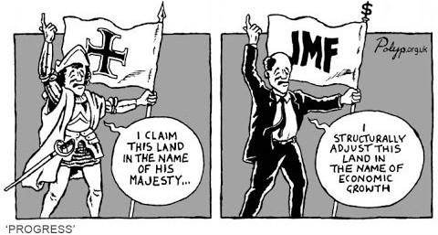
Neocolonialism
The Industrial Revolution
The march of neocolonialism
Capitalism
Globalization

Slide 9
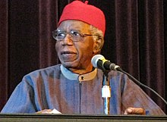
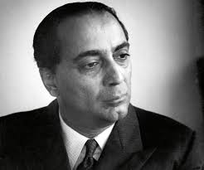
Postcolonial literature
How face the Imperialism
The issue of language and identity
Transnational identity
The characteristic
Chinua Achebe
Salman Rushdie
Homi Bhabha

Slide 10
Language
The language trasformations
Differently of every writer:
Return to the past
Live in the present

Slide 11
The purpose
Facing Imperialism and Eurocentrism
Social and racial oppressions
Otherness
The migrants

Slide 12
Post-Colonial issues
Identity
Culture and tradition
Belif and religion
Sense of displacement

Slide 13
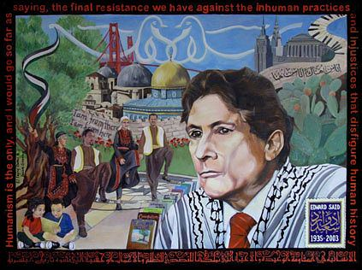
Postcolonial theory
Human freedom
Liberty
Identity
Individuality

Slide 14
The migrants
Migration
Multicultural
Transnational culture

Slide 15
THE END

