Slide 1

Colonial representation in: “Robinson Crusoe”, “Heart of Darkness” and “a Passage to India”
Credits:
Cattaruzzi Simone and Moratti Alex
5 ASA
I.S.I.S. ”Bassa Friulana”- Liceo Scientifico “ A. Einstein”, sezione Scienze Applicate
Cervignano del Friuli, Anno Scolastico 2017-2018

Slide 2
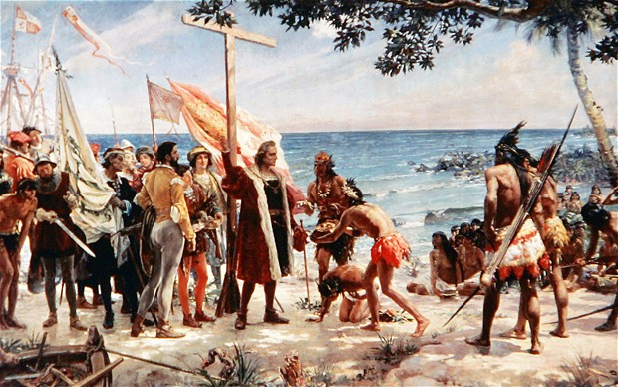
The aim of the Abstract
Denying the idea of colonised that was created by colonisers, with the purpose to subject colonised people
To condemn the European domination based on the binary vision of the world

Slide 3
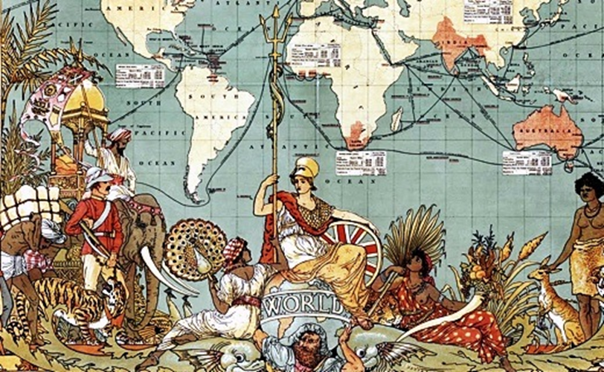
Colonialism
The domination of the powerful over the less powerful was justified by the Colonial literature
It conveys the idea of colonised as “others and inferior”, thus they be subject to colonisers
Colonial representation creates a false image of colonised to control them: it is a political representation that aren’t real

Slide 4

The colonialism can be seen in the postcolonial novels
An example of three European novels are:
Robinson Crusoe by Daniel Defoe
Heart of Darkness by Joseph Conrad
A Passage to India by E. M. Forster

Slide 5
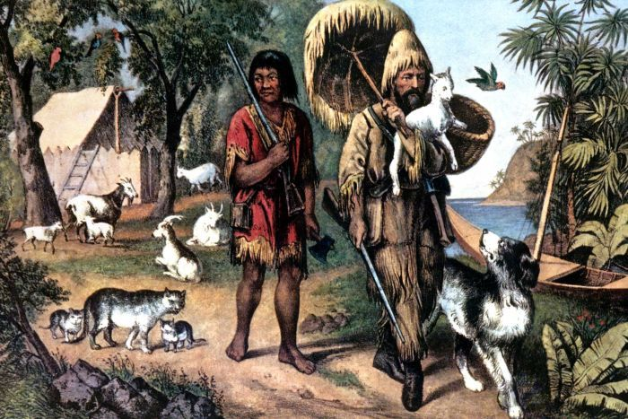
Colonial literature: Robinson Crusoe
It seems only a adventure novel, but it justifies European attempts to colonise other countries
Robinson reflects the idea of European man, while Friday reflects the idea of colonised
Robinson becomes Friday’s master
Friday changes his habits
Robinson’s aim is to improve his situation

Slide 6
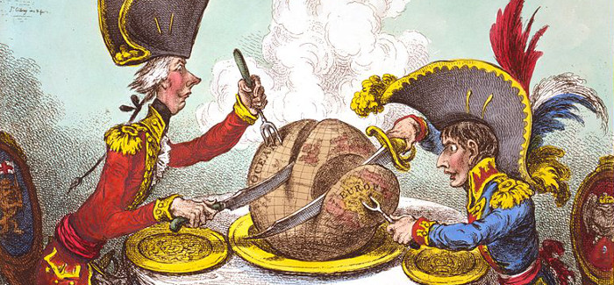
Representation of the colony
Subjugation: European sense of superiority, Robinson puts his foots on Friday’s head
Natives are represented as cannibals and wild differently from and civilised and respectful Europeans
Domination: Robinson imposes his culture and traditions to control natives
Friday speaks with his master’ s words and imitates his actions
It creates a Crisis of Identity

Slide 7
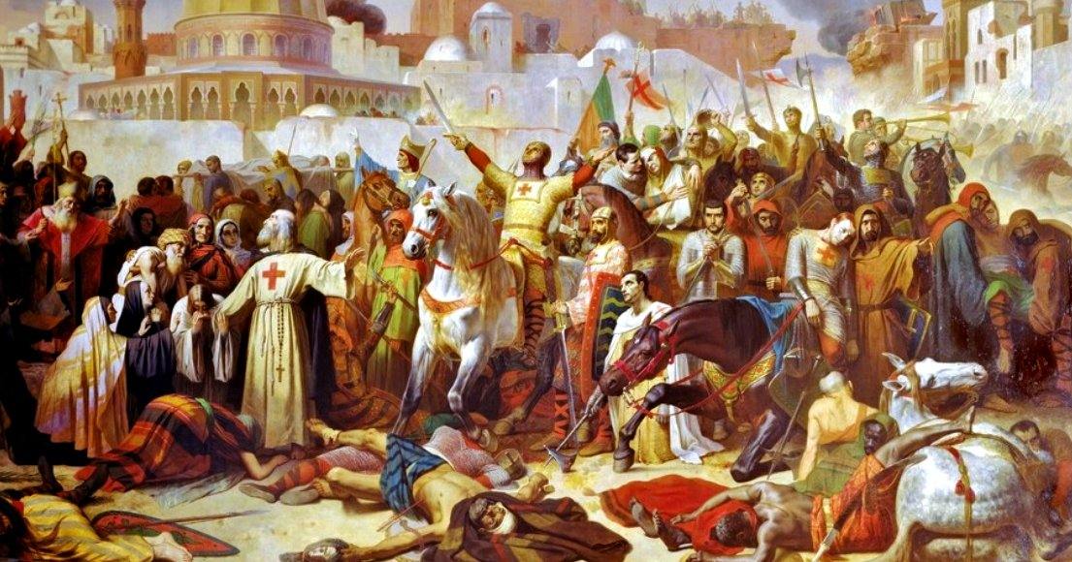
The use of the religion
Europeans brought Christianity and culture to the New World
Power: Robinson seems to influence Friday’s mind without he teaches religious knowledge and language
Robinson cheat Friday, he makes Friday believe that he would safe him soul
The purpose is control and prevail over natives to gain power

Slide 8

Colonial literature: Heart of Darkness
Capitalist attitude to improve the wealth at all costs
Domination toward racial ideas: Natives are enslaved to be under control
Conrad represents the colonists and the colonised in a binary opposition: the colonist are rational and superior while the Africans are inferior
It condemns the European’s purpose, when it becomes only the exploitation of ignorant natives to gain money toward ivory trade

Slide 9
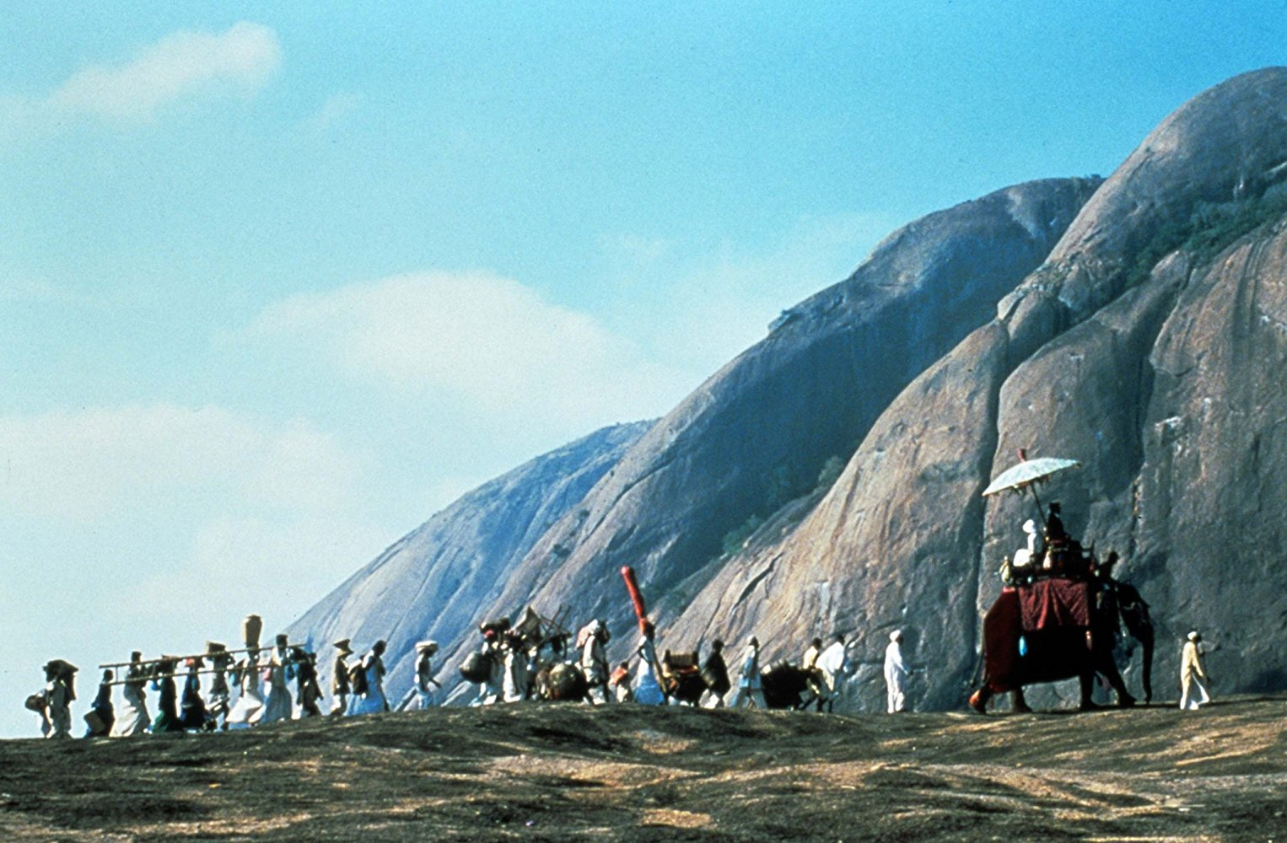

Forster’s A Passage to India
A Passage to India represents: racial antagonism, two great races with different heritage and history.
The English people suffered from arrogance and racial superiority,
The Indians suffered from contempt and nationalist sentiments.

Slide 10
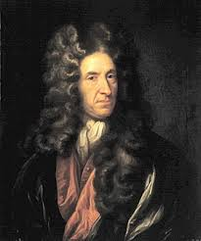
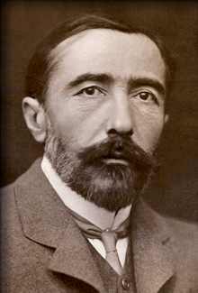
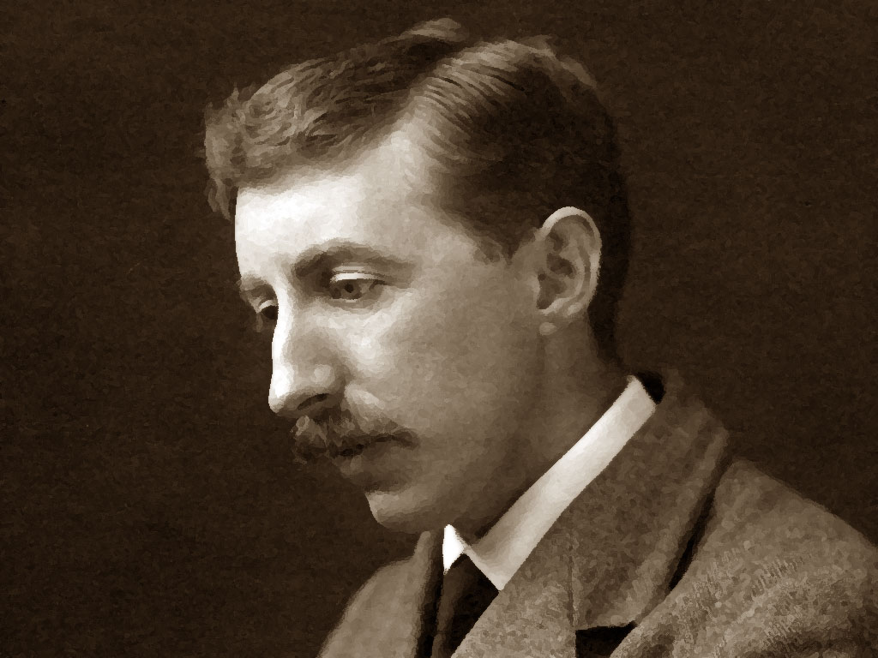
Conclusion
Through these novels these three authors deal with imperialism, racism, class and cultural conflict to show how colonialism creates false illusion to believe that the West is “self” and the East is “other”, one is “superior” other is “subaltern”.

Slide 11
Bibliography
https://www.google.it/search?q=Robinson+Crusoe&rlz=1C1YBKB_enIT505IT508&source=lnms&tbm=isch&sa=X&ved=0ahUKEwiPqZap2rLZAhUJmbQKHXeUAqoQ_AUICigB&biw=1280&bih=918#imgrc=JKj7dgp6BvrSXM
https://www.google.it/search?q=colonialismo&rlz=1C1YBKB_enIT505IT508&source=lnms&tbm=isch&sa=X&ved=0ahUKEwiSpo2Q27LZAhVMaVAKHWSkAKMQ_AUICigB&biw=1280&bih=918
https://www.google.it/search?q=Conrad+Heart+of+Darkness&rlz=1C1YBKB_enIT505IT508&source=lnms&tbm=isch&sa=X&ved=0ahUKEwjrndyg9LTZAhUHUBQKHS2hB0sQ_AUICigB&biw=1280&bih=918#imgrc=hZMAfFQe6IU4dM:
https://www.google.it/search?q=colonialismi&rlz=1C1YBKB_enIT505IT508&oq=colonialismi&aqs=chrome..69i57j0l5.3141j1j9&sourceid=chrome&ie=UTF-8
https://www.google.it/search?q=colonialismi&rlz=1C1YBKB_enIT505IT508&source=lnms&tbm=isch&sa=X&ved=0ahUKEwiX172R9bTZAhWFXBQKHfbYAuAQ_AUICygC&biw=1280&bih=918
https://en.wikipedia.org/wiki/A_Passage_to_India

Slide 12
THANKS FOR ATTENTION

