Slide 1

POSTCOLONIAL LITERATURE
Main features
I.I.S.S. “BASSA FRIULANA” - Polo liceale “A. Einstein” –
Cervignano del Friuli
ANNO SCOLASTICO 2017/2018
CREDITS: Raffaele Carinola

Slide 2
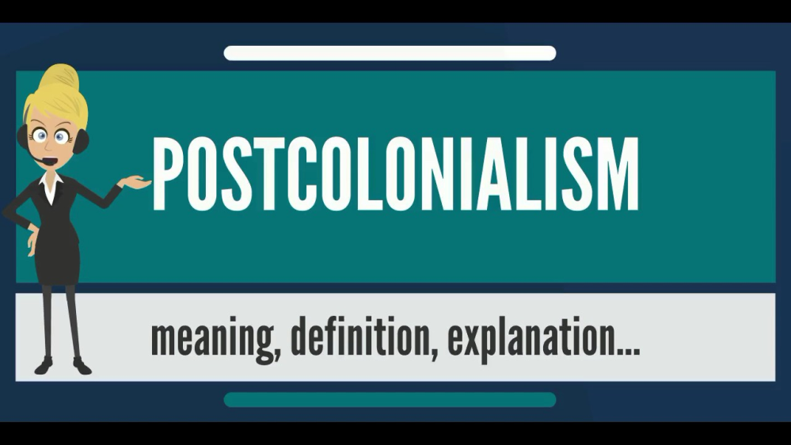
What is its definition?
Postcolonialism has various definitions:
Postcolonialism (or postcolonial studies) is the academic study of the cultural legacy of colonialism and imperialism.
Its focus is on the human consequences of the control and exploitation of colonised people and their lands

Slide 3
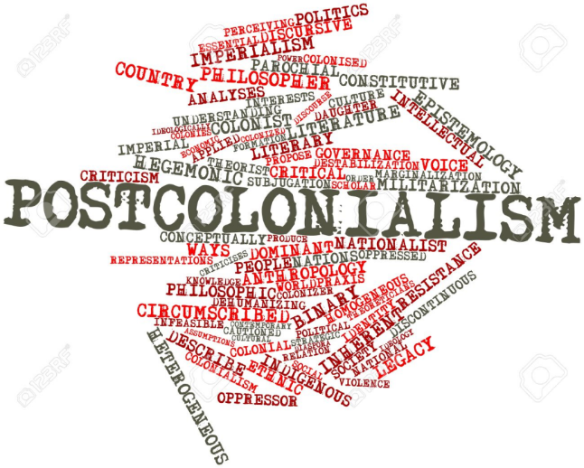
What is its definition?
Postolonial
a theoretical approach in various disciplines
concerned with the lasting impact of colonization in former colonies.
Postolonial
the political or cultural condition of a former colony.

Slide 4
What are its main features?
Appreciation of Cultural Identity
  Postcolonial writers challenge the idea that
  ⇒
  the cultures of colonized peoples were inferior
Nationhood and Nationalism
  Very patriotic writers
  Books written on behalf of their nations.
  Often nationalist output
  Writers like to highlight and appreciate their nation's cultural, political and social identity

Slide 5
What are its main features?
Appropriation of Colonial Languages
  Authors use native language within their writing
Rewriting History
  The British wrote the histories of the conquered empires.
  Postcolonial writers do not accept their historians’works.
  Postcolonial writers write history from their own perspective
  They showingthe violent, terrible aspects of colonialism

Slide 6

What are its main features?
Postcolonial Literature Goals
  Condemnation of the distorting experience and realities of colonized people conveyed by a colonizing culture
  Articulation of the identity of the colonized
  Postcolonial writers want their past back in the face of the past inevitable otherness

Slide 7
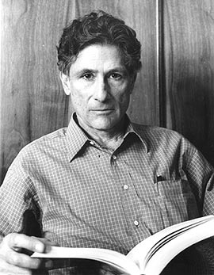
Major figures
Edward Said:
Orientalism (1978): a critique of the cultural representations at the roots of Orientalism.

Slide 8

Major figures
Salman Rushdie:
Sir Ahmed Salman Rushdieis a British: Indian novelist and essayist.
Concerned with the many connections, disruptions, and migrations between Eastern and Western civilizations.

Slide 9

Major figures
Bill Ashcroft:
One of his most significant contribution: The Empire Writes Back

Slide 10
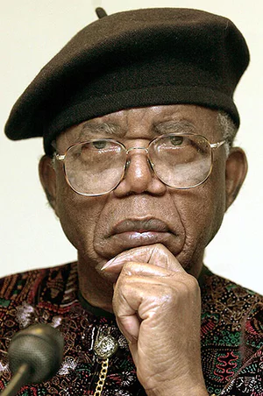
Major figures
Chinua Achebe:
Albert Chinualumogu Achebe, a Nigerian novelist, poet, professor, and critic:
the father of Modern African Literature

Slide 11
Bibliography
http://www.marilenabeltramini.it/schoolwork1718/UserFiles/Admin_teacher/postcolonialism.pdf
http://www.marilenabeltramini.it/schoolwork1718/UserFiles/Admin_teacher/postcolonial_literature.pdf
http://www.marilenabeltramini.it/schoolwork1718/UserFiles/Admin_teacher/postcolonial_response.ppthttps://en.wikipedia.org/wiki
https://en.wikipedia.org/wiki/The_Empire_Writes_Back
https://post-colonialism.weebly.com/features-of-post-colonialism.html
https://www.britannica.com/event/postcolonialism

Slide 12
THANK YOU FOR YOUR ATTENTION

