Slide 1

COLONIAL REPRESENTATION
Credits:
Carinola Raffaele, Gregoretti massimiliano, pommella gianluca
Liceo Scientifico «Albert Einstein» Opzione Scienze Applicate.
A.S. 2017/2018

Slide 2
What does «Representation» mean?
Representation can be defined:
As the act of representing.
As the presentation of an object, individual, idea or entity not by drawing it as it is but by “representing” it or preparing it in a new structure or a new form.

Slide 3
What does «Colonialism» mean?
Colonialism has many definitions:
Colonialism is the control or governing influence of a nation over a dependent country, territory or people.
Colonialism is the system or policy by which a nation mantains or advocates such control or influence.

Slide 4
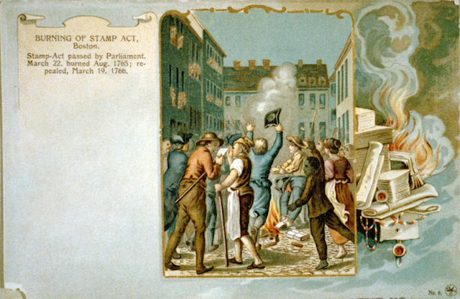
What is Colonial representation?
It presents semiotic meanings in which words, characters or situations often express contradictory attitudes.
It is a political representation that cannot be “natural” or “true”.

Slide 5
What are its main features?
It is constructed with false images: images that relate with colonizers’ ideology.
It is characterized by uniqueness:
  Colonized countries always lose their identity
It is strictly linked with racism:
  Colonized people were considered inferior

Slide 6

Colonisers’ main novels
There are three main colonisers’ novels that convey the idea of colonisation:
“Robinson Crusoe” by Daniel Defoe.
“Heart of Darkness” by Joseph Conrad.
“A Passage to India” by Edward Forster.

Slide 7

Robinson Crusoe
It’s defined an adventure storyby the novelist.
It presents the relationship between Robinson and Friday.

Slide 8
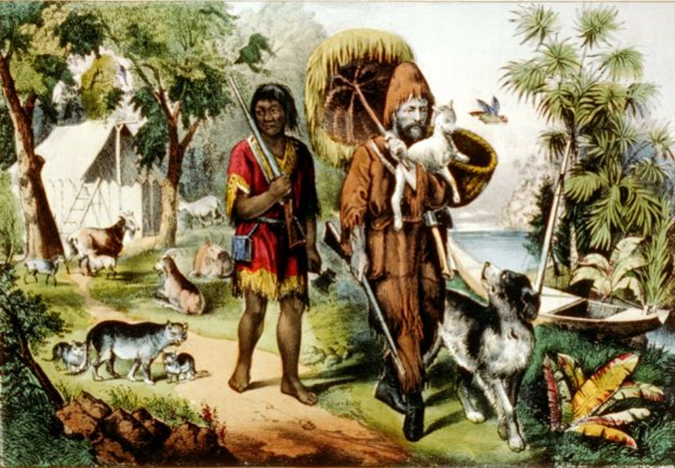
Robinson Crusoe
Robinson is the coloniser.
Friday is the colonised.
The novel conveys the idea of racism and the power of European identity by pointing out the way Robinson behaves with Friday.

Slide 9
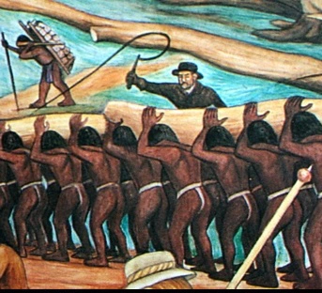
Robinson Crusoe
Robinson can be considerated as the master
Friday is considered a slave by Robinson
The master imposes his culture on they who he considers inferior and therefore they become his slaves.

Slide 10

Heart of Darkness
Also andAdventure novel
It denounces European’s colonialist policy

Slide 11

Heart of Darkness
The novel presents
various themes:
Enslavement
Colonisation
Differences between
European and
African laws.

Slide 12
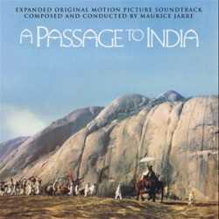
A Passage to India
Criticism, satire and denouncement are the relevant aspects of the novel
It presents the British rule in India.
It underlines the injustice of colonialism.

Slide 13

A Passage to India
India is presented as a relevant expansion of the British Empire.
It is characterized by conflicts.
Colonialism is criticized.

Slide 14
A Passage to India
The novel can be divided into three sections:
The first one underlines the Indians’ emotions
The second one focuses on the Intellects
The third one rest on the emotions of love, devotions and sense of identity.

