Slide 1
The War in the Mountains
Group work 2: Baldan, Bertoli, Danielis, Romano

Slide 2
Introduction
Activities:
Reading of the war report The War in the Mountains by R. Kipling
Analysis of the report
Production of a PowerPoint Presentation
Objective:
- Dis-covery of Kipling’s vision of the war and the soldiers’s role through textual analysis

Slide 3
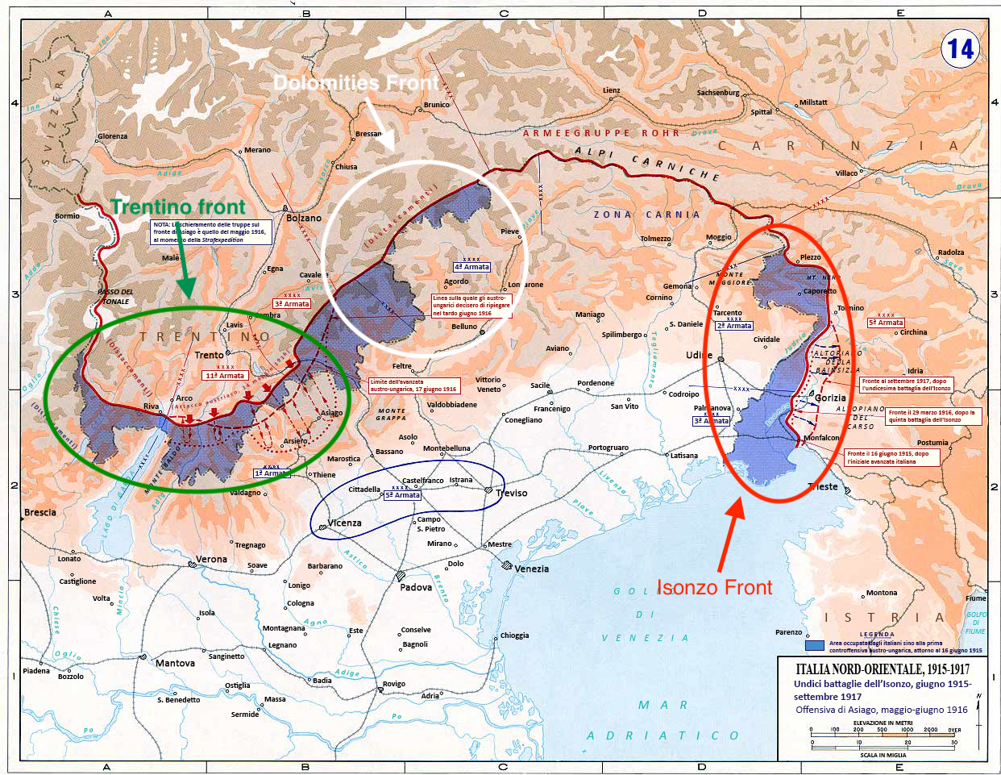

Slide 4
Chapter I - The Roads of an Army
  Text type: War Report
Structure:
  Narrative (mixture of dialogues and descriptions) – telling and showing
  Language:
  short, simple sentences, with the use of coordination
  lexical choices → semantic areas of war (last paragraph of the first sequence and last paragraphs of The Belly of Stones) and nature (first paragraphs)
  Rhetorical figures → alliterations (sound “t”, 3rd paragraph), anaphoras (like head –head, 4th paragraph of The Belly of Stones)
R.Kipling’s ideas of:
  War → It is a way to reach the National Unity of Italy
  Soldiers → He celebrates the slain and the victims of WWI

Slide 5
Chapter II - Podgora
  Text type: War Report
Structure:
  Narrative (mixture of dialogues and descriptions) – telling and showing
  Language:
  short, simple sentences, with the use of coordination
  lexical choices → semantic areas of war and nature (enemy, death, bombs, fights, trench, soldiers, war, cannons, military service)
  rhetorical figures → metaphors “…in a month the smooth Italian roads would overrun them as vine tendrils overrun rubbish-heaps”
R. Kipling’s ideas of:
  War → the war in the mountains is hard and height is everything to survive (not clear idea)
  Soldiers → R.Kipling understands soldiers must be ready for everything in a mountain war

Slide 6
Chapter III - A pass, a King and a Mountain
  Text type: War Report
Structure:
  Narrative (mixture of dialogues and descriptions) – telling and showing
  Language:
  short, simple sentences, with the use of coordination
  lexical choices →Semantic areas of war, nature and references to Puritanism
  rhetorical figures → alliterations of sounds “s” and “t”; similes (Sometimes the discharge sounded like a triumphant whoop across the snows)
R.Kipling’s ideas of:
  War → It involves every aspect of life
  Soldiers → R.Kipling considers soldiers as vehicles to achieve the objective of the war (what is the objective?)

Slide 7
Chapter IV - Only a few steps higher up
  Text type: War Report
Structure:
  Narrative (mixture of dialogues and descriptions) – telling and showing
  Language:
  short, simple sentences, with the use of coordination
  lexical choices → Semantic areas of war and nature
  rhetorical figures → Alliteration of sound “s” and “t”; similes between nature and a monster
Kipling’s idea of:
  War → negative idea: people must adapt to a new situation in order to survive
  Soldiers → R.Kipling considers soldiers as brave and full of energy young men who are ready to adapt to any situation and sacrifice themselves, changing their life to defend their Nation
Liceo Scientifico "A. Einstein" - V ALS - A. S. 2017/2018

Slide 8
Chapter V – The Trentino Front
  Text type: War Report
Structure:
Narrative (mixture of dialogues and descriptions) – telling and showing
Language:
  short, simple sentences, with the use of coordination
  lexical choices → Semantic areas of war, nature and references to Puritanism
  rhetorical figures → similes (Battalions slipped like shadows through the mists between the pines ) ; alliterations of sounds “s” and “t” (hardness that impresses or immense efforts and necessities)
Kipling’s ideas of:
  War → It is a way to reach the National Unit
  Soldiers → R. Kipling underlines their values that remind Puritan ideology: work, efficiency and determination to reach their objectives

Slide 9
Conclusion
IDEAS CONVEYED
The war
R.Kipling shows an ambiguous opinion about the war. Indeed, some chapters convey a contradictory vision of the conflict: on one side it brought innovation in economy, communication and transport, on the other side, it implied sacrifices and the death of young men who believed in the idea of the National Unit.
The soldier
R.Kipling appreciates Italian soldiers’ dedication and values (recalling Puritan ideology: determination, perseverance and work). In addition, soldiers are a means to reach a National Unit.

