Slide 1
POST-COLONIAL LITTERATURE
by
Francesco Napodano
&
Thomas Maran
I.I.S.S. “BASSA FRIULANA” - Polo liceale “A. Einstein” Cervignano del Friuli
ANNO SCOLASTICO 2017/2018

Slide 2
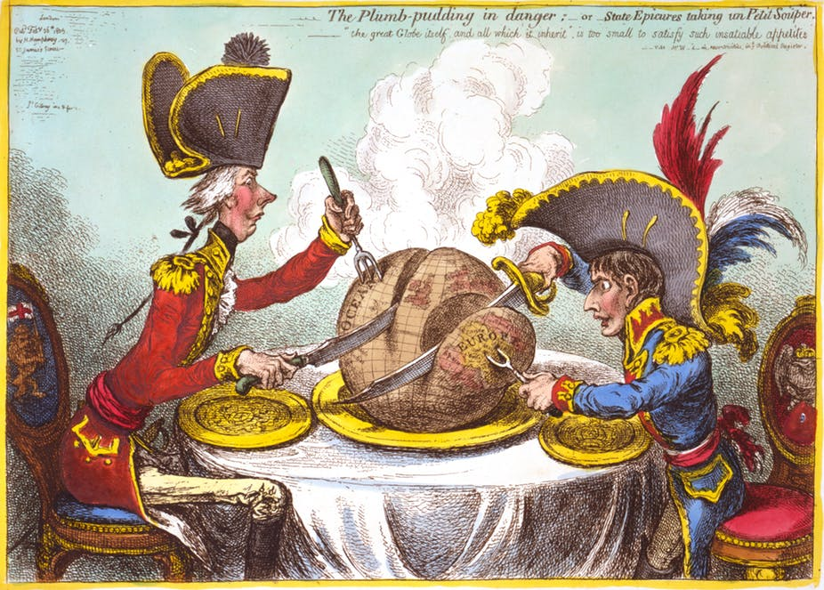
Where does it come from?
It comes from Britain's former colonies
Post-colonial writers write in English and focus on common themes such as the struggle for independence, emigration, national identity and allegiance

Slide 3
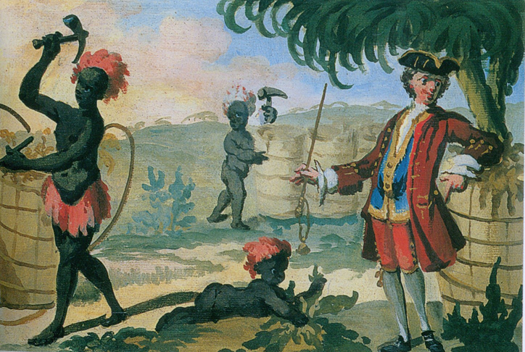
What is Post-colonial theory?
It's a literary theory or critical approach that deals with literature produced in countries that were once, or are now, colonies of other countries
It may also deal with literature written in or by citizens of colonizing countries that takes colonies or their peoples as its topic
The theory is based around concepts of resistance

Slide 4


Most relevant topics :
Human freedom
Liberty
Identity
Individuality

Slide 5


Central issues :
Integration
Language
Culture and tradition (Belief and religion)
Displacement

Slide 6
Colonised Literature
Gradual changes through time
Concept of otherness
Differences between Western and Eastern world
Lack and difficulty of comunication

Slide 7
Colonisers‘ literature
Assumption of their superiority
Hybrid literature with symbols and myths of colonized people
Idea of a refined society

Slide 8
Some examples of both
Literature of the colonised:
Salman Rushdie, Chinua Achebe, Jamajca Kincaid
Literature of the colonizers:
Rudyard Kipling, joseph Conrad, Alan Paton

Slide 9
Push factors of migration :
Wars
Few services
Lack of job
Unhappy life
Shortage of food
Poor transport links

Slide 10
Pull factors of migration :
Access to services
Better job opportunity
Family links
Improved living conditions
Hope for a better way of life

Slide 11
Conclusion
Migration is a global phenomenon that exists and will exists forever; It has changed human being and it will keep shifting people from countries to countries, from black to white and from life to death.

