Slide 1
Colonial representation IN D. DEFOE’ s Robinson Crusoe J. CONRAD’s Heart of Darkness E. M: FORSTER’S a Passage to India
Credits
Cattaruzzi Simone
Moratti Alex
Liceo delle Scienze Applicate 5 ASA

Slide 2
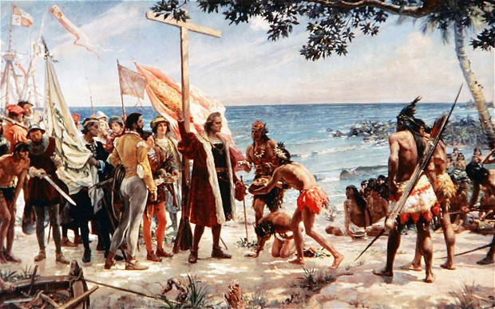
The aim of the Abstract
Denying the idea of the colonised that was created by colonisers, with the purpose to subdue colonised people
To condemn the European domination based on a binary vision of the world

Slide 3
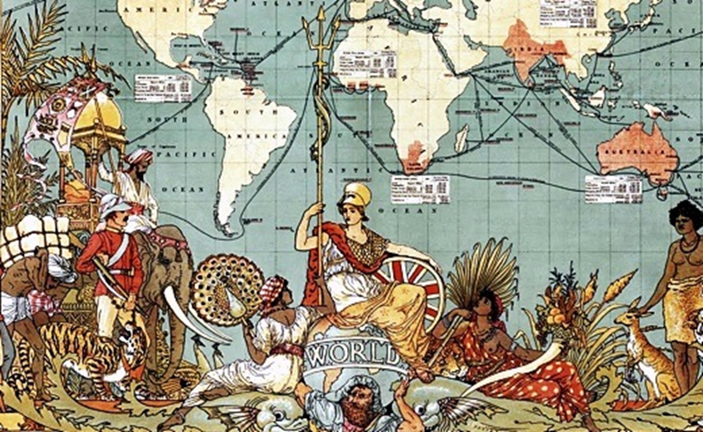
Colonialism
The domination of the powerful over the less powerful was justified by Colonial literature
It conveys the idea of the colonised as “others and inferior” in order for the coloniser to subdue them
Colonial representation creates a false image of the colonised to control them: it is an unreal political representation

Slide 4
Colonialism in Postcolonial Fiction
An example of three European novels :
Robinson Crusoe by Daniel Defoe
Heart of Darkness by Joseph Conrad
A Passage to India by E. M. Forster

Slide 5
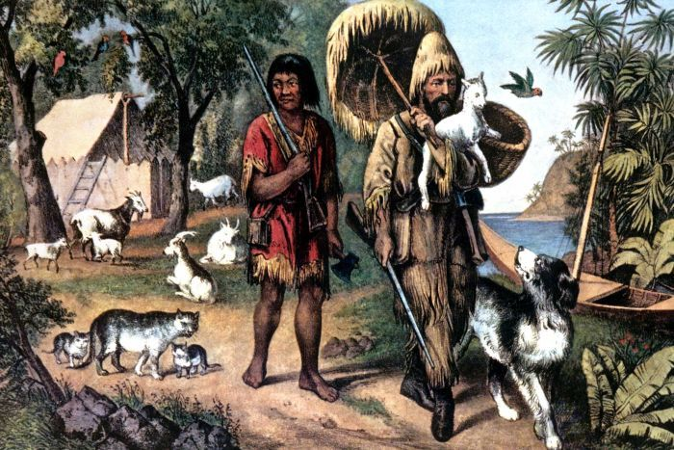
Colonial Literature: Robinson Crusoe
It seems only an adventure novel, but it justifies European attempts to colonise other countries
Robinson reflects the idea of the European man, while Friday reflects the idea of the colonised
Robinson becomes Friday’s master
Friday changes his habits
Robinson’s aim is to improve his situation

Slide 6
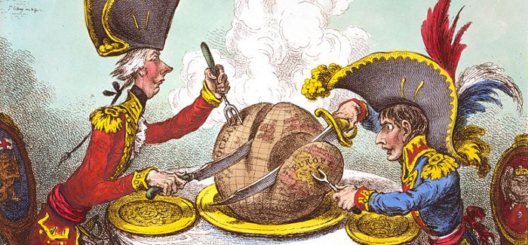
The Colony. A Representation
Subjugation: European sense of superiority, Robinson puts his feet on Friday’s head
Natives are represented as cannibals and wild, very different from civilised and respectful European people
Domination: Robinson imposes his culture and traditions to control the natives
Friday speaks in his master’s words and imitates his actions
This creates an Identity Crisis

Slide 7
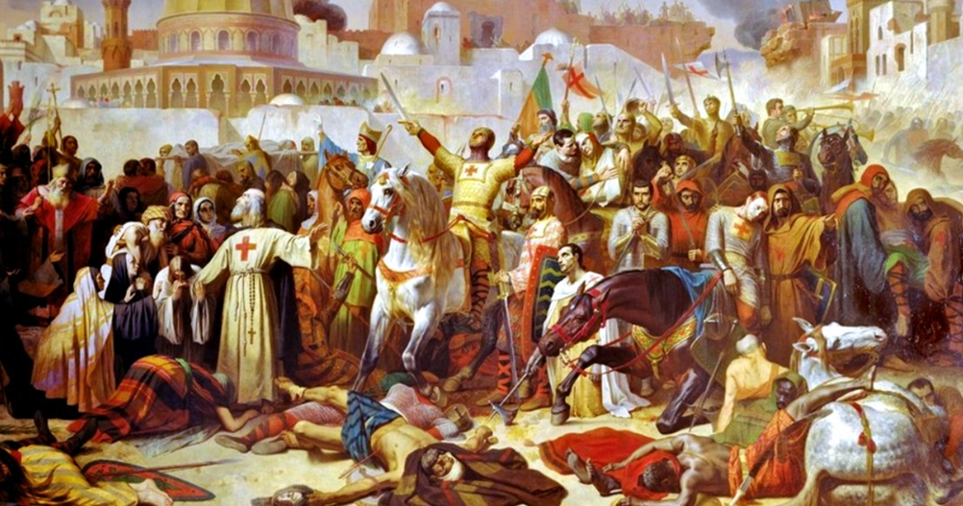
The Use of Religion
Europeans brought Christianity and their culture into the New World
Power: Robinson seems to influence Friday’s mind without explaining him his religious principles
Robinson imposes his language to Friday
Robinson cheats Friday: he makes him believe that his teachings will save his soul
The purpose is to control and prevail over the natives to gain power

Slide 8
Colonial Literature. Heart of Darkness
Capitalist attitude to improve colonisers’ wealth at all costs
Domination toward racial ideas: natives are enslaved to be under control
Conrad represents the colonists and the colonised in a binary opposition: the colonist are rational and superior while the Africans are inferior
The novel illustrates the European’s purpose: the exploitation of ignorant natives to gain money with ivory trade

Slide 9
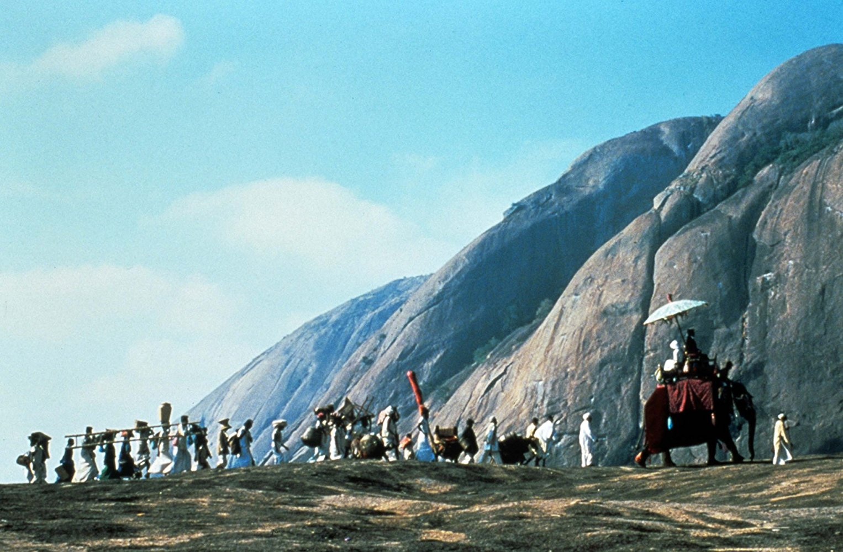
E. M. Forster’s A Passage to India
A Passage to India represents: racial antagonism, two great races with different heritage and history. Face each other
The English people suffered from arrogance and racial superiority,
The Indians suffered from contempt and nationalist sentiments.

Slide 10
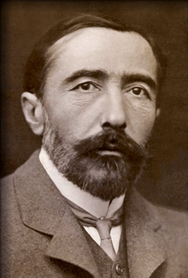
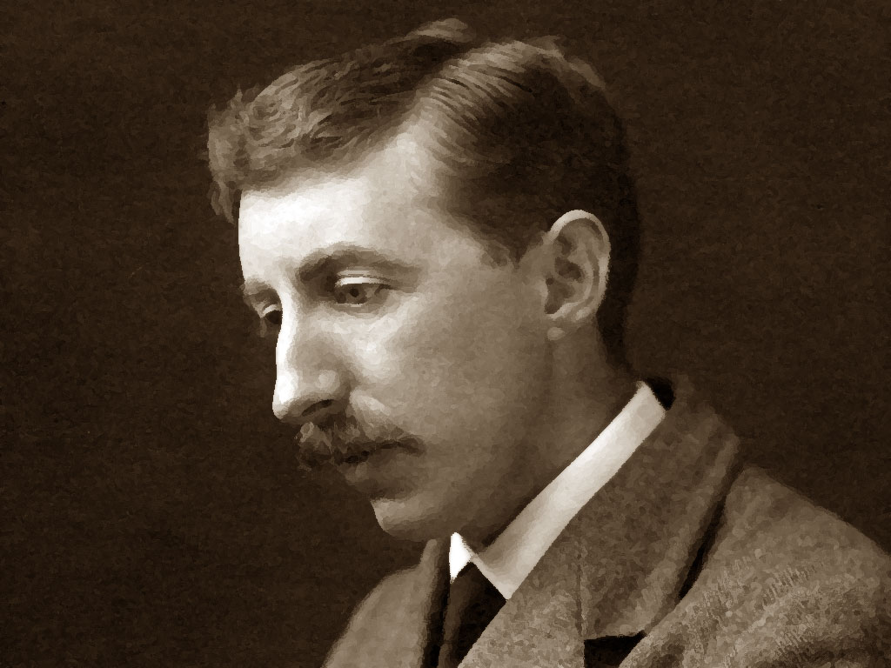
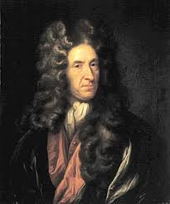
Conclusion
Through their novels the three writers deal with
imperialism
racism
class and cultural conflict
They show how colonialism creates a false illusion: the belief that the West is “self” and the East is “the other”
Superiority versus Inferiority

Slide 11
Bibliography
https://www.google.it/search?q=Robinson+Crusoe&rlz=1C1YBKB_enIT505IT508&source=lnms&tbm=isch&sa=X&ved=0ahUKEwiPqZap2rLZAhUJmbQKHXeUAqoQ_AUICigB&biw=1280&bih=918#imgrc=JKj7dgp6BvrSXM
https://www.google.it/search?q=colonialismo&rlz=1C1YBKB_enIT505IT508&source=lnms&tbm=isch&sa=X&ved=0ahUKEwiSpo2Q27LZAhVMaVAKHWSkAKMQ_AUICigB&biw=1280&bih=918
https://www.google.it/search?q=Conrad+Heart+of+Darkness&rlz=1C1YBKB_enIT505IT508&source=lnms&tbm=isch&sa=X&ved=0ahUKEwjrndyg9LTZAhUHUBQKHS2hB0sQ_AUICigB&biw=1280&bih=918#imgrc=hZMAfFQe6IU4dM:
https://www.google.it/search?q=colonialismi&rlz=1C1YBKB_enIT505IT508&oq=colonialismi&aqs=chrome..69i57j0l5.3141j1j9&sourceid=chrome&ie=UTF-8
https://www.google.it/search?q=colonialismi&rlz=1C1YBKB_enIT505IT508&source=lnms&tbm=isch&sa=X&ved=0ahUKEwiX172R9bTZAhWFXBQKHfbYAuAQ_AUICygC&biw=1280&bih=918
https://en.wikipedia.org/wiki/A_Passage_to_India

Slide 12
THANKS FOR ATTENTION

