Slide 1

POSTCOLONIAL LITERATURE
CREDITS: R. Busdon and A. Moratti
Liceo Scientifico ‘A. Einstein’ Cervignano del Friuli

Slide 2



What does ‘Postcolonial’ mean?

Slide 3
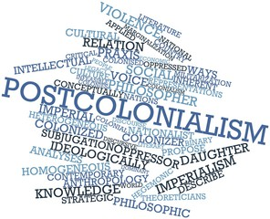
Definition of Postcolonial literature
Literature of the countries colonised by European countries.
Themes
cultural independence
consequences of colonization and racialism

Slide 4
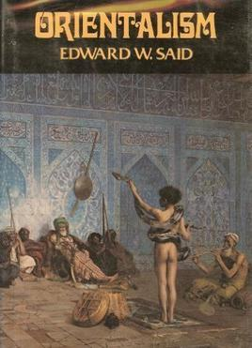

The origins of the word
Postcolonial literature developed since the publication of Edward Said’s Orientalism in 1978
1989 ⇨Publication of
Bill Ashcroft, Gareth Griffiths and Helen Tiffin,
The Empire Writes Back: Theory and Practice in Post-Colonial Literatures

Slide 5

The origins of the word
Political independence did not always lead
to cultural independence
necessity of creating a form of freedom against the limits imposed

Slide 6
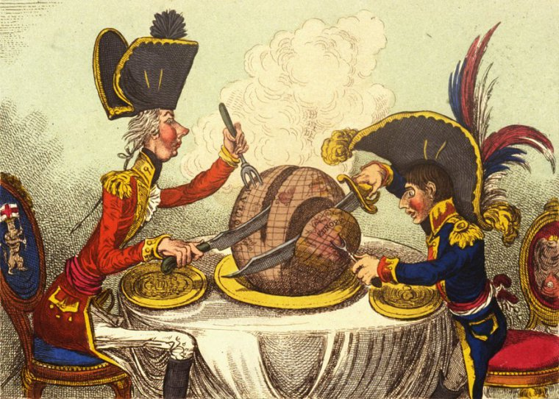

Features of Postcolonial Literature
takes position against imperialism and Eurocentrism
written in the language of the colonizers
key concepts: resistance, otherness and hibridity

Slide 7


Resistance: issue of Postcolonial Studies
Related to ideas of:
liberty,
identity,
individuality
human freedom
Writers write of rebel characters
who fight for their rights
Resistance is interpreted as subversion, opposition or mimicry

Slide 8


Hybridity: issue of Postcolonial Studies
integration of the cultures of the colonisers and the colonized
every aspects of a culture will blend with the ones of another culture.
Salad Bowl versus Melting Pot

Slide 9

Otherness: issue of Postcolonial Studies
lack of identification with something of someone’s personality in a community or the community itself.
impossibility to go back to their pasts, but only to watch at it like a fragmentary puzzle.

Slide 10
The literature(s) of the colonized
Racism and discrimination from colonists
Change of cultures and people through time
The use of English became the favorite one from colonists

Slide 11
The literature(s) of colonists
Colonists help the development of colonizers’ culture and society.
Based on the colonizers’ assumption of their own superiority.
Colonists had to face the opposite phenomenon: globalization.

Slide 12

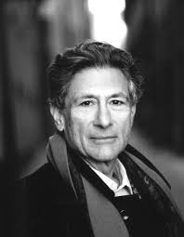

Major Postcolonial Writers
Edward Said
Homi Bhabha
Frantz Fanon
Gayatri Spivak
Chinua Achebe
Wole Soyinka
Salman Rushdie
Jamaica Kincaid
Buchi Emecheta
Salman Rushdie
Edward Said
Homi Bhabha

Slide 13
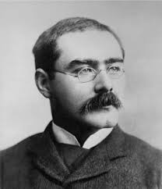
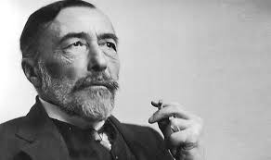


Writers of the colonizers
Rudyard Kipling
Joseph Conrad
Alan Paton
Rudyard Kipilng and the cover of the novel ‘The Jungle Book’
Joseph Conrad and the cover of the novel ‘Hearth of Darkness’

Slide 14
Fin.
THANK YOU
FOR
YOUR ATTENTION

