Slide 1
Postcolonialism
CREDITS
Gemma Canesin
Dana Pastoricchio
5^ASA
a.s.2017/2018
http://4.bp.blogspot.com/_hYyFi7Gz75E/TAz-zViEaRI/AAAAAAAAAaw/R1Bth70OP2c/s1600/ALTERITY.jpg

Slide 2
What is postcolonialism?
Literature from the colonised poeople's point of view
Literature written in colonised countries dealing with colonisation or colonised people
The study of the interactions between European nations and the societies they colonised in the Modern Period
Postcolonialism_by Gemma Canesin and Dana Pastoricchio 5^ASA a.s. 2017/2018

Slide 3
WHAT are ITS FUNCTIONS?
Discussing
The way literature by the colonisers’ culture distorts experiences and realities
The way literature in colonising countries takes possession of the colonized countries' language, images, scenes, traditions and the like
A critical approach to the past experiences of the colonised
Postcolonialism_by Gemma Canesin and Dana Pastoricchio 5^ASA a.s. 2017/2018

Slide 4
Where does the word come from?
In a literal sense, "postcolonial" is that which has been preceded by colonization
It is important to say that colonization is not the only object of postcolonial studies
"postcolonial" is used to underline a position against imperialism and Eurocentrism
Postcolonialism_by Gemma Canesin and Dana Pastoricchio 5^ASA a.s. 2017/2018

Slide 5
PROBLEMS WITH THE TERM
Meaning of the overall sense
Many writers are from nations that were colonies in previous times
The word seems to suggest that colonialism covers a limited period. Indeed it is still in progress
Postcolonialism_by Gemma Canesin and Dana Pastoricchio 5^ASA a.s. 2017/2018

Slide 6
When was it born and why?
The growth of the expression Postcolonialism was consolidated in 1989 in "The Empire Writes Back" thanks to the «Theory and Practice in Post-Colonial Literatures» by Bill Ashcroft, Gareth Griffiths, and Helen Tiffin.
Postcolonialism_by Gemma Canesin and Dana Pastoricchio 5^ASA a.s. 2017/2018

Slide 7
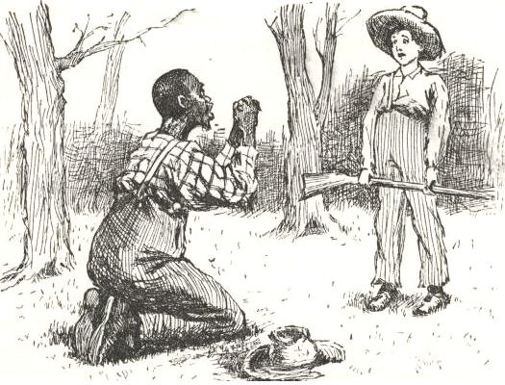
Main features
Identity
Culture and tradition
Believ and religion
Language
Location or sense of displacement
https://2012books.lardbucket.org/books/creating-literary-analysis/section_09/e201be21fabeb034d661ed8c9e2addaf.jpg
Postcolonialism_by Gemma Canesin and Dana Pastoricchio 5^ASA a.s. 2017/2018

Slide 8
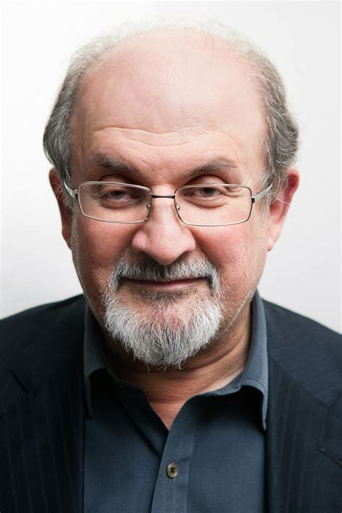
COLONIALISM AND POstcolonialism
Not all Postcolonial scholars are literary scholars
Salman Rushdie
Moshin Hamid
Peter Abrahams
Rudyard Kipling
Joseph Conrad
Alan Paton
Moshin Hamid
Salman Rushdie
Postcolonialism_by Gemma Canesin and Dana Pastoricchio 5^ASA a.s. 2017/2018

Slide 9
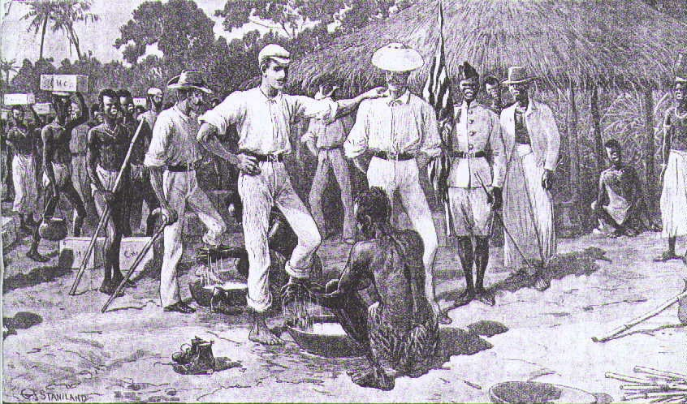
Postcolonial Criticism
It can be used to interpret literature in the Western literary canon
http://3.bp.blogspot.com/-ULJXL7tgOsw/TtSAcnb46yI/AAAAAAAAADU/rHmajLknJAk/s1600/feet.jpg
Postcolonialism_by Gemma Canesin and Dana Pastoricchio 5^ASA a.s. 2017/2018

Slide 10
Differences between the LITERATURE OF the colonized and OF the colonist
Literature(s) of the colonized | Literature(s) of the colonists:
Hybrid, integrated with other cultures | Standard, replicated, equal to the original tradition
Concept of equality | The colonized are different from the natives
Concept of resistance | Imposes its origins
Postcolonialism_by Gemma Canesin and Dana Pastoricchio 5^ASA a.s. 2017/2018

