Slide 1
IN DEPTH Nourin Binte Saeed
CREDITS: Alessia Alampi
Liceo scientifico Scienze Applicate “A. Einstein”
A.S. 2017/2018

Slide 2
STRUCTURE
Abstract: summary of document content
Introduction: explaination of main concepts
Chapter I : colonialism aspect – Robinson Crusoe
Chapter II: imperialist ideology - Heart of Darkness
Chapter III: representation of India and colonial background – A Passage to India
Conclusion

Slide 3
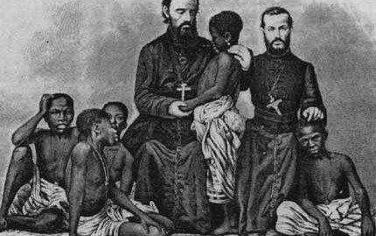
COLONIALISM
External facade
policy of a nation seeking to extend or retain its authority over other people or territories and helping the colonies modernise

Slide 4
COLONIALISM
Reality
idea: white people are more powerful and have to dominate over the “others”
colonizers have the aim of exploiting the colonists to their benefit
Colonised are forced to speak the same language, have the same religion and customs as the colonizers

Slide 5
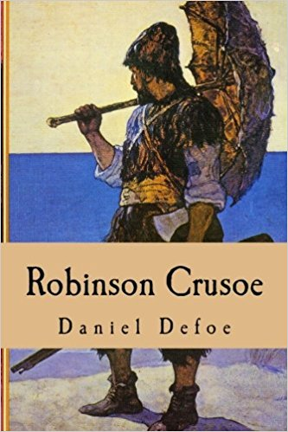
ROBINSON CRUSOE
Novelist: Daniel Defoe in 1719
Allegorical novel –
surface: adventur story
deep meaning: colonialism, issues like race, power identity formation seen from a colonizer’s perspective
Protagonists: Robinson Crusoe and Friday

Slide 6
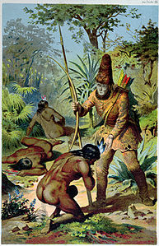
ROBINSON CRUSOE
Connection between the two protagonists:
Robinson Crusoe Friday
colonizer colonized
master slave
civilized uncivilized

Slide 7
ROBINSON CRUSOE
Robinson Crusoe imposes to Friday:
a name
the use of English
his religion
From a savior R. Crusoe becomes Friday’s master Friday: consciously and unconsciously accepts his colonial identity

