Slide 1
POSTCOLONIALISM
Simone Cattaruzzi 5 ASA
I.S.I.S. ”Bassa Friulana”- Polo liceale “A. Einstein”
Cervignano del Friuli, Anno Scolastico 2017-2018

Slide 2
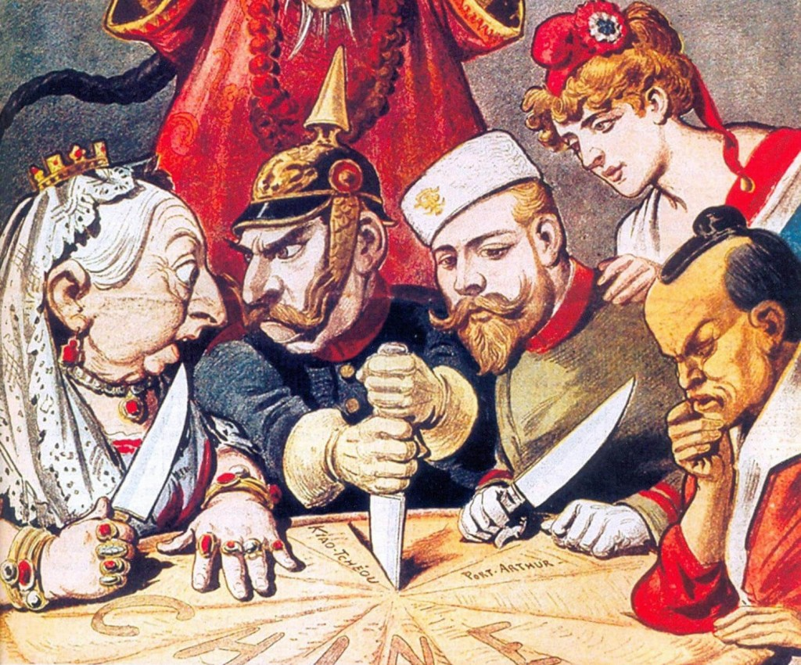
Colonialism
European power
European behaviour towards the native
The colonizers’ rule
Integration or disintegration of cultures
The colonizers’aims

Slide 3
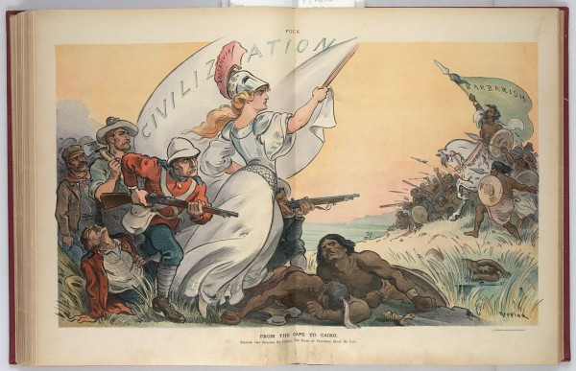
Colonial literature
Rudyard Kipling: "The White Man's Burden: The United States and the Philippine Islands”
Development of English values

Slide 4
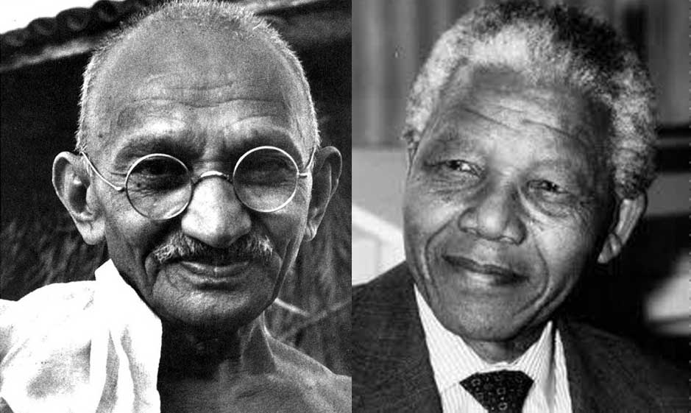
Decolonisation
It is not a historical period
Different in different countries:
Settlers
Non-settlers
Partially settled

Slide 5
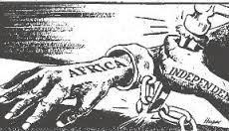
Postcolonialism
Definition:
Of, relating to, or being the time following the establishment of independence in a colony
Countries that gained total independence and relevant power in world politics
Different situations
Only political independence

Slide 6
Similarities in Postcolonial Output
The influence of colonizing culture
The question of identity, the concept of hibridity
The impossibility to return to the past
The issue of language and culture

Slide 7
Dissimilarities
The way indipendence was gained
The relation between the center and the margins of the Empire
The history of every country before colonialism
New phase of immigration
The idea of a transnational culture

Slide 8
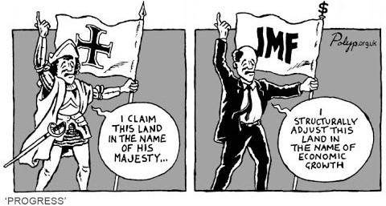
Neocolonialism
The Industrial Revolution
The march of neocolonialism
Capitalism
Globalization

Slide 9
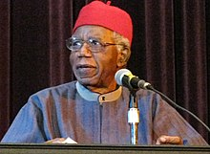
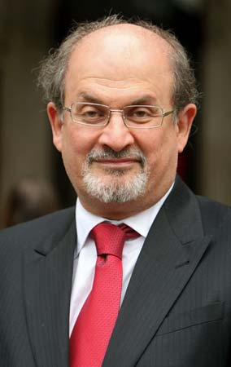
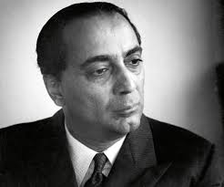
Postcolonial literature
How it faces Imperialism
The issue of language and identity
Transnational identity
Chinua Achebe
Salman Rushdie
Homi Bhabha

Slide 10
Language
Language trasformations
Difference of every writer
Return to the past
Living in the present

Slide 11
Aims of Postcolonial Production
Facing Imperialism and Eurocentrism
Social and racial oppressions
Otherness
Migrants

Slide 12
Post-Colonial Issues
Identity
Culture and tradition
Belif and religion
Sense of displacement

Slide 13
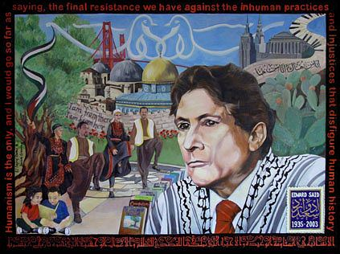
Postcolonial theory
Human freedom
Liberty
Identity
Individuality

Slide 14
Migrants
Migration
Multicultural
Transnational culture

Slide 15
THANK YOU FOR THE ATTENTION

