Slide 1
POSTCOLONIAL LITERATURE
CREDITS
Clementin Emilio - Zamò Federico
I.I.S.S. “BASSA FRIULANA” - Polo liceale “A. Einstein” –
Cervignano del Friuli
ANNO SCOLASTICO 2017/2018
Cl. 5 ASA

Slide 2
POSTCOLONIALISM KEYWORDS
ALTERITY: lack of identification, diversity.
DIASPORA: refers to any people or ethnic population forced or induced to leave their traditional ethnic homelands.
EUROCENTRISM: the practice of emphasizing European concerns, culture and values disadvantaging the other cultures.
HYBRIDITY: an important concept in post-colonial theory. It refers to the integration of cultural practices from the colonizing and the colonized cultures.
IMPERIALISM: the policy of extension of the authority over foreign countries to increase European power. The word refers to the policy of a country in maintaining colonies and dominance over distant lands.

Slide 3
WHAT IS POSTCOLONIAL LITERATURE?
Two considerations :
Postcolonial literary production took position against imperialism (political, linguistic and cultural domination) and European colonial powers (Eurocentrism)→colony
The adjective “Post-colonial” sends back to the process of “decolonization”, when the colonies gained independence from European empires.

Slide 4
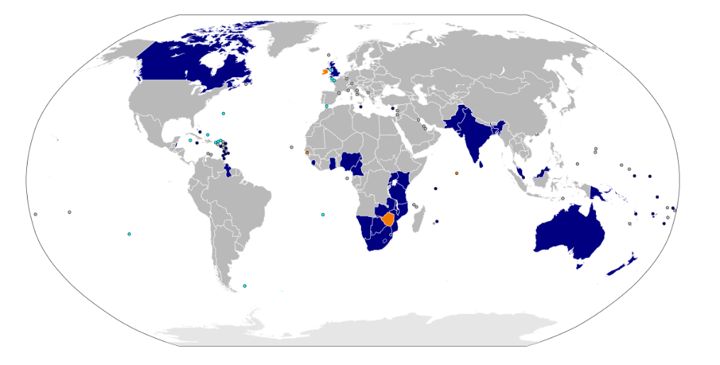
WHEN AND WHERE?
After decolonization.
Postcolonial studies → prominence in the 1970s.
Edward Said’s → Orientalism (1978)
Salman Rushdie’s → The Empire Writes Back (1982)
Postcolonialism → developed in all the colonies of the British Empire (actually members of the Commonwealth):
Africa
South America
Middle East
Ireland
India
Australia
New Zealand
Canada

Slide 5
WHY?
Postcolonialism objects to Imperialism and Eurocentrism
Political independence did not always lead to cultural independence from political, economic and cultural models
British English was used over local languages, written culture over oral culture and highbrow culture over folk culture
Reactions :
Some want a native identity and language to be adopted to get back their lost cultural heritage ⇨(minority).
Others prefer a «transnational» identity and criticize
the post-colonial state (majority)

Slide 6
FEATURES
Postcolonial writers(The writers of the colonized countries)
⇨ protest against former European powers using literature
⇨ highlight the problems related to Post-colonialism:
Identity
Culture and tradition
Belief and religion
Language
Location or sense of displacement
Postcolonial writers
⇨ use English to make their voice audible everywhere ⇨ use English as a provocation (it was the language of the British empire)

Slide 7
THEMES
Condition of exile
Racial conflict
Eradication of emigrants
Post-war migration
Migrations
Globalization
Struggle for individual and collective cultural identity
Alienation
Unhomeliness
Double consciousness
Hybridity
Economic problem

Slide 8
STYLES
Innovative Postmodern narrative styles
Use of ironical registers to take distance from the serious questions writers are dealing with
Current use of magic realism
Characters in search of identity in the novels

Slide 9
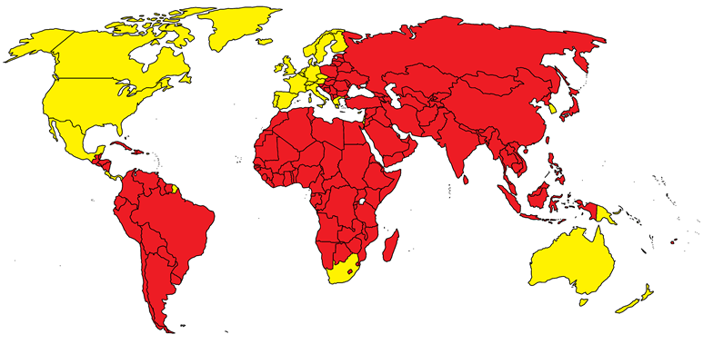
Postcolonial theory
relies on
the concept of otherness and
the concept of resistence/opposition
Western concept of the Oriental world
⇒
based on prejudices
West is ordered, rational, masculine and
East is chaotic, irrational, feminine, evil…
Postcolonial writers want to change such perspective
Hybrid → referring to the integration of cultural
signs and practices from the colonizing and the
colonized cultures

Slide 10
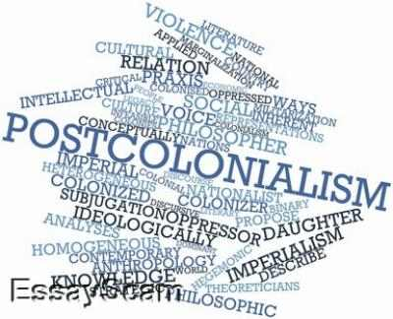
Postcolonial Writers
claim dignity for themselves and for the communities they belong to.
represent a different voice in the debate about contemporary issues

Slide 11
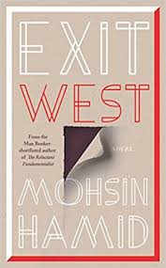
POSTCOLONIAL WRITERS
CHINUA ACHEBE (THINGS FALL APART, 1958)
NADINE GORDIMER (THE CONSERVATIONIST,1974)
SALMAN RUSHDIE (MIDNIGHT’S CHILDREN, 1981)
TASLIMA NASREEN (OPPOSITION, 1992)
MOHSIN HAMID (EXIT WEST, 2017)

Slide 12
POSTCOLONIAL WRITER: SALMAN RUSHDIE
Representative of Post-colonial literature
Use of literature to overturn the stereotyped point of view about colonialism
The Empire Writes Back
Employment of magic realism

Slide 13
THE EMPIRE’S LITERATURE
DEVELOPED DURING XIX CENTURY (GROWTH OF THE BRITISH EMPIRE)
FOCUSSED ON THE SUPERIORITY OF THE WHITE
JUSTIFIED EUROPEAN DOMINATION IN THE WORLD

Slide 14
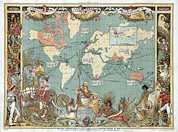
COLONIZATION
DIFFUSION OF BRITISH SYSTEM AND ORGANIZATION OVER THE COLONIES
IMPOSITION OF A BRITISN DOMINATING CULTURE
APPEARENT REASON: NEED TO CIVILIZE INDIGENOUS PEOPLE
REAL REASON: NEED TO
INCREASE THE EMPIRE’S
POWER

Slide 15
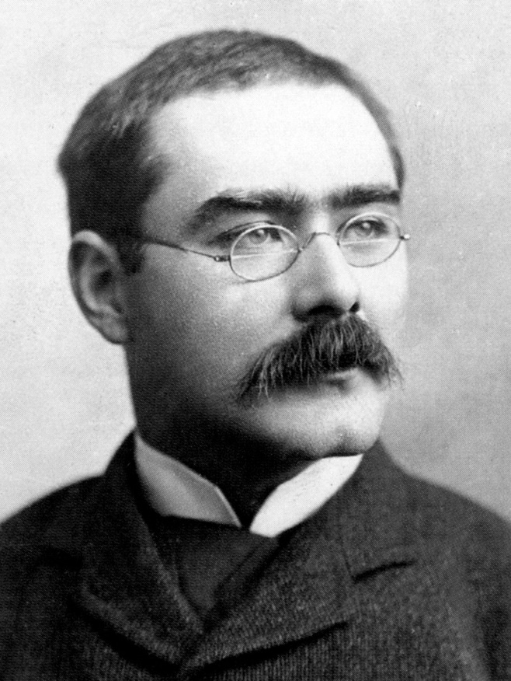
COLONIZERS’ LITERATURE: RUDYARD KIPLING
Focussed his studies on India
Justified European supremacy
⇒
the idea that Western countries were more «developed»
Promoted the spread of civilization for colonized countries
(the white man’s burden)

