Slide 1
The Italian Soldiers in
R. Kipling’s
The War in the Mountains
5^ALS
Bergantin E., D‘ Agostinis I., Ongaro A., Scolaro E., Sorato N.

Slide 2

Objectives and approach
OBJECTIVES
to identify and analyse the idea of the soldier in R. Kipling‘s The War in the Mountains
to identify differences and effects in the English and the Italian version of the reports
APPROACH
  Individual textual and comparative analysis of the text
  Sharing of considerations
  Construction of the present presentation

Slide 3

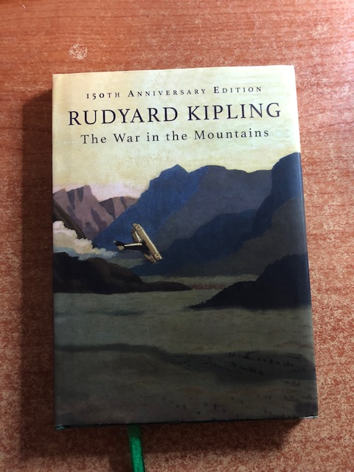
The War in the Mountains
Reporter: R. Kipling
Period: 1917
Profile: R. Kipling:
a war correspondent
on the Western front first
on the Italian one front later

Slide 4
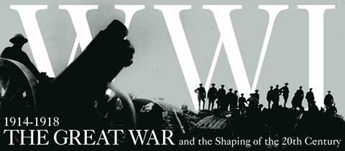
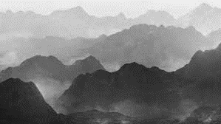
Title
The war → publication date sets the report in WWI
„in the mountains“→ provides a space reference defining the setting

Slide 5
Text type
War report
Picture-painting vocabulary → generates vivid images in readers‘ mind
Signficant factual information → allows the reader to better put narration into focus
Significant and personal details about the people involved in the battle

Slide 6


Textualities in the reports
The language embeds features of
Poetry
The use of rhetorical figures to generate clear and emotional images in the readers‘ mind
Journalism
Simple and readable language
Precise references to setting

Slide 7
Narrator and narrative technique/s
1st person narrator with an inner perspective → adding truth to narration
showing and telling are combined to provide a lively, concrete effect
Telling is more frequent
The reader can figure out “reality” according to a narrator-mediated perspective

Slide 8
Structure
5 reports
The presence of sub chapters helps the transition from an image to another
Connections are created by a war environment

Slide 9
Setting
Presence of precise references to space/s
The reader perceives space/s as far-away distant places
Description of the setting does not always allow the reader to understand the subject

Slide 10
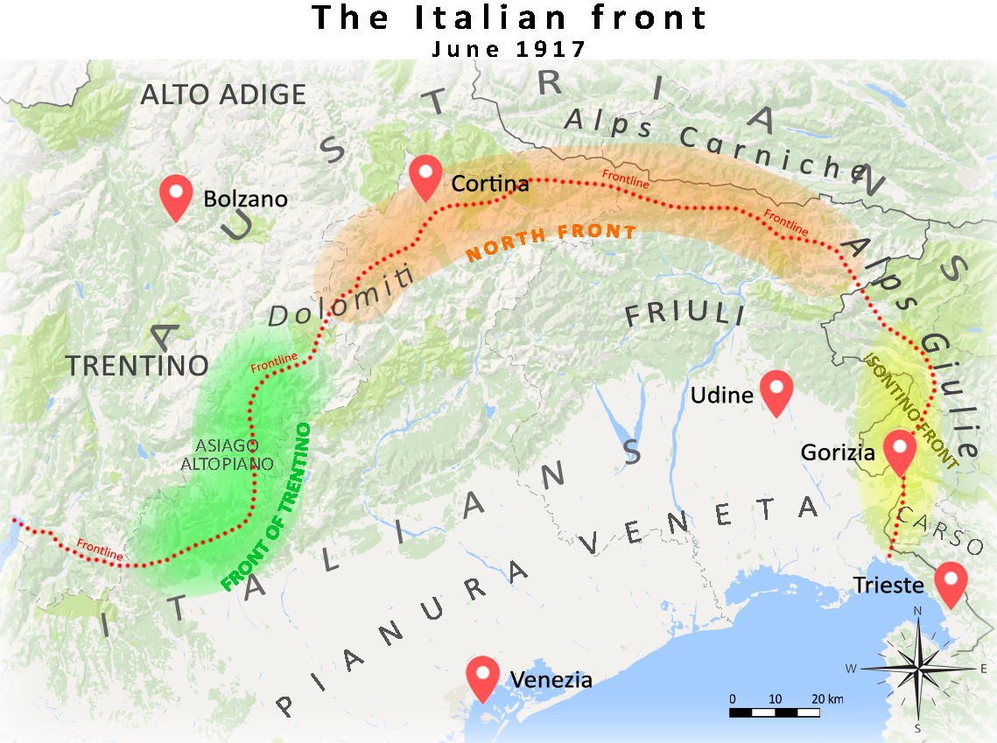

Slide 11

Time
Narration covers about 20 days in June 1917
Narration proceeds by images
Time shifts and time expansion do not allow the reader to refer to clear landmarks except for the dates at the beginning of the chapter

Slide 12
Language
Simple language:
  Informal register
  Short, simple sentences, with the use of coordination
  Metaphores with terms of comparison belonging to popolar culture
→ Wide prospect of expectation

Slide 13
The idea of Italian soldiers
Chapter I
Italian soldiers‘ characterization
Features
physical
psycological
Strong points:
Obedience (page 9)
Perseverance (pages 11, 14)
Courage (page 13)
Never surrender(page 16)

Slide 14
The idea of Italian soldiers
Chapter II
Italian soldiers‘ characterization
Features
behavioural
psycological
Strong points:
Perseverance(page 22)
Temperance (page 25)
Gratitude (page 33)

Slide 15
The idea of Italian soldiers
Chapter III
Italian soldiers‘ characterization
Features: psycological
Strong points
Kindness (page 30)
Territorial knowledge (page 31)
Endurance (page 34)
Tenacity (page 34)
Loyalty (page 33)
Wilfulness (page 34)
Temperance (page 33)

Slide 16
The idea of Italian soldiers
Chapter IV
Italian soldiers‘ characterization (the Alpine regiments )
Features
physical features
soldiers‘ tasks
Physical appearance
they wear a hat embellished with an eagle feather
their boots have nails
Tasks:
build roads;
climb up fissures of rock chimneys;
mine into the solid rock with compressed-air drills and fill galleries with nitroglycerine

Slide 17
The idea of Italian soldiers
Chapter V
Italian soldiers‘ characterization
Features
behavioural
Psycological
Strong points
Temperance (page 58)
Constancy (page 58)
Seriousness (page 57)
Obstinacy to face difficulties (page 57, 59, 60)

Slide 18
Language differences
The Italian version is more wordy: plenty of adjectives and adverbs referring to soldiers
Presence of more metaphores in the Italian version
Semantic differences
⇨ positive qualities of Italian soldiers are more exalted in the Italian version than in the English one

Slide 19
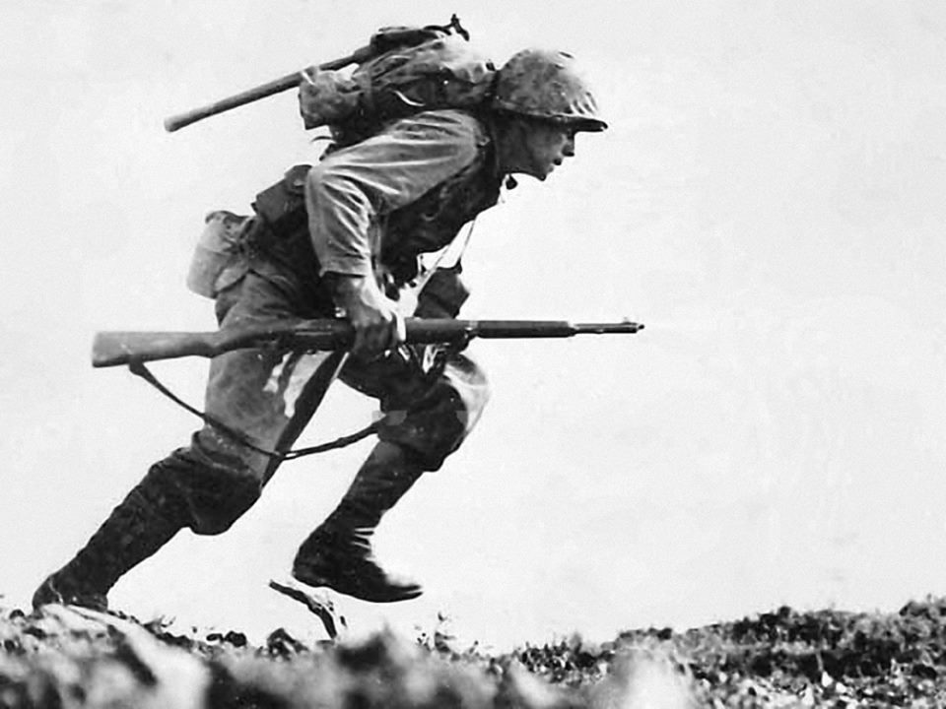
Idea of the soldiers
Soldiers show: tenacity, physical strength, courage, obedience, loyalty and temperance.
They sound and look perfect war machines
The Italian version exalts their qualities more linguistic differences (…examples….)???

