Slide 1
The Elizabethan Era
1485-1603

Slide 2
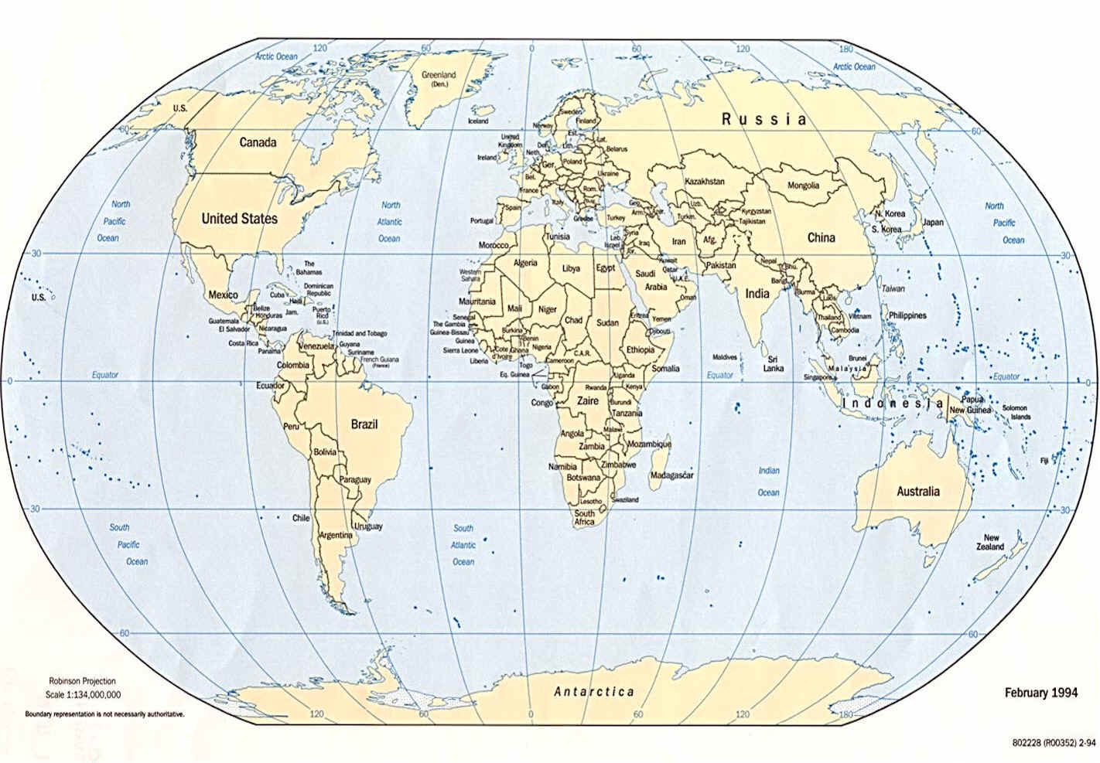
The World

Slide 3
Where is England?

Slide 4
YOU ARE HERE
ENGLAND

Slide 5
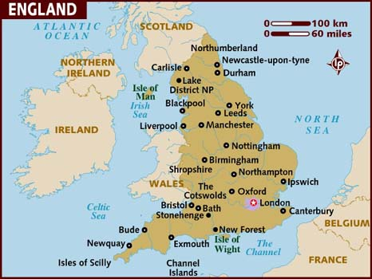
United Kingdom/ England

Slide 6
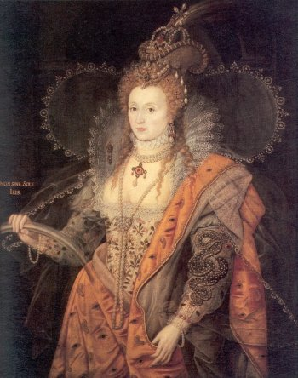
The Elizabethan Era
was named after
Queen Elizabeth I.

Slide 7
Queen Elizabeth FACTS
BORN→ September 7, 1533
GIVEN Name → Elizabeth Tudor
BIRTH LOCATION → Greenwich Palace, England

Slide 8
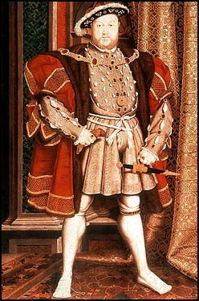
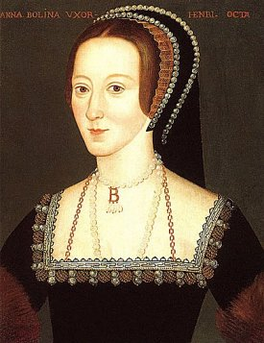
Her FAMOUS Parents
Henry VIII Anne
Boleyn

Slide 9
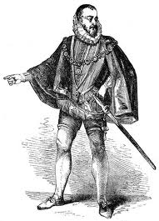
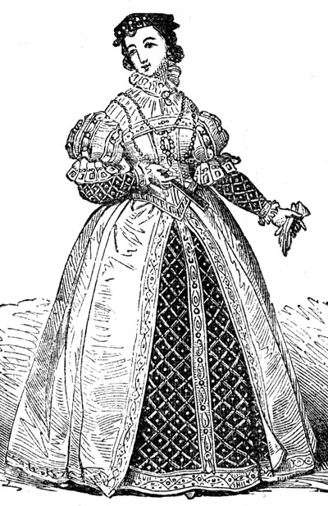
Elizabethan Clothing

Slide 10
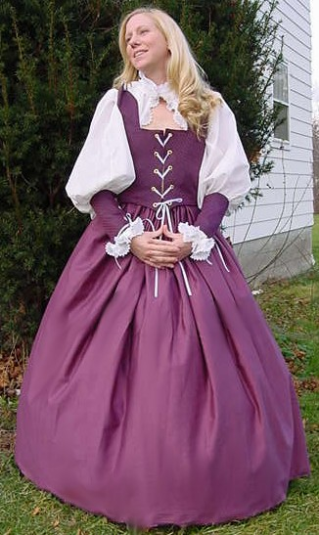
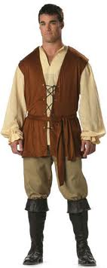
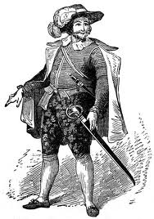

Slide 11
Elizabethan Daily Life
England was ruled by Queen Elizabeth I. She was a popular monarch (ruler; royalty) and the people loved her.
During a speech, she told the people of England—
“I know I have the body of a weak and feeble woman; but I have the heart of a king, and of a king of England too; and if Spain or Europe decide to invade… I myself will take up arms.”

Slide 12
FACTS about the People
*Life Expectancy during this time was
42 years* *The RICHER lived longer.*
*Sickness and disease were rampant because of the low sanitary conditions. Rather than have a trash company pick up trash, they’d simply throw their trash outside their homes. They would also throw away their human waste in this manner. They would go to the bathroom just about anywhere.

Slide 13
Elizabethan Men & Women
POOR WOMEN did not go to school. They stayed home to learn how to cook, clean, and take care of their families.
WOMEN of NOBILITY were educated.
MEN made choices for the women in their lives. Women didn’t have a choice when it came to whom they’d marry.
MEN made a a living while WOMEN stayed and took care of the home.

Slide 14
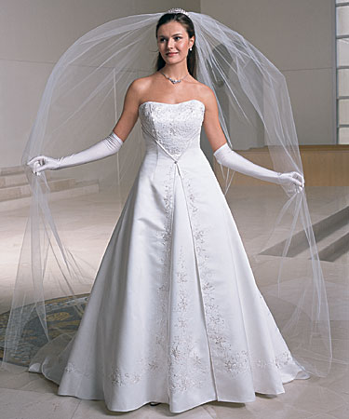
Elizabethan Marriages
Back then, women looked forward to getting married like they do today. The MAIN difference is that back then, a woman had little to no choice as to whom she would marry. She had very little right in choosing her husband.
Marriages were arranged in such a way that BOTH families would benefit from the marriage. Love was generally NOT a factor in getting married.

Slide 15
Elizabethan Women of nobility…
*were educated and expected to know at least four languages: Latin, Greek, Italian and French.
*weren’t allowed to go to school. They were educated by private tutors at home.
*were highly influenced to go to a nunnery if they had already reached their mid-20’s and still weren’t married.

Slide 16
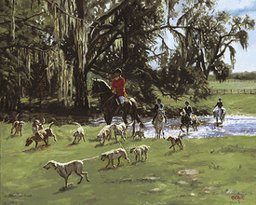
Favorite Sports
For the
RICH
HUNTING
For the POOR
BLOOD SPORTS

Slide 17
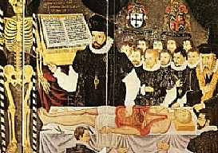
Elizabethan Medicine
**Healthy, clean vegetables weren’t readily available so many people died from malnutrition. Also, waste wasn’t properly disposed. People were often sick and would die of sickness that are easily treatable today.

Slide 18
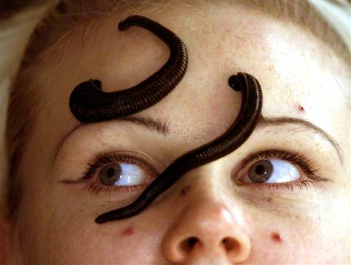
IF YOU HAD MONEY, STANDARD MEDICINES you’d receive were POTIONS and HERBS.
IF YOU WERE POOR you were “bled” to let the impurities drain from your blood, or leeches were put on your body to suck out the sickness.

Slide 19
Elizabethan Occupations
The basic professions of this time were:
Apothecary- treated people with herbs and potions.
Blacksmith- worked with iron and metals
Bower- made bows
Clothier- made clothes
Chaplain- dealt with the religious activities
Harker- one who made announcements given by the Queen
Jester- fool; whose job was to make the Queen laugh

Slide 20
More JOBS…
Knight- would fight for and protect the Queen
Moneylender- Banker
Page- a young man, usually seven years old. He was a personal servant. He prepared the lord’s clothes, set his table, ran his errands.
Potter- made pots from clay or ceramic.
Steward- took care of household responsibilities.
Watchman- was in charge of the security of the castle.

Slide 21
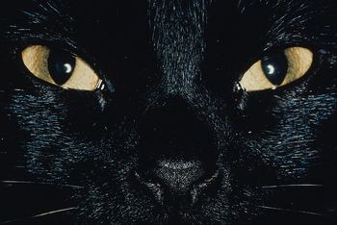
Elizabethan Superstitions
*It was believed that when you open your mouth to sneeze, you give the devil a chance to enter your body and bring about spiritual harm. Saying "bless you" allegedly stops the devil from entering since they thought that no demon could stay in a place that a Christian has blessed.

Slide 22
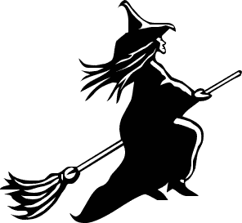
**A superstition that was most influential to them was that witches exist and they can cast spells on anyone. The spells were understood as so bad, they can lead to death. They were also blamed for mostly everything unexplainable -- the plague, famine, diseases and low crop yields during harvest time.
**Sailors wore golden hoop earrings all the time. It is said that this was done so they would have gold to pay their fare in the underworld if ever they sink and drown.

Slide 23


**Many good luck charms involved the following elements: iron, silver, fire, salt, and running water.
**Balance was considered a great deal in the Elizabethan era. They saw that the evil and good should balance each other. During the plague, they walked around with sweet-smelling flowers in their pockets and burned scented firewood to drive out the disease.

Slide 24

Elizabethan Religion
Before Elizabeth became queen, England was Catholic. Under Elizabeth’s reign, the country was converted to Protestantism.
Elizabeth was pressured to change her country’s religion to Protestantism because of the marriage between her parents. Roman Catholics weren’t happy with Henry VIII and his marriage to Anne Boleyn.

Slide 25
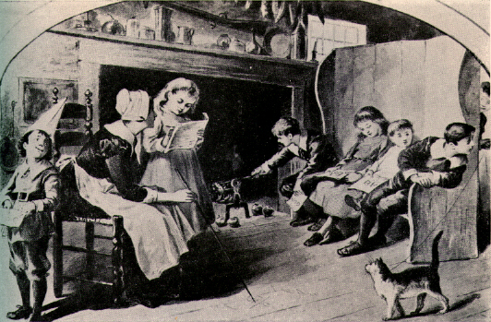
Elizabethan Education

Slide 26
*The kind of religion at a certain time played a big role in the education of the country.
*Children went to school in houses not school buildings like we do today. The teacher was always a housewife who was well-schooled and able to teach. She charged tuition.
*When Catholic religion was the country’s religion, catechism classes were also given during instruction. During Protestantism, students were also educated in the Christian faith with Protestant views.

Slide 27
Children were to learn certain passages from the catechism book which relate to what it takes to being a good Christian. It is widely believed that people then actually believed in the theory that children (students) must have their education and manners beaten into them. Many parents were said to have supported this theory. How lucky many of us weren't born during that time!

Slide 28
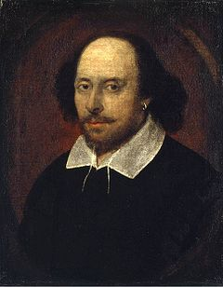
Elizabethan Literature and Drama
The most profound and prolific writer of this time was William Shakespeare. Edmund Spenser was also famous during this time.
William Shakespeare was as much of a celebrity as he would be if he were living today where his name is recognizable in almost every household. His plays were primarily drama which was a change from previous plays in former eras of England. Previous plays had a strong religious influence. Shakespeare plays did not.

Slide 29
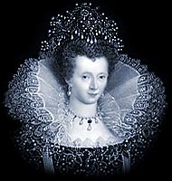
Because Queen Elizabeth 1 loved literature, she highly influenced the writers of the time to produce high quality literature.
Because she also loved plays, she often requested private performances.

