Slide 1
The War in the Mountains
Rudyard Kipling
Group work 3: Bragagnini, De Losa, Della Torca, Tecovich, Zuliani

Slide 2
Introduction
Task:
Finding out the idea of the Italian soldiers fighting at the Italian front in The War in the Mountains to discover:
R.Kipling’s idea of Italain soldiers
the idea of the soldier
Objectives:
to analyse WWI from a different point of view (a foreigner’s)
to learn how to analyse a war report
to generate a multimedia presentation
Text type: war report

Slide 3
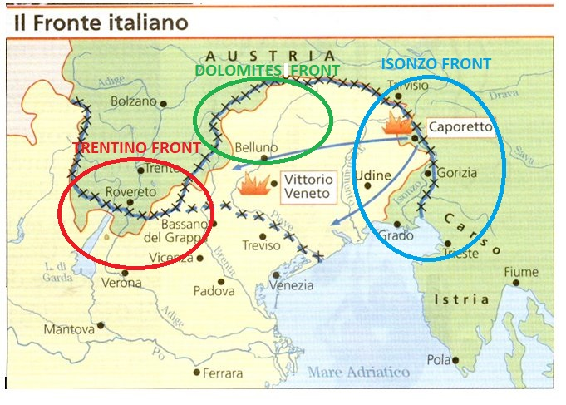
SETTING

Slide 4
Chapter I: The Roads of an Army
Narrator and Narrative techniques:
First person narrator
Showing and telling
Language:
Informal register
Present tense
Simple and words and war register
Rhetorical figures → metaphors (giants at a hunting)
→ anaphoras (head, head)
→ alliterations (made maps, showed streaks of snow, hard people . habituated to handing hard stuffs)
R. Kipling’s opinion:
Italian soldiers’ skills ( to fight and work in spite of mountainous and bad conditions)
Italian people’s adaptability and spirit of cooperation

Slide 5
Chapter II: Podgora
Narrator and Narrative techniques:
- First person narrator
- Showing and telling
Language:
- Semantical choices → references to natural elements and its colours
- Rhetorical figures
→ metaphors (in a month the smooth Italian roads would overrun them as vine tendrils overrun rubbish-heaps)
→ metonymy (but none the less the machines beat over them from both sides)
→ personification (No one, except a few pieces who were finishing some private work, was saying anything)
R.Kipling’s opinion:
- Italian soldiers are considered as stubborn and hard as French soldiers
- From the officer-informant’s answers like «height is everything» in the war in the mountains come to light

Slide 6
Chapter III: A Pass, a King, and a Mountain
Narrator and Narrative techniques:
- First person narrator
- Showing and telling
Language:
- Informal register
- Simple present and simple past
Rhetorical figures → similes
(They arrive at their proper place by the same means that Rome was built) (new roads [...] as thin and threadlike as the exposed roots of a botanical diagram to illustrate capillary attraction)
R. Kipling’s opinion:
- Italian soldiers’ values in their speech about the King of Italy
- Human activity refers to a Puritan and Protestant ethic

Slide 7
Chapter IV: Only a few steps higher up
Narrator and Narrative techniques:
- First person narrator
- Showing and telling
Language:
- Informal register
- Simple present and simple past
Rhetorical figures
⇨personification of nature⇨ described like a monster
⇨ alliteration of sounds “w” and “s” (wilderness of wrathful crags and fissures had revealed itself)
R.Kipling’s opinion:
- He uses expressions such as «joyous children» and the adjective «young» more than once in order to highlight the members of the Alpine regiments’ ability even if they may not have many years of experience
- They are brave, strong, genuine and happy young people who chose to fight for their Nation

Slide 8
Chapter V: The Trentino front
Narrator and Narrative tecniques:
- First person narrator
- Showing and telling
Language:
- Informal register
- Past simple
- Specific words ⇨ reportage
Rhetorical figures
similes (the single sentry lying-out like a panther pressed against a hump of rock)
⇨ metaphors (General Cadorna’s headquarters, which might be a monastery or a laboratory)
R.Kipling’s opinion:
Italian soldiers’ sense of belonging
Italian soldiers’ organization
Austrian Empire as the Devil
War as a way to reach National Unity

Slide 9
Conclusion
R. Kipling’s overall idea of Italian soldiers comes to light in the war reports and underlines their positive attitudes. Their courage, strength and sacrifice always come to the forefront.
Indeed they are re-presented as heroes who left their homes and families and completely devoted to their country by joining the Army.
Waging war campaigns does not simply mean fighting, but engaging into activities ranging from road to outposts construction, through some maintenance work necessary to support soldiers at the front.
R.Kipling does not express a clear judgment about war.
He underlines the worthless massacre of the WWI despite exalting the innovations brought about in Italy by war (the construction of new roads, …)

