Slide 1
ANALYSIS OF A QUOTE FROM HAMLET’S MONOLOGUE
“Thus conscience does make cowards of us all”

Slide 2
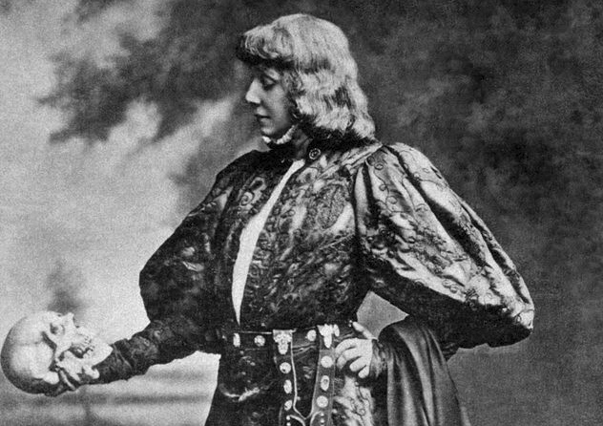
thus conscience does make cowards of us all
Almost at the end of the monologue
What did he mean with this sentence?

Slide 3
MORPHOLOGICAL AND SEMAntical ANALYSIS
Use of “does”
Paronomasia between “Thus” and “does”

Slide 4
Explanation
Does:
Enhancing the meaning
Paronomasia:
Repeating the sound

