Slide 1
OLIVO FEDERICO 5^LSAB
HUMAN RIGHTS
DECLARATION OF INTENT
Definition of Human Rights
Historical Backgroung of Human Rights
References to Italian Costitution
Analysis of Texts

Slide 2
DEFINITION OF HUMAN RIGHTS
HUMAN A member of the species Homo Sapiens: a man, woman or a child; persona che ha a person
RIGHTS Things that are granted to you and freedoms that are guaranteed
HUMAN RIGHTS The rights you have for the simply fact of being human
AS A RESULT, THEY INCLUDE
AND THEY ARE
RESPECT
FREEDOM
INVIOLABLE
UNIVERSAL

Slide 3
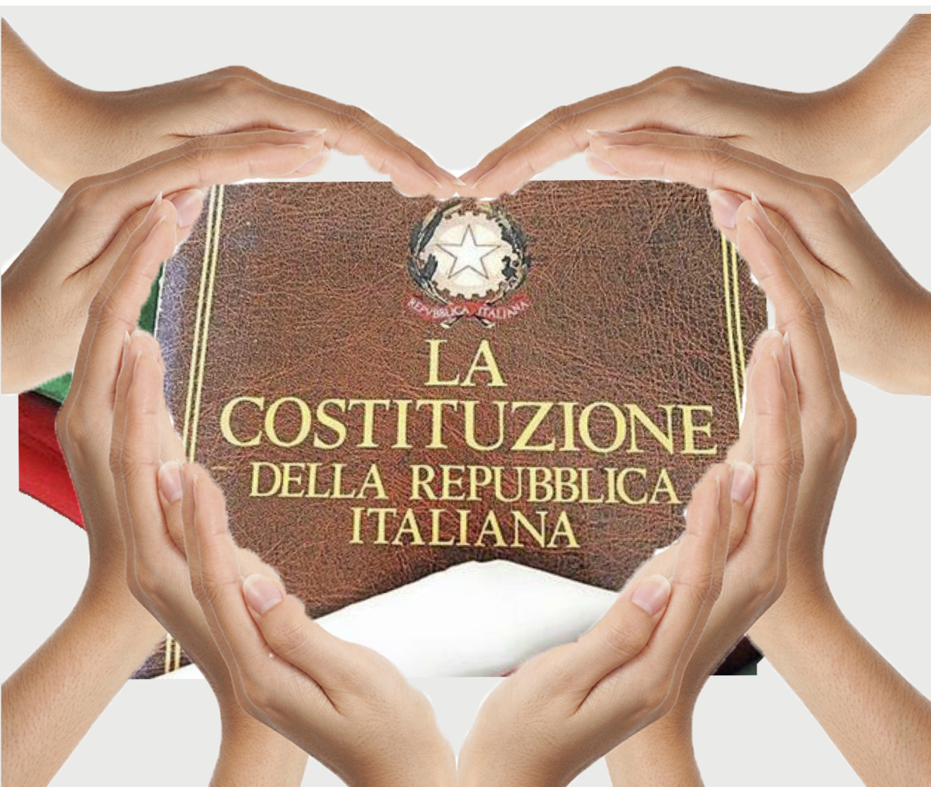
ITALIAN CONSTITUTION
ARTICLE 2
“The Republic recognizes and guarantees inviolable rights of man, for the individual, and for social groups where personality is expressed, and demands the fulfilment of the fundamental duties of political, economic, and social solidarity”

Slide 4
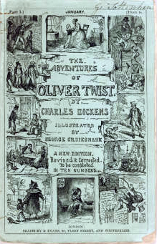
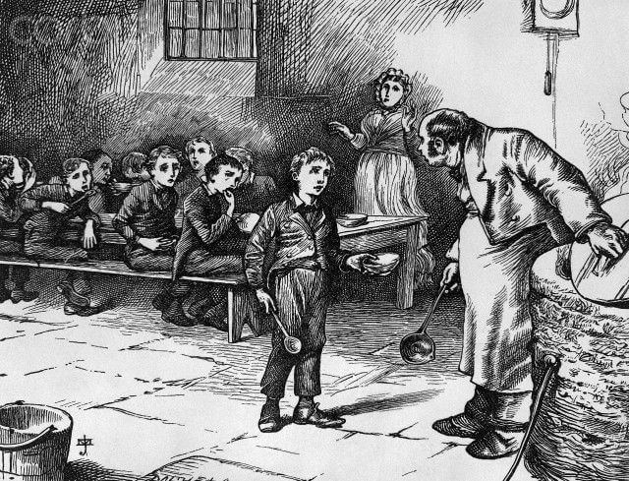
OLIVER WANTS SOME MORE
Chapter of the novel «Oliver Twist» (1839)
Description about children’s conditions in workhouses
Hunger and Slavery
HUMAN RIGHTS VIOLATED
Article 3. (UDHR) “Everyone has the right to life, liberty and security of person.”
Article 4. (UDHR) “No one shall be held in slavery or servitude; slavery and the slave trade shall be prohibited in all their forms.”
Article 25. (UDHR) “(1) Everyone has the right to a standard of living adequate for the health and well-being of himself and of his family, including food, clothing, housing and medical care and necessary social services, and the right to security in the event of unemployment, sickness, disability, widowhood, old age or other lack of livelihood in circumstances beyond his control.

Slide 5
FRANKISSSTEIN
NO-ONE MUST BE
DISCRIMINATED
BECAUSE OF ITS KIND
NOVEL’S TOPICS IMPLAYS ALL HUMAN RIGHTS, BUT IN PARTICULAR ART. 1 OF UDHR:
“All human beings are born free and equal in dignity and rights. They are endowed with reason and conscience and should act towards one another in a spirit of brotherhood”
Doubleness of life
Supply of A.I. on human rights
Life can no longer be divided in a binary way: there are no longer fixed genders

Slide 6
SOURCES
http://www.marilenabeltramini.it/schoolwork1920/readInteracting.php?act=readTask&tid=128
https://www.un.org/en/universal-declaration-human-rights/
https://msmms.hubscuola.it/public/3266278/cdi3270689/costituzione_italiana_commentata/costituzione_italiana_commentata/articoli/art2.html
https://www.unitiperidirittiumani.it/what-are-human-rights/

