Slide 1
HUMAN RIGHTS
Capocasale Matteo
5^BLSA
Lingua e Cultura Inglese

Slide 2
Human Rights
Human rights are moral principles or norms that describe certain standards of human behaviour and are regularly protected as natural and legal rights in municipal and international law.
They are commonly understood as inalienable, fundamental rights.

Slide 3
The Constitution of the Italian Republic
Human rights in the Constitution of the Italian Republic are mostly expressed in the 3rd article.
All citizens have equal social dignity and are equal before the law, without distinction of sex, race, language, religion, political opinions, personal and social conditions.

Slide 4
The Constitution of the Italian Republic
Third article
What does it mean?
The article assumes the principle of equality between all citizens as a fundamental right.
According to this principle men are equal in nature, not in the sense that they are identical as if they were photocopies, but in the sense that they have the same rights. Race, gender, political views etc. they determine important differences between citizens, but not such as to make some superior and others inferior from the point of view of rights.

Slide 5
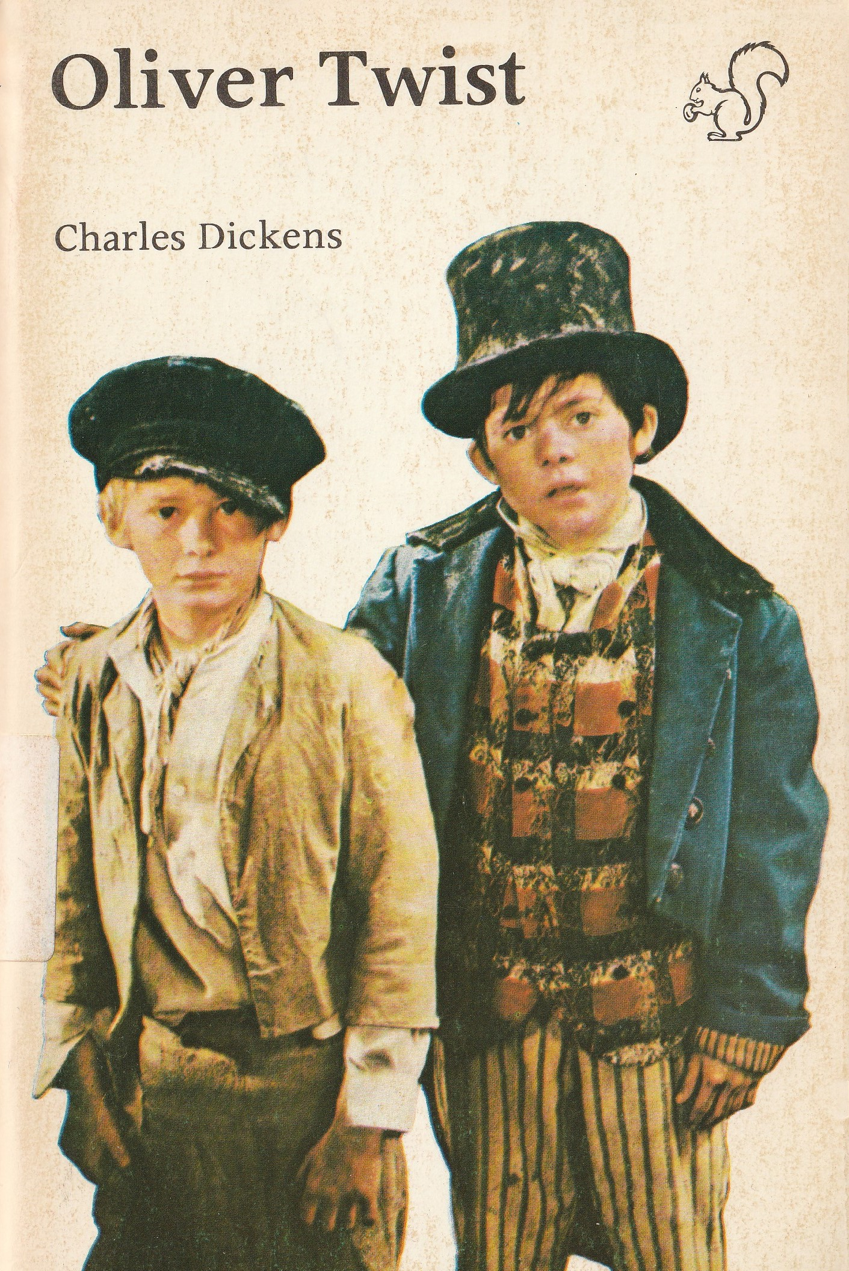
Literary texts
Oliver Twist
Art. 13 of the Constitution of the Italian Republic: no restriction on personal freedom is allowed.
Art. 27 of the Constitution of the Italian Republic: the penalties cannot consist of treatments contrary to the sense of humanity and must aim at the reeducation of the condemned

Slide 6
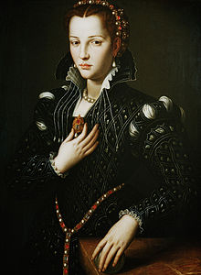
Literary texts
My Last Duchess
Art. 3 of The Constitution of the Italian Republic: all citizens have equal social dignity and are equal before the law, without distinction of sex.

Slide 7
Frankissstein
In Jeanette Winterson’s book the fundamental right to gender self-determination is respected as the protagonist is a transgender doctor.

