Slide 1
HUMAN RIGHTS
Matteo Sverzut
5LSAB
A.S 2019-20

Slide 2
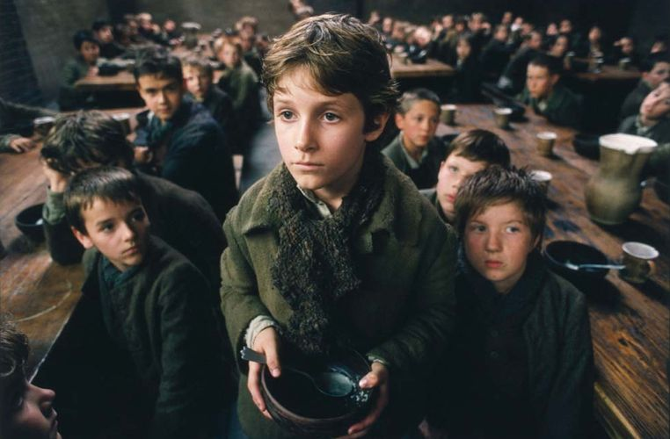
OLIVER TWIST, C.DICKENS (1838)
«A bill was next morning pasted on the outside of the gate, offering a reward of five pounds to anybody who would take Oliver Twist off the hands of the parish» :
Violation of article 13 («Personal liberty is inviolable…»)

Slide 3
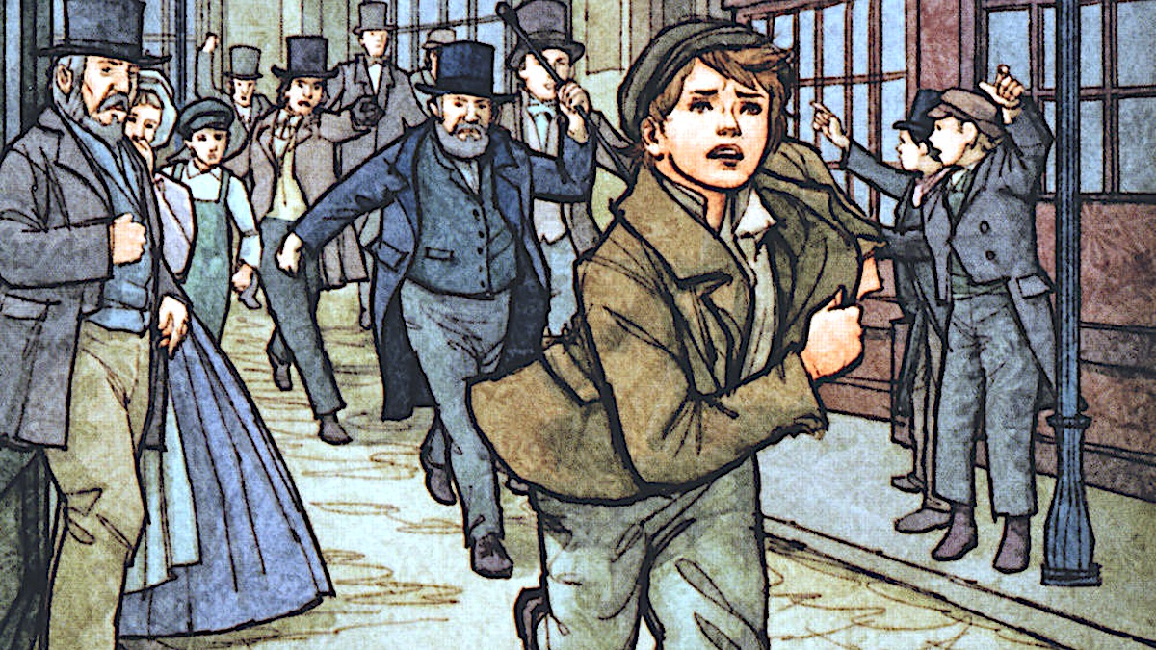
OLIVER TWIST
«The master aimed a blow at Oliver’s head with the ladle»:
Violation of article 21 (« All have the right to express freely their own thoughts by word…»)
Violation of article 27 → («Punishment cannot consists in treatment contrary to human dignity…»)

Slide 4
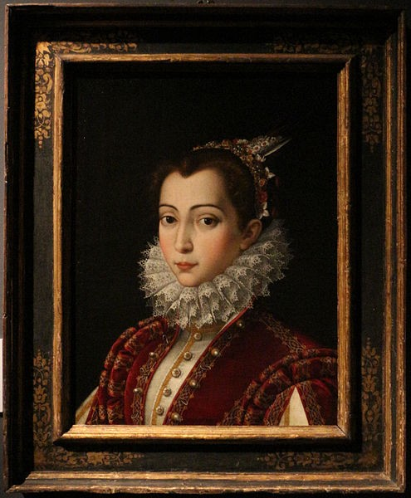
MY LAST DUCHESS, R.BROWNING (1842)
“Though his fair daughter’s self, as I avowed At starting, is my object” :
Violation of article 3 (“ All citizen have equal social dignity and are equal before the law, without distinction as to sex, race, language, religion, political opinions, or personal or social condition…”)

Slide 5
FRANKISSSTEIN, J.WINTERSON (2019)
Contemplation of Article 3 → «All citizens have equal social dignity and are equal before the law, without distinction as to sex, race, language, religion, political opinions, or personal or social condition…”
Gender equality

