Slide 1
FRANKISSSTEIN A Love Story Jeanette Winterson, 2019
A.S.2019-2020
Capocasale Matteo – 5LSAB
Lingua e cultura inglese

Slide 2
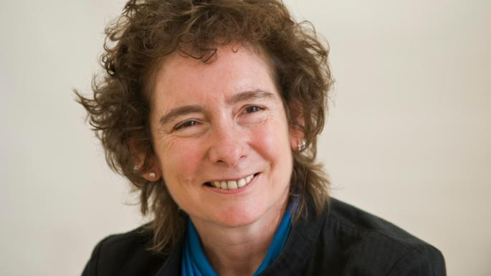
THE NOVELIST Jeanette Winterson
BORN → 27 August 1959, Manchester, England, U.K. NATIONALITY → British
OCCUPATION → Novelist, Professor at Manchester University, Journalist
OUTPUT → Science Fiction

Slide 3
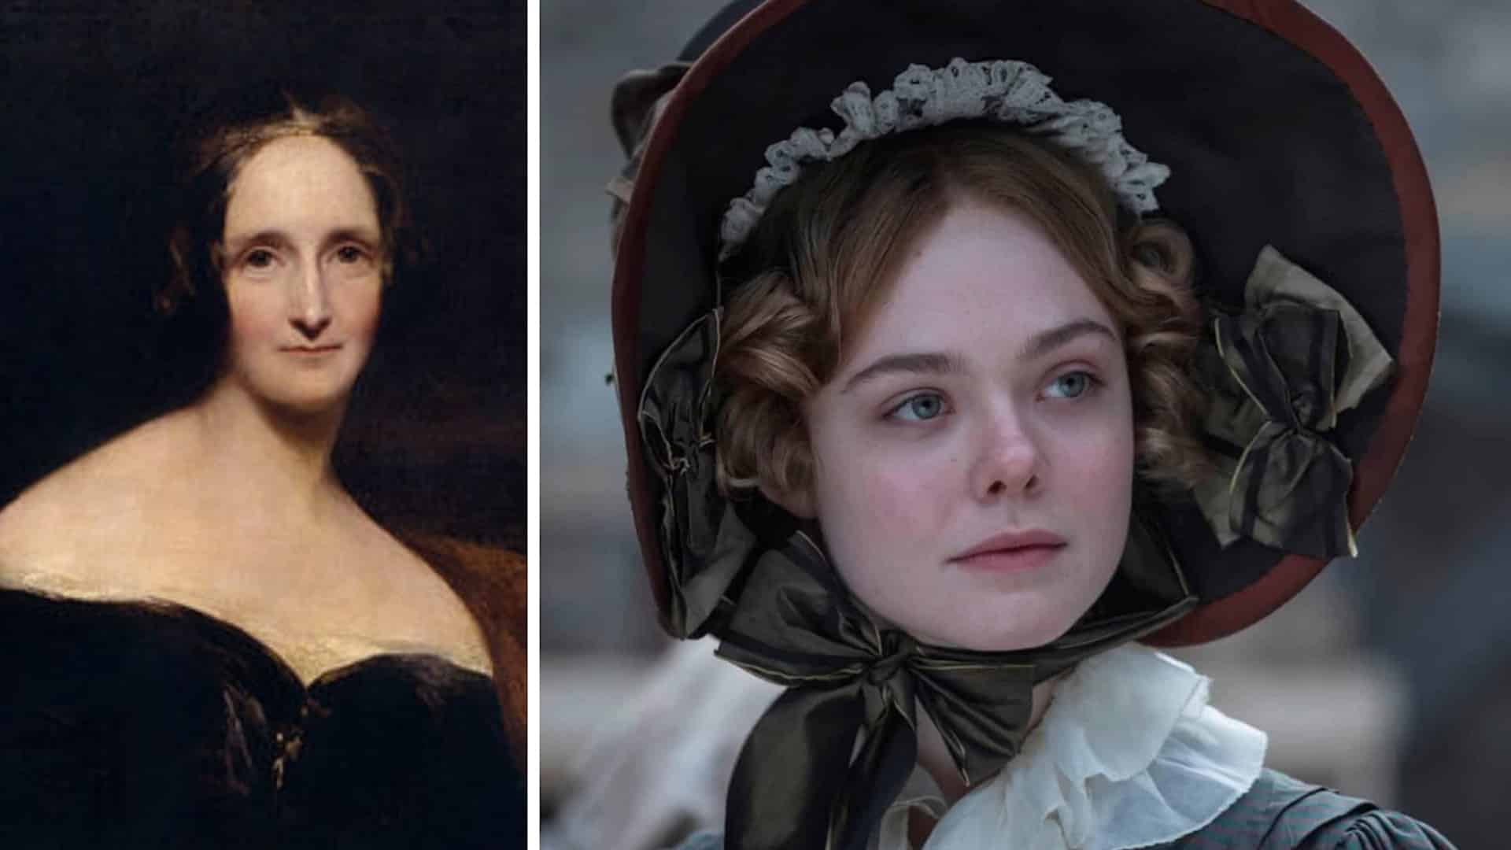
THE TITLE Frankissstein – A love story
FRANKENSTEIN
KISS
(A love story)
Mary Shelley

Slide 4
NOVEL’S SUMMARY
→ 21st century postmodern novel
Retelling of the original Mary Shelley’s Frankenstein
→ Assortment of science and literary fiction → Based on the protagonist’s duality

Slide 5
STRUCTURE: TWO PARALLEL PLOTS
ROMANTIC NOVEL In 1816 Mary Shelley decides to write Frankenstein basing it on the events she personally experienced
POSTMODERN NOVEL
The transgender doctor Ry supplies body parts to professor Victor Stein and face up with AI and cryogenics

Slide 6
SETTING
1st PLOT
Time →1816 and 19th century
Places → Lake Geneva; Italy; Bedlam
2nd PLOT Time → in the 21st century
Places → Manchester; Memphis; Phoenix (Arizona)

Slide 7
MAIN CHARACTERS
PARALLEL CHARACTERS
M. Shelley, Frankenstein,1818 | J. Winterson,Frankissstein,2019
Geneva 1816 | Manchester 21st century
Mary Shelley | Ry
Lord Byron | Ron Lord
Claire Clairmont | Claire
Polidori | Polly D.
Victor Frankenstein | Victor Stein

Slide 8
NARRATOR
1st person narrator
Speaking from Mary’s and Ry’s point of view
Reader’s knowledge limited to what the narrator knows and shows

Slide 9
MAIN THEMES
Artificial Intelligence
Philosophical investigation
Human identity’s nature
Transgender reality
Love
Sexism
Life after death

Slide 10
POSTMODERN FEATURES
→Use of quotations
→Interior monologue
→Intertextuality
→Stream of consciousness
→Simultaneity and time distortion
→Use of irony

Slide 11
NOVELIST’S MESSAGES
→Reflecting on the meaning of being human
→Exploring human identity
→Everything you experience is in your head
→To be aware that technology could put us aside

