Slide 1
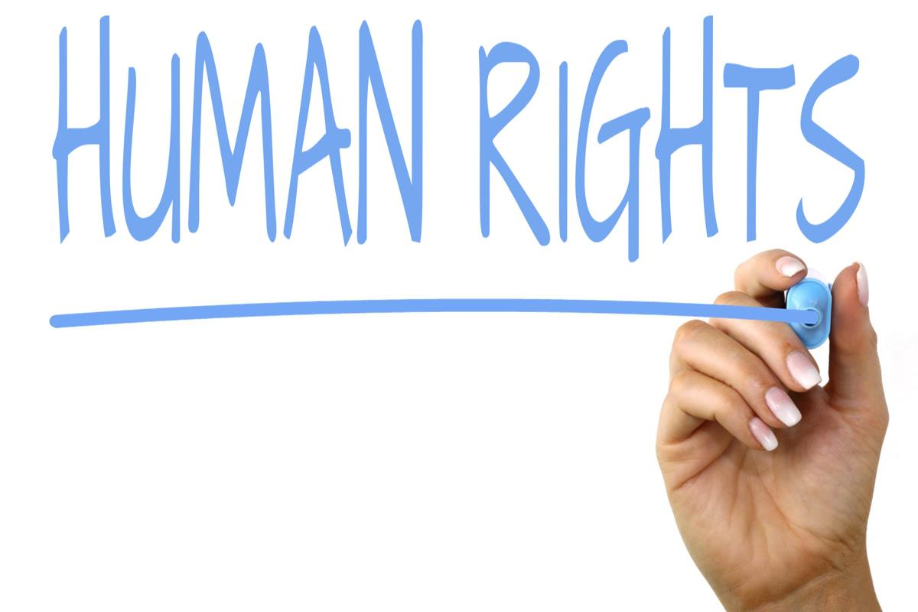
What are human rights?
rights and freedoms inherent to all human beings
universal and inalienable
based on shared values
defined and protected by law
can be restricted

Slide 2
Human rights in literature
literature can be used to promote human rights
create awareness
realism
writing about human rights it’s not only contemporary
fiction is the best way to express them
poetry is a powerful way to change society
read between the lines
poetry can infuse emotions to the readers

Slide 3
Fundamental rights
Some of the Italian fundamental rights:
right to life
right not to suffer any cruel treatments or punishments
right not to be reduced into slavery
right to freedom and personal safety
right of action in order to protect one’s rights
right to the respect of family and private life
right to freely manifest one’s thoughts
right of freedom of pacific meetings and freedom of association
right to marry and form a family

Slide 4
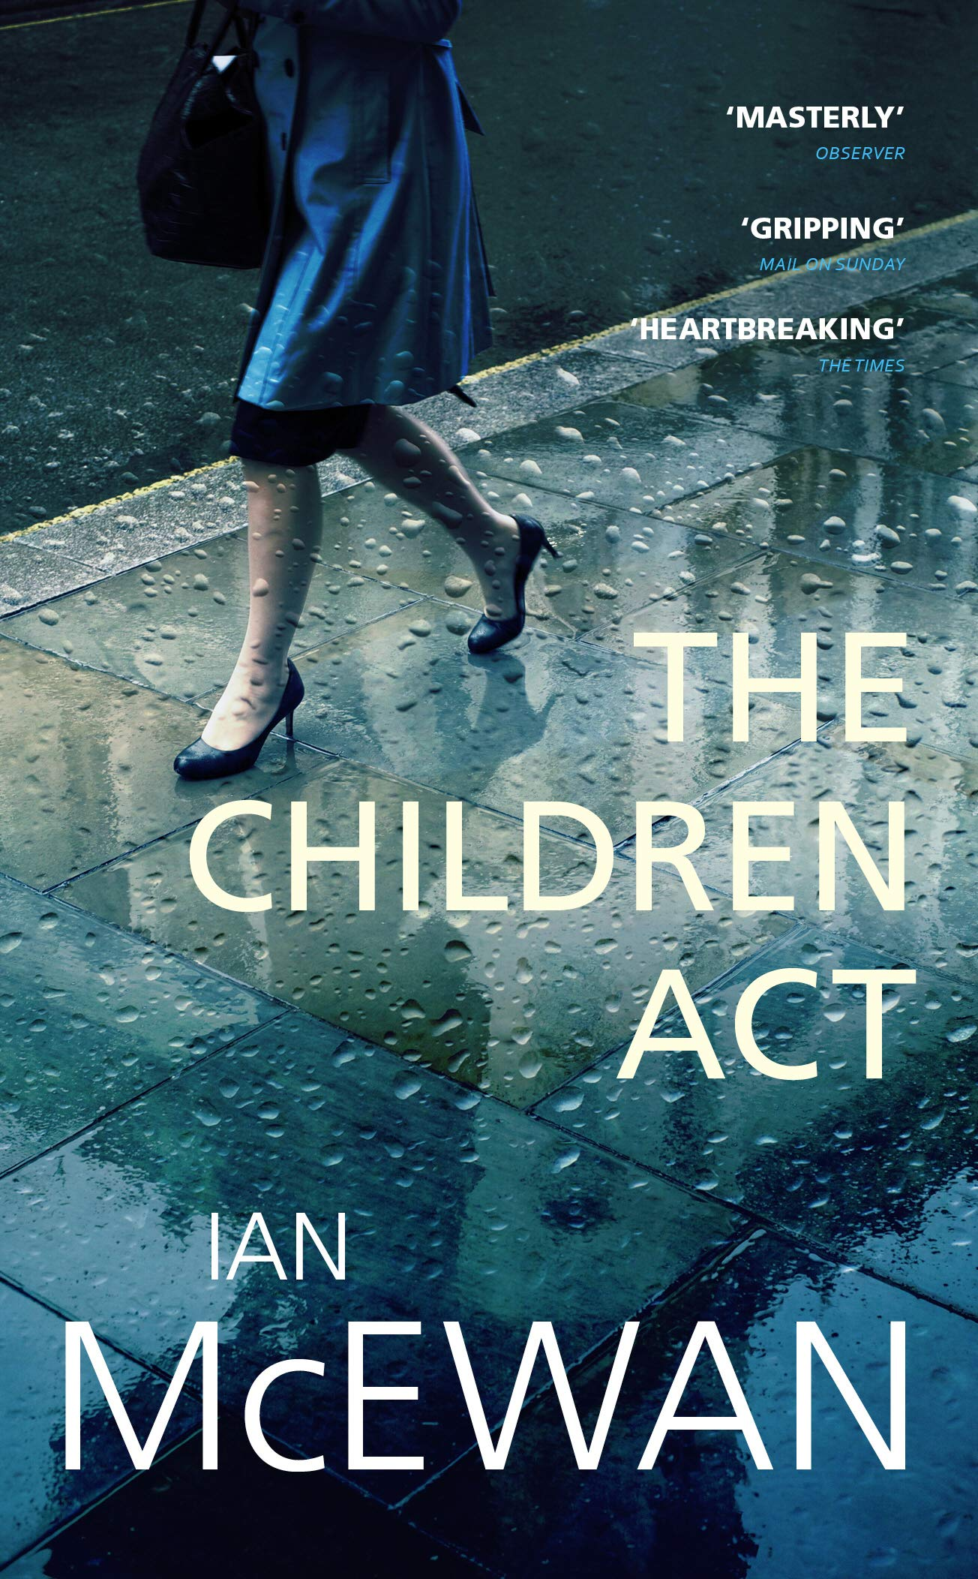
Human rights in literature
Ian McEwan - The children act (2014)
violation: art. 32 of the Constitution of the Italian Republic
respect: art. 8 and art. 19 of the Constitution of the Italian Republic
Children’s act (1989) = act to guarantee children’s well being
right to life
respect of different religious faith
17 year old dying of leukemia
he is a Jehovah Witness

Slide 5
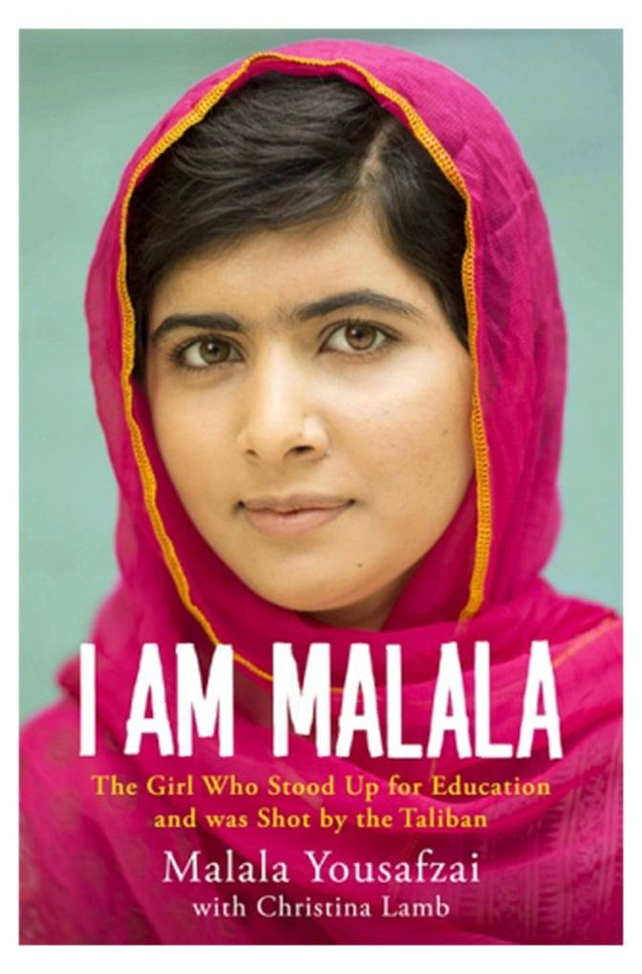
Human rights in literature
Malala Yousafzai - I am Malala (2013)
violation: art. 34 of the Constitution of the Italian Republic
autobiographical novel
right to education
female rights in Pakistan
brave
winner of the 2014 Nobel Peace Prize

