Slide 1
Children’s education and health in the Constitution of the Italian Republic
Art. 30
It is the duty and right of parents to support, instruct and educate their children, even those born outside of matrimony. [...]
Art. 32
Art. 33
The arts and sciences are free, as is their teaching. The Republic lays down general rules for education and establishes all the kinds and levels of State schools. [...]
Art. 34
Schools are open to everyone. Primary education, which is imparted for at least eight years, is compulsory and free. [...]
The Republic safeguards health as a fundamental right of the individual and as a collective interest, and guarantees free medical care to the indigent.[...]

Slide 2
The power of literature
Source of transformation in the mind of the reader and in society.
Students become committed to society to make a social and positive change.
Power to change live, to touch hearth and mind, to motivate people to take action.
A union between the literary driving force and motivating students for action.
A better understanding of Human Rights.
Children can find their place in the world and discover their sense of responsibility.

Slide 3
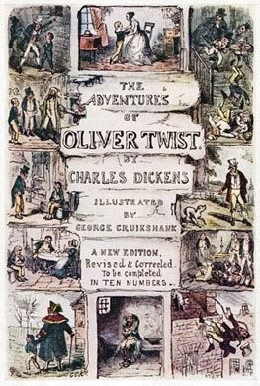
Reference to studied literary texts
C. DICKENS, Oliver Twist, 1837
A Victorian Novel
Quotation: “Please, sir, I want some more”
Oliver Twist is a poor boy who lives in a workhouse
inhuman way
extreme health’s conditions
no education
He represents a symbol of change and progress
Poor children ⇨ lower class
Society does not recognize children's rights

Slide 4
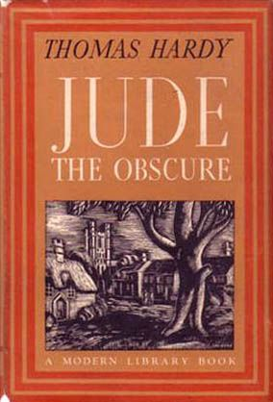
Reference to studied literary texts
T. HARDY, Jude the Obscure, 1895
A novel of
the Anti-Victorian reaction
Quotation: “It was better to be out of life than in it
at this price”
Jude is a working-class young man, a stonemason
Children are victims, without expectation for the future
T. Hardy uses cinematic technique in view of a dramatic and ghastly effect
Health is uncertain and so is the whole existence
Children express their uneasiness about life

Slide 5
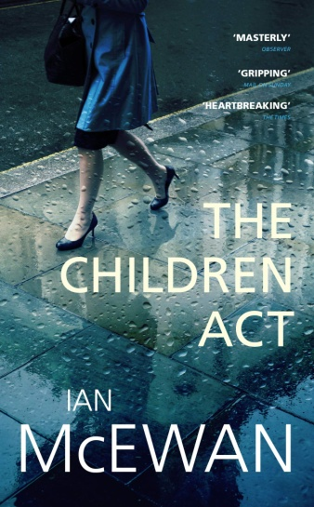
A turning point in the History of Childhood
Prevention of Cruelty to, and Protection of, Children Act (1889)
Commonly known as the Children’s Charter
Act of the Parliament of the United Kingdom of Great Britain and Ireland
From Legislation to Literature → Ian McEwan’s The Children Act (2014)
Quotation: “Adam came looking for her and she offered nothing in religion’s place, no protection, even though the Act was clear, her paramount consideration was his welfare. How many pages in how many judgments had she devoted to that term? Welfare, well-being, was social. No child is an island. She thought her responsibilities ended at the courtroom walls. But how could they? He came to find her, wanting what everyone wanted, and what only free-thinking people, not the supernatural, could give. Meaning”

