Slide 1
Frankisstein
A LOVE STORY
by Jeanette Winterson
Narrative techniques analysis
Alice Santoro

Slide 2
cover
Main colours:
Blue → male gender
Neon pink → female gender
Red → “ A LOVE STORY”
Image:
Wound and “x” stitches → reference to Frankestein’s wound
}doubleness

Slide 3
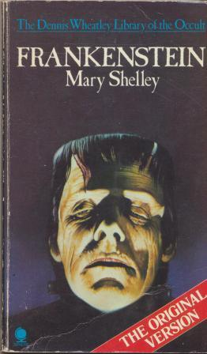
title
FRANKISSSTEIN
FRANKESTEIN + KISS
by Mary Shelley ↓
A LOVE STORY

Slide 4
UNCONVENTIONAL PLOT two parallel plots
Switzerland ,1816
How Mary Shelley wrote Frankestein + her life after writing the book
Bedlam (asylum)
Mary Shelley meets her creature Victor Frankestein
Manchester, Memphis, Phoenix, 21° century
Postmodern update of Frankestein stories

Slide 5
characters
1816
21° century
Mary Shelley
(writer)
Victor Frankestein (scientist)
Lord Byron
(poet)
Polidory
(physician)
Claire Clairmont (Mary’s stepsister)
Ada Lovelace (mathematician)
Ry Shelley (transgender doctor)
Victor Stein
(professor)
Ron Lord
(creator of sex bots)
Polly D
(Vanity Fair journalist)
Claire (Ry’s point of contact in Memphis)

Slide 6
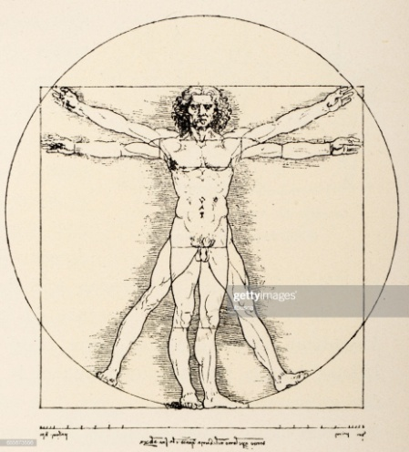
How are the plots related?
Characters correspondance
Same themes: artificial life artificial intelligence
Same quotations: ex pp.14, 30, 61
Same elements es. Vitruvian man pp. 73, 191
Continuous references to Frankestein
ex p.96 “The year could be 1816”
Same ending

Slide 7
Speaking voice
First person narrator
Mary Shelley Ry Shelley
Inner thaughts examples:
p.234 p. 112

Slide 8
visible presence of the author:
p.133
p.226
Notes:
Mary Shelley dice che sposerebbe the contented pig
Ron dice che non vorremo indietro tutte le persone che muoiono ogni anno

Slide 9
Postmodern themes
Quotations at the very beginning and before every chapter
We live by language p.62
p. 65/68 there is only production (stories made by other stories)
Temporal distortion p.108 “The fututre always carries something from the past”
intertextuality

Slide 10
Message
Everything you know is in your mind -> reality is an invention
REALITY IS WATER SOLUBLE

