Slide 1
The dead written by James Joyces
Giacomo girardi
5lsca

Slide 2
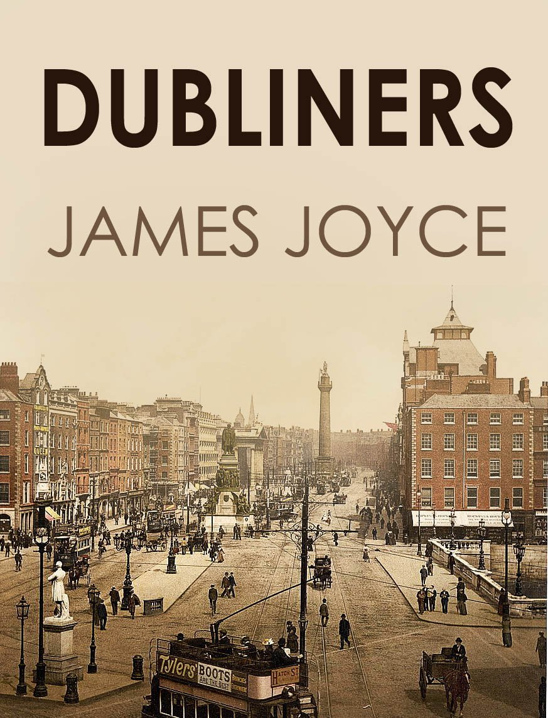
AUTHOR: James Joyce
GENERE: Short Story ( 15 short stories)
PUBLICATION DATE: June 1914

Slide 3
Setting
The short story is stetted in Kate and Julia morkan’s house, but towards the end the setting changes and the narrative takes place in a hotel.

Slide 4
CHARACTERS AND CHARACTERIZATION
GABRIEL CONROY | A teacher and writer, Gabriel has simple conversations but straightforward questions catch him off guard. Sometimes he feels out of place. Gabriel represents a force of control in the story, but his wife Gretta’s fond and sad recollections of a devoted lover make him realize he has little grasp on his life and that his marriage lacks true love.
GRETTA CONROY | Gabriel’s wife. Gretta plays a relatively minor role for most of the story, until the conclusion where she is the focus of Gabriel’s thoughts and actions. She appears sad and distant when a special song is sung at the party, and she later plunges into despair when she tells Gabriel the story of her childhood love, Michael Furey.
LILY | The housemaid to the Morkan sisters who rebukes Gabriel in “The Dead.”
MOLLY IVORS | The nationalist woman who teases Gabriel during a dance in “The Dead.”
JULIA AND KATE MORKAN | Sisters who throw an annual dance party in “The Dead.”Julia has a grey appearance that combines with her remote, wandering behavior to make her a figure sapped of life.Kate is vivacious but constantly worries about her sister, Julia, and the happiness of the guests.
MICHEAL FUREY | Gretta Conroy’s childhood love in “The Dead” who died for her long ago.

Slide 5
NARRATIVE TECHNIQUES
The element of the epiphany: a simple object, a usual fact, an irrelevant detail, suddenly has a profound and unexpected meaning. Moments of interior illumination in which man becomes aware of reality.
Paralysis: that applies to characters, places, social and private relationship and thoughts. Restrictive routines and repetitive actions mark the lives of Joyce’s Dubliners and trap them in circles of frustration.
Detailed description of the characters and environments in order to make it easier for the reader to imagine the scenes

Slide 6
USE OF THE LANGUAGE
Use of adjectives in order to describes people their mood and emotions, places
Formal language

Slide 7
Symbols
Through images and symbols Joyce put into practice the transmutation of everyday life, that is, he knew how to capture the universal element hidden in the little things around us.
‘’ The Lass of Aughirm ’’: music becomes the symbol of something, Gabriel can’t understand it but ‘’ there was grace and mystery in her attitude as if she were a symbol of something. He asked himself what is a woman standing on the stairs in the shadow, listening to distant music, a symbol of. ‘’

Slide 8
Message
life is short, and those who leave the world like Michael Furey are actually more alive than "paralyzed" people like Gabriel. Gabriel sees himself as the shadow of a person, shining in a world where the living and the dead meet.
we're all dead, though still alive.
After all, doesn't living passively mean not living at all?

Slide 9
Why should one read it?
This story should be read because it has a central role in our contemporary society.

